Slide 1
Modifier Monday: Modifier KX

Slide 2
Disclaimer
We prepared this education as a tool to assist the provider community. Medicare rules change often. They are in the relevant laws, regulations and rulings on the Centers for Medicare & Medicaid Services (CMS) website.
We will provide responses to questions based on the facts given, but the Medicare rules will determine final coverage.
CMS prohibits recording of the presentation for profit-making purposes.

Slide 3
Acronyms
AFO – Ankle Foot Orthosis
CPT – Current Procedural Terminology
FDA – Food and Drug Administration
HCPC – Healthcare Common Procedure Coding System
OT – Occupational Therapy
PT – Physical Therapy
REMS – Risk Evaluation and Mitigation Strategies
SLP – Speech Language Pathology

Slide 4
Objective and Agenda
Learn about the appropriate uses of Modifier KX in various Medicare covered services
Review services that use KX

Slide 5
Use of KX Modifier
Informs claims processing system that the provider’s documentation supports the payer’s requirements for payment

Slide 6
Requirements for use Varied by Policy
In some policies:
Pertains to HCPCS codes
It applies only to select codes
It refers to very limited information
It attests that multiple criteria have been met
The absence of the KX results in medical necessity denial
The lack of the modifier results in a statutorily noncovered denial

Slide 7
Podiatrist Usage
All HCPCS codes listed under the AFO (L1900-L4397) and
Orthopedic footwear (L3000-L3649)
Use of procedure codes: 64575, 64580, 27600, 64905, 64910, 64585, 64708, 64890, 64891, 64892, 64912, and 64913
When the service meets policy requirements

Slide 8
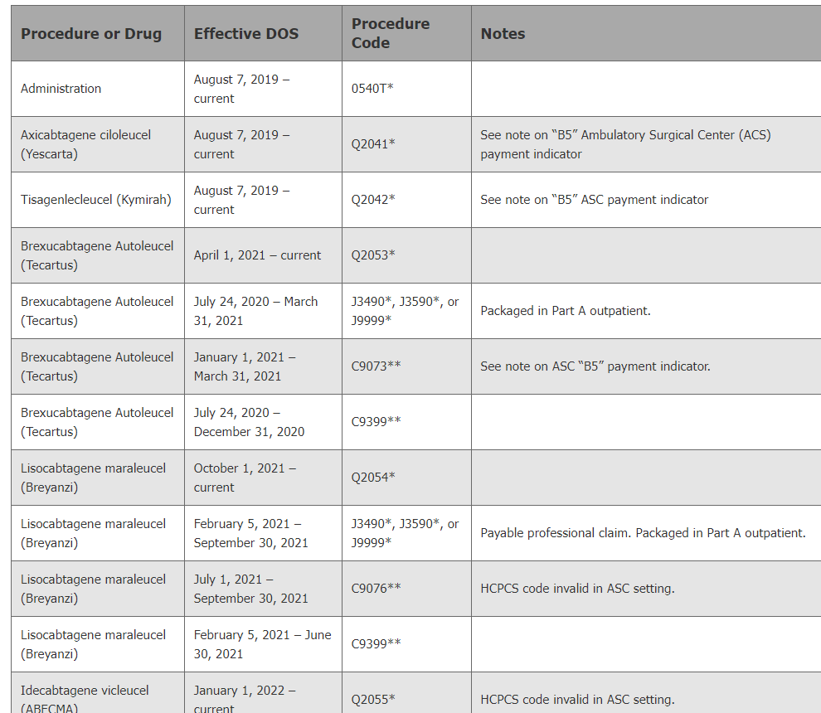
CAR T-cell Therapy
Professional services under Part B
Specific procedure codes from the Hospital Outpatient Coding and Billing chart
https://www.wpsgha.com/wps/portal/mac/site/claims/guides-and-resources/chimeric-antigen-receptor-car-t-cell-therapy
KX - attests to services provided by FDA REMS facility
For fractional billing
KX – meets requirements specified in medical policy

Slide 9
Outpatient Therapy
Continued treatment above therapy threshold amount is medically reasonable and necessary
Documentation is being kept to supports medical necessity
See YouTube: https://youtu.be/1OImSDsoqDU

Slide 10
Thresholds
KX threshold
Monetary amount of yearly services provided at which KX should be appended
Changes yearly
PT and SLP services combined
OT
Manual medical review threshold
Targeted reviews performed on services >$3000
KX continues to be appended

Slide 11
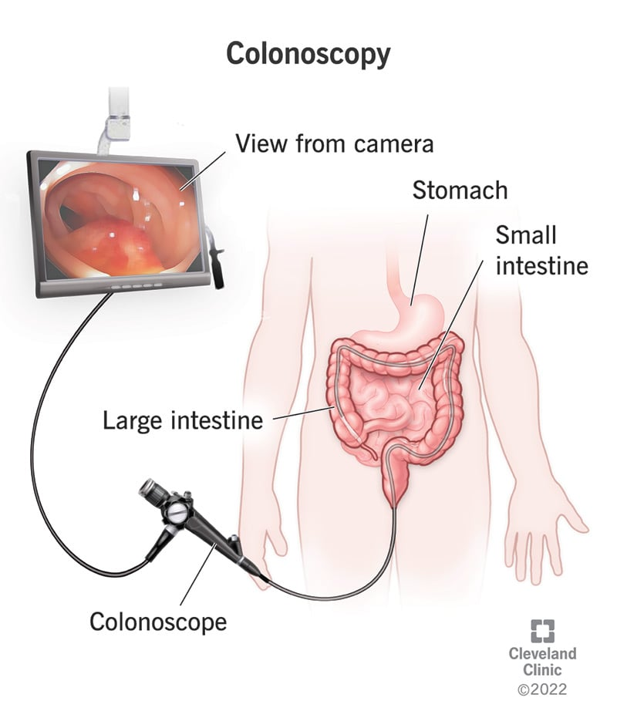
Screening Colonoscopy
Use KX modifier on screening to indicate the service was performed after a positive stool-based test
G0105 – Colorectal cancer screening: colonoscopy on individual at high risk
G0121 – Colorectal cancer screening; colonoscopy on individual not meeting criteria for high risk
Transmittal 11865 Change Request 13017

Slide 12
Gender Specific Billing – Part B
For procedure codes often considered appropriate for only one gender, indicate on the claim detail if the patient’s experienced gender is different than their sex at birth
Report KX modifier for any claims related to transgender, intersex and gender-expansive system issues
Medicare Learning Network (MLN) Connects 2023 06 08

Slide 13
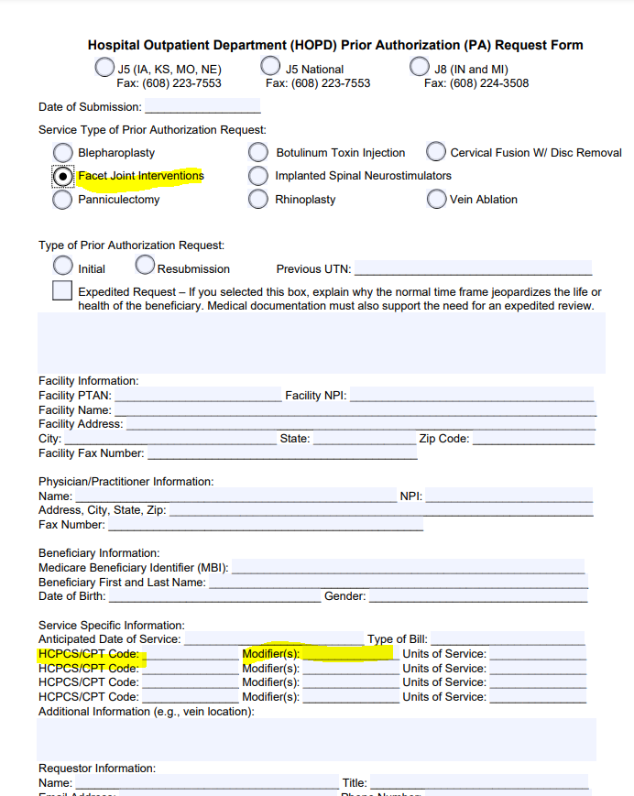
Diagnostic Facet Joint Injections
Report the KX modifier on the Prior Authorization (PA) Request Form for hospital outpatient department facet interventions
Append the KX modifier to the line for all diagnostic facet injections
How do we tell the MAC what type of facet joint procedure we are requesting? Do we use modifiers?

Slide 14
Cardiac Rehabilitation (CR) and Intensive Cardiac Rehabilitation (ICR)
CR - treatment beyond 36 session up to a total of 72 meets the coverage criteria
ICR - any further sessions beyond 72 sessions within a 126-day period meet the requirements of medical policy
Billing and Coding: Frequency and Duration for Cardiac Rehabilitation and Intensive Cardiac Rehabilitation

Slide 15
Inappropriate Use of KX
Service not allowed based on statute
When the medical record will not offer any more data than contained on the claim form

Slide 16
Encore Survey
Let us know what you think!
Take time to complete the survey now.
Survey link

