Slide 1
National Skilled Nursing Facility (SNF)
5- Claim Probe and Educate Reviews

Slide 2
Disclaimer
We prepared this education as a tool to assist the provider community. Medicare rules change often and are part of relevant laws, regulations and rulings found on the Centers for Medicare & Medicaid Services (CMS) website. We will provide responses to questions based on the facts given, but the Medicare rules will determine final coverage. CMS prohibits recording of the presentation for profit-making purposes.

Slide 3
Acronyms
ADR - Additional Documentation Request
CERT – Comprehensive Error Rate Testing
CMG – Case Mix Group
CMS – Centers for Medicare & Medicaid
HIPPS – Health Insurance Prospective Payment System
MAC – Medicare Administrative Contractor
PDPM – Patient Driven Payment Model
PHE – Public Health Emergency
RUG – Resource Utilization Group
SNF – Skilled Nursing Facility
TPE – Targeted Probe and Educate

Slide 4
Objective
To learn about the probe and educate process that will affect all Skilled Nursing Facilities (SNF)

Slide 5
Agenda
What’s going on
Who is affected
When reviews will start
Information on how this review process will work

Slide 6
What’s Going On?
CMS has given all MACs transmittal instructions to perform 5-claim probe and educate medical review on every SNF
Purpose – to lower SNF improper payment rate

Slide 7
Root Cause for Improper Payments from 2022 Improper Payment Data
Root Cause Description | Error Category | Sample Claim Count
Case Mix Group (CMG) component documentation – missing | Insufficient Documentation | 102
HIPPS level changed based on documentation submitted | Insufficient Documentation | 73
Nursing home records - missing | Insufficient Documentation | 68
Order – inadequate | Insufficient Documentation | 65
Physician’s certification/recertification – inadequate | Insufficient Documentation | 54
Order – missing | Insufficient Documentation | 51
Physician’s certification/recertification – missing | Insufficient Documentation | 38
Signature log to support a clear identity of an illegible signature – missing | Insufficient Documentation | 21
HIPPS/RUG level in the repository does not match the RUG level billed | Other | 17
Physical/Occupational/Speech Therapy – plan of care - missing | Insufficient Documentation | 15

Slide 8
Who is Included?
All Skilled Nursing Facilities
Unless they are already under review
Low volume provider

Slide 9
How Many Claims will be Reviewed?
MACs will select five (5) claims from each selected provider
MACs will complete one (1) round of probe and educate for each selected provider
Notes:
MACs will select five (5) claims from each selected provider unless they are already under review or a very low volume provider.
MACs will complete one (1) round of probe and educate for each selected provider instead of the potential three (3) rounds as instructed by the traditional targeted probe and educate (TPE) program.
Education offered will be individualized based on the claim review errors identified in the probe.

Slide 10
What Type of Review?
Pre-pay review (before Medicare pays)
Unless provider requests post-pay for hardship purpose
Providers with errors in all five claims reviewed may be prioritized for TPE program
Notes:
This will be a pre-pay review unless a provider requests a post-pay review for hardship. If the MAC identifies an improper payment, it will adjust the individual claim payment, as appropriate, in addition to providing education – including the explanation for denial or payment adjustment. MACs may prioritize providers in all five claims reviewed for the traditional and more extensive TPE program.

Slide 11
Effective Date
June 5, 2023
Starting with the top 20% of providers that show highest risk based on MAC data analysis
Notification letters sent
Will continue to request additional providers on a rolling basis

Slide 12
Initial Notification
Phone call to establish a point of contact
Letter sent via portal, mail, or email
Probe number provided

Slide 13
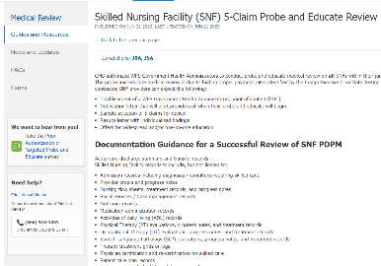
Documentation Guidance
Listed in the ADR request
Available on wpsgha.com
Part A> Topic Center> Medical Review> Guides and Resources> Skilled Nursing Facility (SNF) 5-Claim Probe and Educate Review

Slide 14
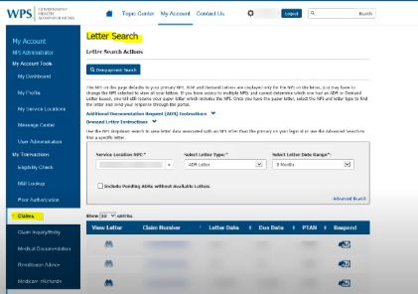
Additional Documentation Request
Letter sent to provider to request documentation
Sent via mail and in our portal
Providers can view new and existing letters from the portal dashboard
Respond to request within 45 days

Slide 15
Responding to the ADR Letter
WPS Government Health Administrators Portal
Mail
Hardcopy paper documentation
CD/DVD/Flash drive
Fax
Electronic submission of medical documentation (esMD)

Slide 16
The Review and Decision
The MAC has 30 days to review and make a decision on payment
Individual decisions can be found in the provider portal
After the 5-claim sample is completed, the MAC will send a detailed result letter

Slide 17
Providers with Error Rate 20% or Less
Widespread education will be provided
Option for 1:1 education if requested

Slide 18
Providers with Error Rate Greater Than 20%
1:1 Education offered in results letter
MAC will reach out to schedule if two or more claims in error
Education to include claim specific information
Discussion may be monitored by CMS
> 20%

Slide 19
Five of Five Claims in Error
Providers with 5/5 claims in error will be prioritized for Targeted Probe and Educate (TPE) review

Slide 20
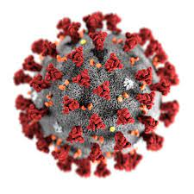
Exclusions
Claims including the COVID-19 diagnosis for dates of service during PHE are excluded when possible
Any relevant flexibilities and waivers will be applied if reviewing claims for dates of service from:
March 1, 2020 –May 11, 2023

Slide 21
Wrap Up
All SNF’s will have 5-claim review
Providers will be contacted prior to start
Education will be provided
Providers with high error rates could be prioritized for TPE
COVID-19 claims will be excluded when possible

Slide 22
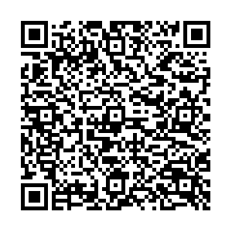
Survey
Let us know what you think
Take time to complete the survey now
QR code
Survey link
Survey link in description of video

