Slide 1
Benefit Periods: Getting Started
October 23, 2023

Slide 2
Disclaimer
We prepared this education as a tool to assist the provider community. Medicare rules change often. They are in the relevant laws, regulations and rulings on the Centers for Medicare & Medicaid Services (CMS) website.
We will provide responses to questions based on the facts given, but the Medicare rules will determine final coverage.
CMS prohibits recording of the presentation for profit-making purposes.

Slide 3
Agenda
We will:
Define a benefit period
Explain the affects on providers
Starting and stopping the benefit period
Calculate a benefit period
Today’s goal: understand a benefit period and how it affects different types of providers.

Slide 4
Definition

Slide 5
Define
Medicare measures the use of medically necessary hospital and Skilled Nursing Facility (SNF) services inpatient benefits
Medicare Part A coverage
Used to determine:
Inpatient deductible
Co pay
Payment

Slide 6
Hospitals Defined

Slide 7
Beginning and Ending
Starts with an inpatient admission
Continues regardless of facility type
Ends with a 60-day inpatient care lapse
Consecutive days
Multiple benefit periods in a year

Slide 8
Includes
A benefit period includes:
Part A deductible days
Medicare full pay days
Medicare co pay days
Benefits exhaust days

Slide 9
Hospital Benefit Periods
Key to understanding:
Medicare covers 90 medically necessary days
Deductible days 60
Copay days 61 to 90
Optional use: lifetime reserve days 60
Higher copay
Day 91 or 151 patient pays all expenses

Slide 10
SNF Benefit Period
Key to understanding:
Applies to SNF and swing bed stays
Medicare covers up to 100 inpatient days
20 days for which covers all expense
80 days for which the patient has a copay
Day 101 or more of the medical necessary the patient is liable for all expenses

Slide 11
SNF Medically Necessary Stays

Slide 12
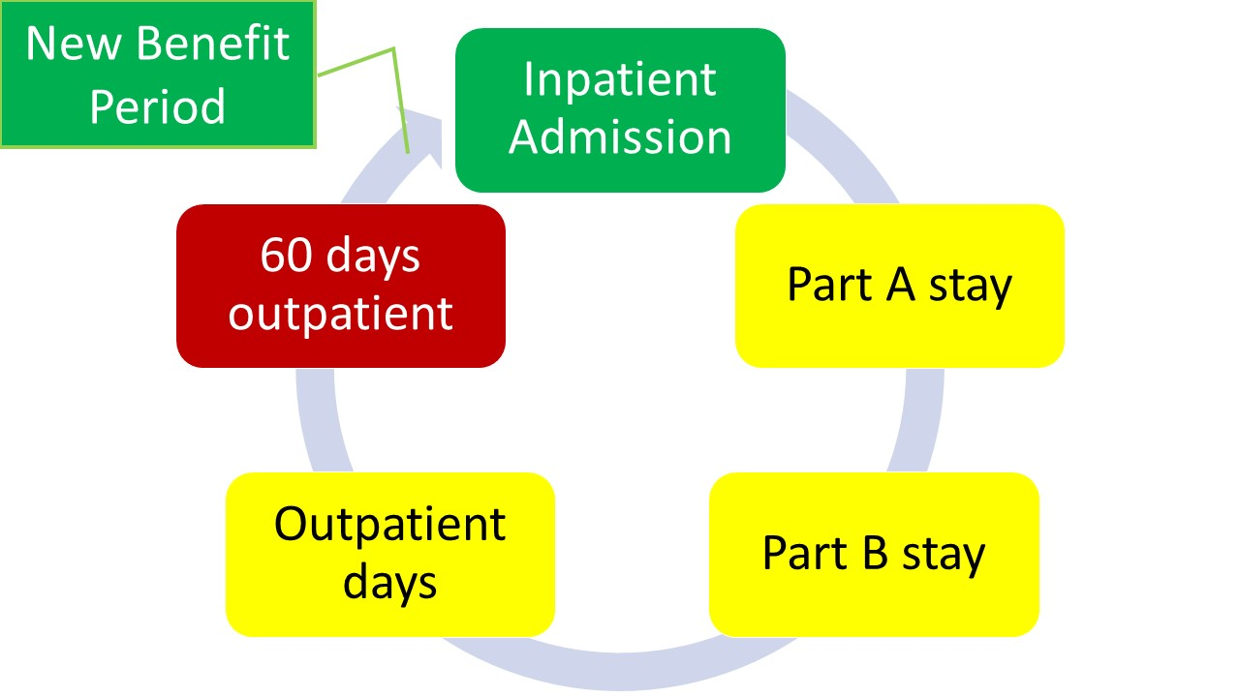
Benefit Period Chart

Slide 13
Benefit Days

Slide 14
Affects on Providers

Slide 15
Bundling
During the inpatient Medicare payable days, bill the hospital or SNF
SNS consolidated billing
Hospital bundling

Slide 16
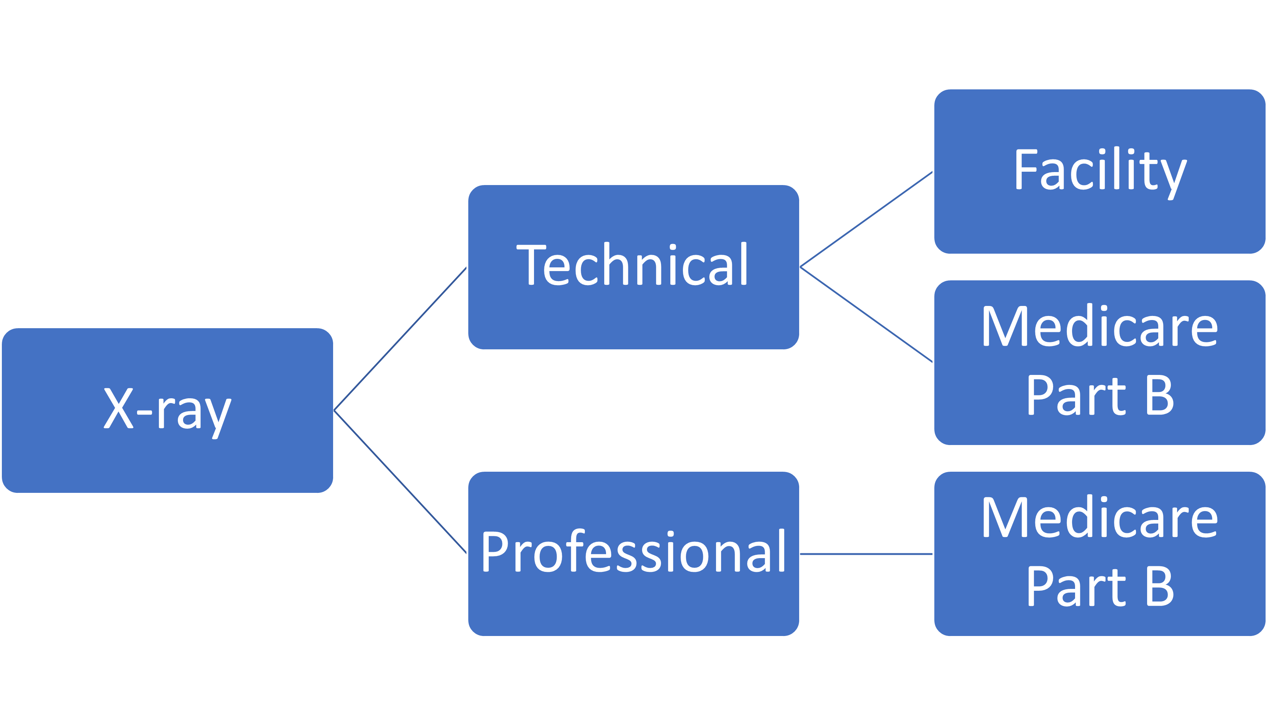
Split Billing
Part A covered stay 3-day to 1-day payment window
Profession to Medicare
Technical to inpatient facility

Slide 17
Observation Care

Slide 18
Calculating a Benefit Period

Slide 19
Example 1
John admits to the hospital through the emergency room after a suicide attempt
Remain in acute care hospital for 10 days for medically necessary treatment
Transfer to an Inpatient Psychiatric facility for 30 days
Discharged home on day 31
Admits to a hospital 49 days later following a car accident.
Remains in the acute care hospital for 23 days
Discharges to home health on day 24

Slide 20
Calculation Example 1
No 60-day lapse, so count as 1 benefit period. Days used:
10 acute care days
30 inpatient psychiatric facility days
23 acute care days
63 total hospital days

Slide 21
Example 2
Judy resides a nursing home. She has a right hip replacement.
She remains in the hospital for 12 days following the procedure due to an infection
After hospital discharge, she returns to the nursing facility where she lives for medically necessary skilled care
She is discharged from skilled care after 63 days and remains in at the nursing home as a residence.
After 63 days, she is admitted to the hospital for the left hip replacement.

Slide 22
Calculation Example 2
Is there a 60-day lapse in medically necessary care?
Yes, she moves to a non-skilled level of care for 63 days
She remains in the same facility

Slide 23
Example 3
April 12th, Jake as a car accident
He admits to observation following an ER visit
April 14th, a hospital admission occurs due to complications
May 23rd, hospital discharge and SNF admission occur
July 17th, SNF discharges to home health care
September 8th, hospital admission for a medically necessary surgical procedure due to the car accident
September 15th, hospital discharges him home

Slide 24
Calculation Example 3
Here are the benefit period days:
One benefit period
Day 1: April 14 (hospital deductible and co-pay)
Day 25: discharge from hospital to SNF (SNF fully covered days)
Day 60: discharge to home health
Day 61: August 8 admission for surgery
Day 67: discharge home
July 17th to September 8th is not 60 days!

Slide 25
Final Questions

Slide 26
Resources
Medicare Benefit Policy Manual, Chapter 3 - Duration of Covered Inpatient Services
Medicare Claims Processing Manual, Chapter 3 - Inpatient Hospital Billing, Section 40.3

Slide 27
Your Success if Our Goal

