Slide 1
Medicare Secondary Payer (MSP): Group Health Plan (GHP)
Employment based insurance

Slide 2
Disclaimer
We prepared this education as a tool to assist the provider community. Medicare rules change often. They are in the relevant laws, regulations and rulings on the Centers for Medicare & Medicaid Services (CMS) website.
We will provide responses to questions based on the facts given, but the Medicare rules will determine final coverage.
CMS prohibits recording of the presentation for profit-making purposes.

Slide 3
Agenda
Goal: Understand when a GHP is primary to Medicare
Today we will cover:
GHP basics
Employer Group Health Plan (EGHP)
Large Group Health Plan (LGHP)
End-Stage Renal Disease (ESRD) patients

Slide 4
GHP Basics

Slide 5
Definition
Health coverage sponsored by employer or employee organization which includes:
Self-insured plans
Government plans (Federal, state and local)
Employee organization plans
Union plans
Employee health and welfare funds

Slide 6
Active Employment
Employment through:
Self
Spouse: legally married
Opposite sex
Same sex
Child
Other
Includes retiree plans

Slide 7
Employment
Insured is actively working as an employee
Self-employed or the employer
Associated with the employer in a business relationship
Carried on the employer's plan meeting all of the following:
Not actively working
On short-term or long-term disability or sick leave from employer
Active on the employer's employment rolls
Has employment-based GHP coverage
Not Consolidated Omnibus Budget Reconciliation Act (COBRA) continuation coverage

Slide 8
Self-Employed
Do not include as employees for purposes of determining the employee requirement
EGP
LGHP

Slide 9
Covered Services
Covers all services
Covered under the plan
Medicare covered services
Frequency
Medical necessity
Excluded

Slide 10
Take Into Account
GHPs are primary
Can not consider if a person has Medicare
Terminate coverage due to Medicare
Impose limits based on Medicare
Change premiums due to Medicare
Force a person to take Medicare

Slide 11
Basics Questions

Slide 12
EGHP (Working Aged)

Slide 13
Working Aged
Medicare secondary
Medicare eligible due to age (65 and older)
GHP coverage through the patient, their spouse, or legal guardian
Based upon current employment status
Employment criteria met
20 or more employees

Slide 14
20 or More Employees
Employer employs 20 or more employees with a single employer GHP and includes
Full-time and part-time employees for each working day in each of the 20 or more calendar weeks in the current or preceding year
Weeks do not have to be consecutive
At least 20 full or part-time employees on its employment rolls each working day of that week

Slide 15
Medicare Eligibility
Meets the following:
First of the month the person turns 65
Chooses Part A and B
Part A
Free after 40 quarters worked
Monthly fee for 39 or less quarters worked
Part B monthly fee

Slide 16
EGHP Questions

Slide 17
LGHP (Disability)

Slide 18
LGHP
Medicare secondary
Medicare eligible due to disability
Under age 65
GHP coverage through the patient, their spouse, or legal guardian
Based upon current employment status
Employment criteria met
100 or more employees

Slide 19
100 or More Employees
Employer employs 100 or more employees with a single employer GHP and includes
Full-time and part-time employees for each working day in each of the 20 or more calendar weeks in the current or preceding year
Weeks do not have to be consecutive
At least 100 full or part-time employees on its employment rolls each working day of that week

Slide 20
Disabled
Medicare eligible due to disability
Under 65
Medicare eligible commonly 24 months after disability income begins
Deemed eligible by Social Security Administration (SSA) or Railroad Retirement Board (RRB)

Slide 21
LGHP Questions

Slide 22
ESRD Patients

Slide 23
ESRD Coverage
Medicare eligible due to kidney failure
Usually, Medicare starts in the fourth month of dialysis, when beneficiary participates in dialysis treatment in a dialysis facility
Admitted for Medicare-approved hospital for kidney transplant
For health care services needed before a transplant
If transplant takes place in same month or within the two following months

Slide 24
ESRD and GHP
GHP coverage through the patient, their spouse, or legal guardian
Active employment
No employee limits
Includes COBRA and retirement plans

Slide 25
Coordination Period
GHP is primary when Medicare eligibility starts and lasts for 30 months
Regardless of number of employees
Regardless of coverage based on current employment status
Regardless of plan stating Medicare is primary
Federal law

Slide 26
ESRD Coverage Ends
Medicare eligible due to ESRD and
12 months after month the beneficiary stops dialysis treatments, or
36 months after month the beneficiary had a kidney transplant
May have more than one coordination period in life-time

Slide 27
Double Medicare Coverage
Medicare eligibility may be simultaneously due to:
"Age" and "ESRD“
"Disability" and "ESRD"
Medicare eligibility may not be simultaneously due to:
"Age" and "Disability"

Slide 28
Final Questions

Slide 29
Resources
Medicare Secondary Payer Manual
Chapter 1 - General MSP Overview
Chapter 2 - MSP Provisions
Medicare Secondary Payer Booklet
Coordination of Benefits & Recovery Overview
Patient guide: Your Guide to Who Pays First

Slide 30
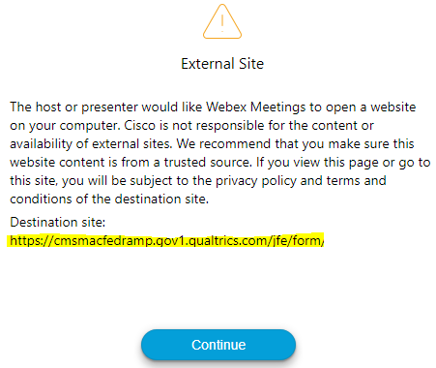
Survey
Let us know what you think!
Take time to complete the survey now.
QR code
Survey link in chat
Redirect after closing webinar

Slide 31
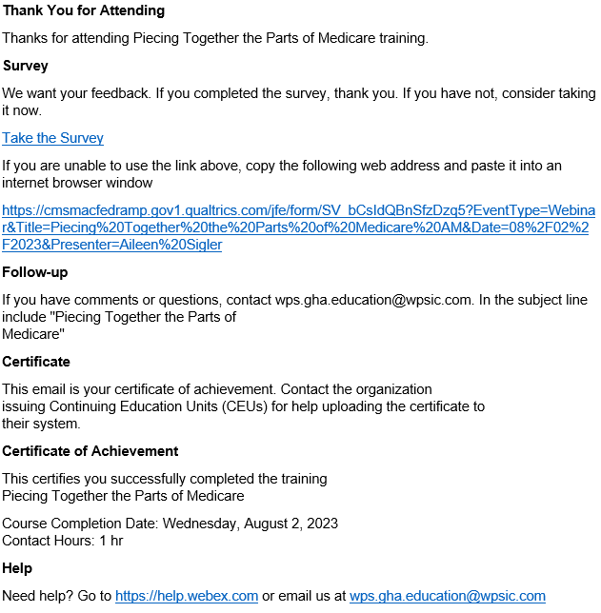
Proof of Attendance
Complete survey
Email contains contact hours
From messenger@webex.com
Check Junk or Spam folders
Add to safe sender list

Slide 32
Closing
Follow-up Questions
Email wps.gha.education@wpsic.com
Topic: “MSP: GHP Webinar”
Submit by 11/20/2023 at 8:00 A.M. CT
Send claim specific questions to Customer Service

