Slide 1
Medicare Secondary Payer (MSP): Getting Started
An MSP overview

Slide 2
Disclaimer
We prepared this education as a tool to assist the provider community. Medicare rules change often. They are in the relevant laws, regulations and rulings on the Centers for Medicare & Medicaid Services (CMS) website.
We will provide responses to questions based on the facts given, but the Medicare rules will determine final coverage.
CMS prohibits recording of the presentation for profit-making purposes.

Slide 3
Agenda
Today we will:
Define MSP
Explain the basics
Demonstrate resources to help you

Slide 4
Define

Slide 5
Definition
When another payer must consider the charges before Medicare
Medicare may not pay

Slide 6
Goal
Save the Medicare trust fund money!
Approximate fiscal year 2022 savings $9.17 billion.
Increase provider revenue
Keep the payment from the primary payer above the Medicare allowed amount
Avoid Medicare recovery and payment issues
Stop the confusion over payment

Slide 7
Questions from the Define Section

Slide 8
Explain

Slide 9
Group Health Plan (GHP)
Based on patient, spouse, or other’s active employment
Employer Group Health Plan (EGHP)
Large Group Health Plan (LGHP)
End-Stage Renal Disease (ESRD)

Slide 10
Non-Group Health Plan (NGHP)
Based on situation
Liability
No-fault (NF)
Workers’ Compensation (WC)
Federal Black Lung (BL)

Slide 11
Not Primary
This coverage is not primary to Medicare:
Medicare Advantage
Veteran’s Administration (VA)
Medigap
Plan with policies stating supplemental to Medicare
Medicaid

Slide 12
Determining
Before billing, providers must determine the correct billing order
Ask you patient
Website portal
Interactive Voice Response (IVR) system
Direct Data Entry (DDE)

Slide 13
Timely Filing
One year from:
Date of service
Date of discharge
CMS does not allow an exception for MSP situations

Slide 14
Contractors
CMS uses the following for MSP related actions:
Medicare Administrative Contractor (MAC)
Process claims
MSP contractor
Benefits Coordination & Recovery Center (BCRC)
Determining primary coverage
NGHP recoveries and activities related to recovering improper payments
Commercial Repayment Center (CRC)
GHP recoveries and activities related to recovering improper payments

Slide 15
Questions on the Explain Section

Slide 16
Demonstrate

Slide 17
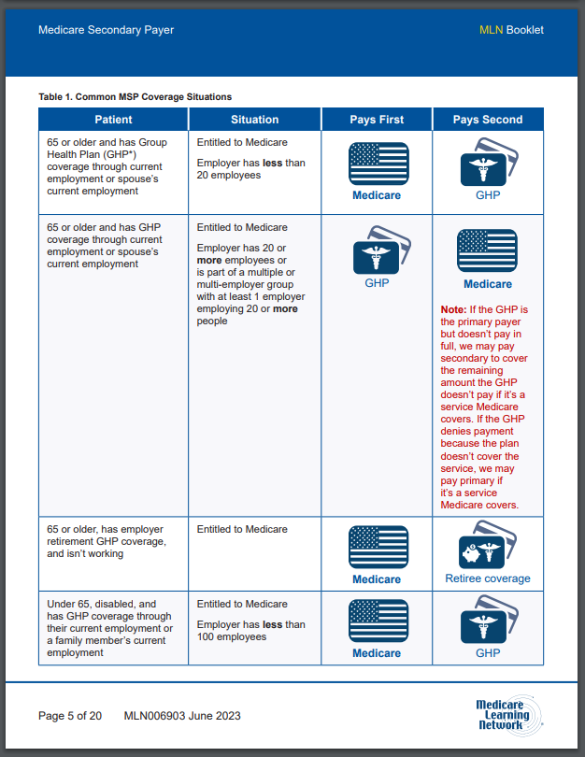
Medicare Secondary Payer Booklet
Medicare Learning Network Publication
MSP overview
Reference chart
MLN006903

Slide 18
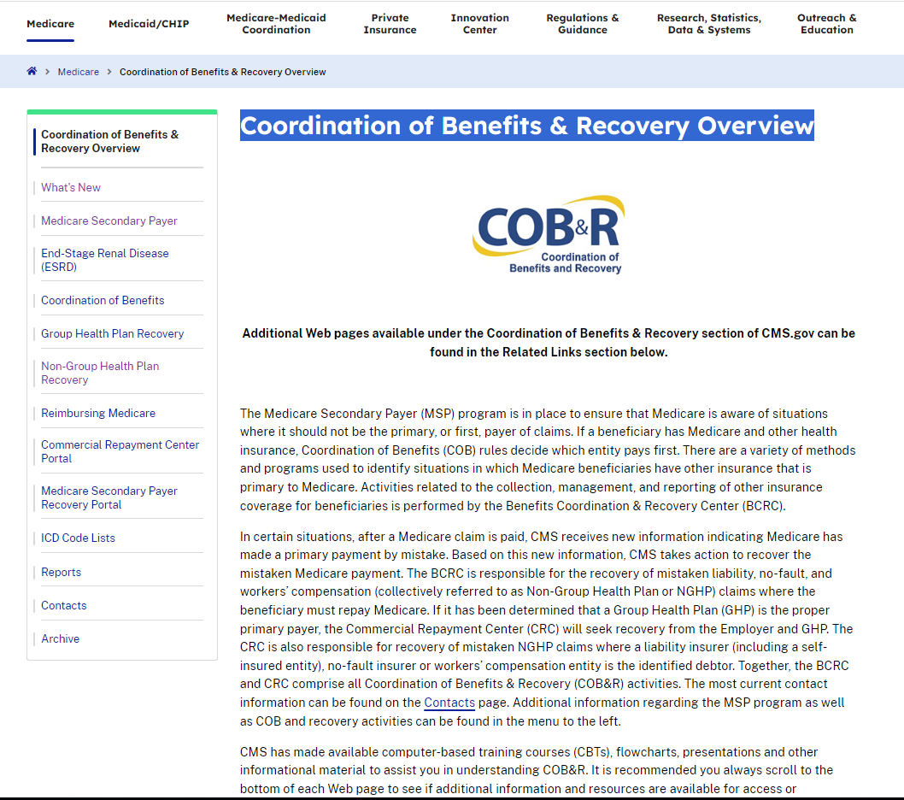
Coordination of Benefits & Recovery Overview
CMS’ MSP web page
What’s available:
Define MSP
Contractors affecting MSP
Coordination of Benefits
Reports
Contacts

Slide 19
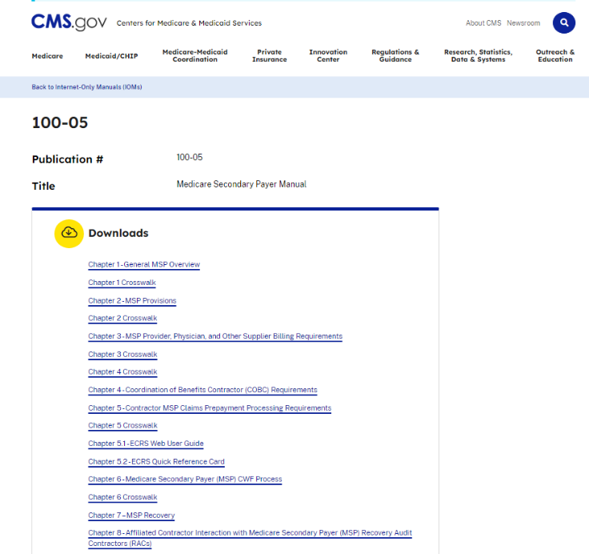
Medicare Secondary Payer Manual
Day-to-day operating instruction
Eight chapters
Contractor
Providers

Slide 20
Your Guide to Who Pays First
Medicare patient booklet
On the Medicare’s beneficiary website
In the publication section

Slide 21
Final Questions

Slide 22
Closing

