Slide 1
Appeals for Erythropoiesis Stimulating Agents
August 16, 2023

Slide 2
Acronyms
AIC – Amount in Controversary
CMS – Centers for Medicare & Medicaid
CKD – Chronic Kidney Disease
DPA – Darbepoetin alfa
EPO – Epoetin alfa
ESA – Erythropoiesis Stimulating Agent
GFR – Glomerular filtration rate
HCT – Hematocrit
Hgb – Hemoglobin
ICD-10 – International Classification of Diseases
LCD – Local Coverage Determination
MAC – Medicare Administrative Contractor
MDS – Myelodysplastic syndromes
NCD – National Coverage Determination
QIC – Qualified Independent contractor

Slide 3
Disclaimer
We prepared this education as a tool to assist the provider community. Medicare rules change often. They are in the relevant laws, regulations and rulings on the Centers for Medicare & Medicaid Services (CMS) website. We will provide responses to questions based on the facts given, but the Medicare rules determine final coverage. CMS prohibits recording of the presentation for profit-making purposes.

Slide 4
Goals and Agenda
Goal:
Review documentation requirements for erythropoiesis stimulating agent claims
Aid in avoiding future denials
We will review:
Coverage criteria
The appeals process
Common denial reasons with documentation examples
Answer provider questions

Slide 5
What Is An Erythropoiesis Stimulating Agent (ESA)?
Epoetin alfa (EPO)
Epogen®
Procrit®
Darbepoetin alfa (DPA)
Arenasp®

Slide 6
NCD
Originate from CMS
Applies to all jurisdictions
Development comes from provider groups, beneficiary groups, or other groups often working thru legislative channels
Basis found in Coverage Issues Manual and the NCD Manual
Italicized language is CMS verbiage

Slide 7
LCD
Carrier developed coverage policy
Usually defines “medical necessity”
Developed for various reasons
To define appropriate use of new technologies
To address services with an abusive history or potential
High volume, high dollar services

Slide 8
Where Can I Find The Medicare Coverage Requirements?
National Coverage Decision
Erythropoiesis Stimulating Agents (ESAs) in Cancer and Related Neoplastic Conditions (INJ-040)
Local Coverage Determination
Erythropoiesis Stimulating Agents Epoetin alfa (EPO), Darbepoetin alfa (DPA)(INJ-023)

Slide 9
Do We Use The NCD Or The LCD?
NCD
ESA for cancer
LCD
ESA for CKD
ESA for MDS

Slide 10
Appeal Process
Redetermination
120 days from the date of receipt of the notice of initial determination
No monetary threshold to be met
Reconsideration
180 days from the date of receipt of the redetermination.
NOTE: If a party requests QIC review of a contractor’s dismissal of request for redetermination, the time limit for filing a request for reconsideration is 60 days from the date of the receipt of the contractor’s dismissal
No monetary threshold to be met

Slide 11
Appeal Process Continued
Administrative Law Judge (ALJ) Hearing
60 days from the date of receipt of the notice of the reconsideration
Current AIC requirements found on CMS Website
Departmental Appeals Board (DAB) Review/Appeals Council
60 days from the date of receipt of the ALJ hearing decision
No monetary threshold to be met
Federal Court Review
60 days from date of receipt of Appeals Council Decision
Current AIC requirements on CMS Website

Slide 12
Appeal Process: Nurse Reviewer Roll
Reviews additional documentation sent in during redetermination
Responsibility of provider submitting appeal to obtain and submit documentation as necessary
Submit redetermination via:
WPS Government Health Administrators Portal
Fax
Written Request

Slide 13
Documentation for All ESA Claims
Documentation must:
Be legible
Include patient identification information
Include the legible signature of provider responsible for patient care
Support use of ICD-10 code
Support ESA therapy for individual patient is medically reasonable and necessary
Include recent blood pressure
HCT and Hb level prior to administration of ESA therapy
Evidence other causes of anemia have been ruled out
Dosage
Route of administration

Slide 14
Common Denial Reasons
ESAs for CKD
Missing GFR or creatinine.
GFR must be <60 or a creatinine >=3 in the past 30 days
ESAs for MDS
Missing bone marrow biopsy report.
This report must confirm the diagnosis of MDS
Missing provider signature
Missing Hgb or HCT results
For all ESA use (for CKD, MDS, cancer), the Hgb must be <10 or the Hct <30
Notes:
59274 denial codes

Slide 15
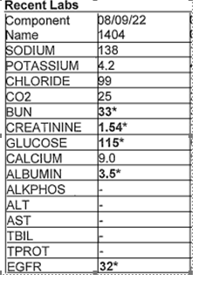
GFR / Creatinine Result Example

Slide 16
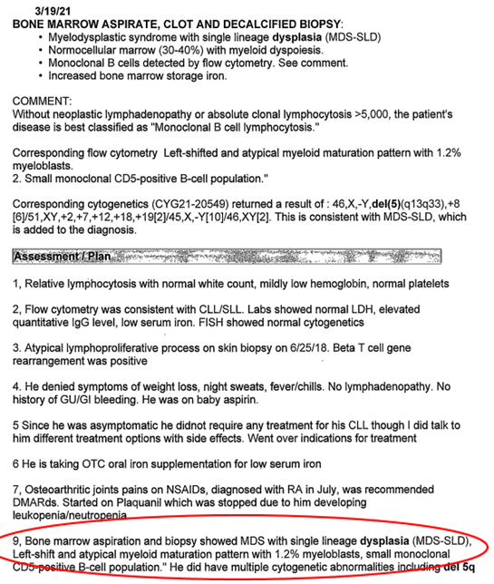
Bone Marrow Biopsy Example

Slide 17
Hemoglobin Or Hematocrit Example

Slide 18
Denial Letter Examples

Slide 19
Reconsideration (Second Level of Appeal)
Qualified Independent Contractor (QIC)
Reconsideration Request Form
Mail to:
C2C Innovative Solutions, Inc. - QIC Part B North P.O. Box 45208 Jacksonville, Florida 32232-5208

Slide 20
Appeal Process Resources
WPS GHA YouTube Channel, Appeals playlist
WPS GHA Website, Appeals Guides and Resources
CMS MLN, Medicare Part A & B Appeals Process

Slide 21
Survey
Let us know what you think!
Use smart device to scan the QR code
Use this link

