Slide 1
Revalidation Post PHE
July 11, 2023

Slide 2
Disclaimer
We prepared this education as a tool to assist the provider community. Medicare rules change often and are part of relevant laws, regulations and rulings found on the Centers for Medicare & Medicaid Services (CMS) website. We will provide responses to questions based on the facts given, but the Medicare rules will determine final coverage.
CMS prohibits recording of the presentation for profit-making purposes.

Slide 3
Agenda

Slide 4
March 2020
Ease provider burden
Paused revalidation activities:
Solicitation
Processing
Failure to respond activities:
Payment pend
Deactivations

Slide 5
End of 2021
Revalidations for certain providers
Received accelerated payments
Mostly Part A providers
Potential risk
Claim volume
High dollar
Claim type

Slide 6
What’s Next?

Slide 7
November 2019—February 2020
Revalidation submitted
No actions taken
Sending follow-up letters
Failure to respond:
Payment pend
Possible deactivation

Slide 8
March 2022 — December 2021
Not accountable during PHE
Revalidation submitted
Approved — No actions needed
Incomplete — Rejection
Maintain active enrollment
Request will be sent

Slide 9
January 2022 — May 2023
Revalidation letter sent
Must comply with request
Follow-up letter
Failure to respond:
Payment pend
Possible deactivation

Slide 10
Moving Forward
MAC request letter
60 Days prior
Data.CMS.GOV
Failure to respond:
Payment pend
Possible deactivation

Slide 11
Data.CMS.Gov

Slide 12
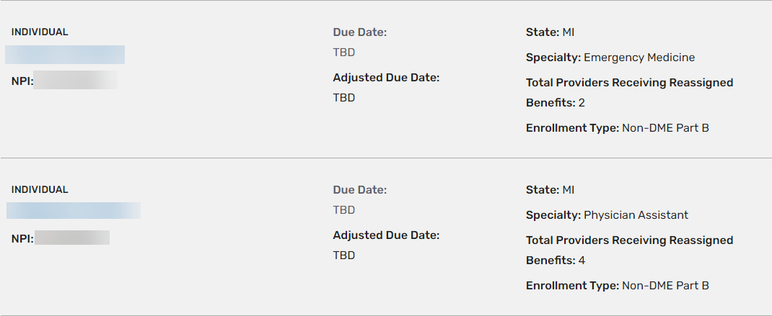
Search Results

Slide 13
Due Dates

Slide 14
Reminders
All enrollment data:
Current
Additions
Deletions
Respond timely
Initial request
Development requests

Slide 15
Resources
CMS.GOV: https://www.cms.gov/medicare/provider-enrollment-and-certification/revalidations
Data.CMS.GOV: https://data.cms.gov/tools/medicare-revalidation-list
GHA Website: https://www.wpsgha.com/wps/portal/mac/site/enrollment/guides-and-resources/revalidation-med-enrollment

Slide 16
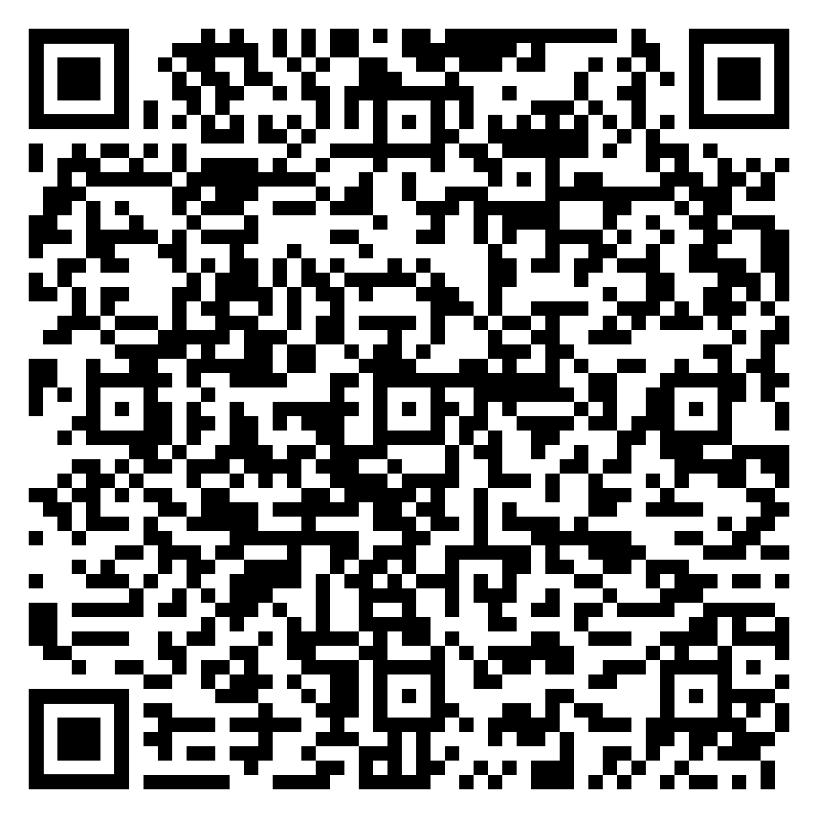
Survey
Let us know what you think!
Take time to complete the survey now.
Survey

Slide 17
Closing
Follow-up Questions
Email wps.gha.education@wpsic.com
Topic “Encore: Revalidation Post PHE”
Send claim specific questions to Customer Service

Slide 18
Thank you!

