Slide 1
Exploring the Website Changes

Slide 2
Disclaimer
We prepared this education as a tool to assist the provider community. Medicare rules change often. They are in the relevant laws, regulations and rulings on the Centers for Medicare & Medicaid Services (CMS) website.
We will provide responses to questions based on the facts given, but the Medicare rules will determine final coverage.
CMS prohibits recording of the presentation for profit-making purposes.

Slide 3
Agenda
Today we will cover:
Design changes
The training center
Available self-service tools
Let’s work together to make the transition easier!

Slide 4
Design Changes

Slide 5
Reason for Change
You asked, “Why did you decide to change your website?”
Feedback from survey
Faster website
Improve search
Data analysis

Slide 6
Top Arrangement
Moved items around
Topic Center
Tools
Training Center
Message indicator
Login
Jurisdiction selection

Slide 7
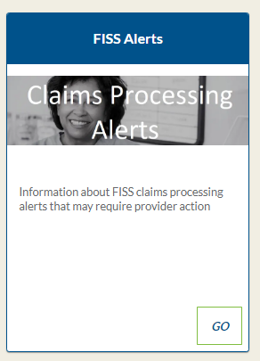
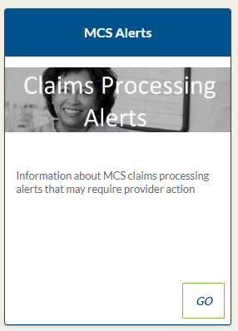
System Status and Claims Alerts
Move to separate boxes

Slide 8
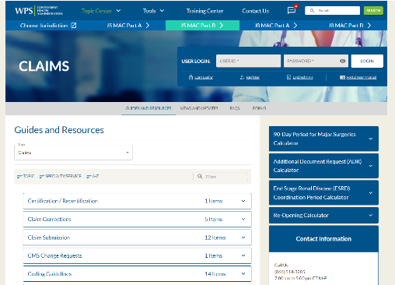
Topic Center Pages
New look and feel to show less
Same content
Drop-downs to help locate information
Sort by
Topic
Specialty
Alphabetical titles

Slide 9
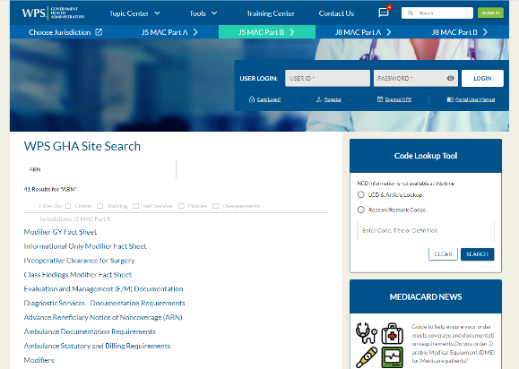
Search
Improved results
Faster
Intuitive typing
Topic center selection

Slide 10
Training Center

Slide 11
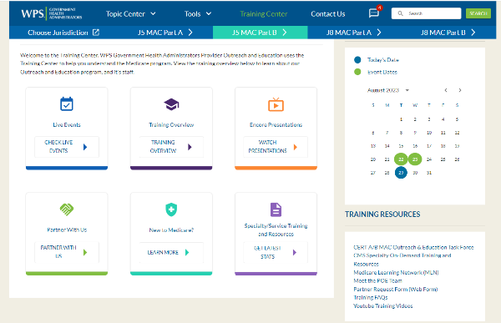
New Features
Items you wanted us to pay attention to
Easily available
Calendar
Stand out
Live events
Encore

Slide 12
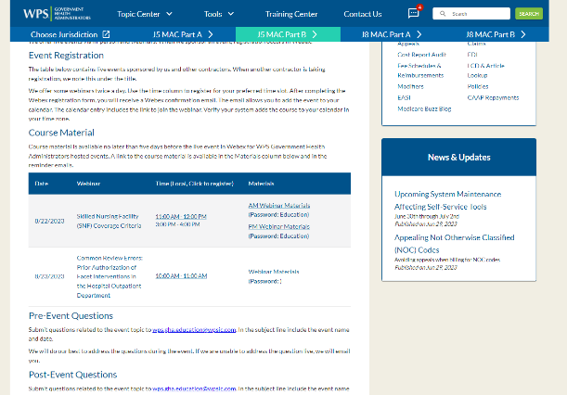
Live Events
List of upcoming events
Registration links
Presentations without going somewhere else
Timely Topics

Slide 13
Encore Presentations
List of previously recorded events
Last 90 days
YouTube playlist
Slides available

Slide 14
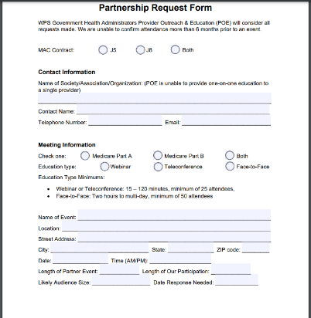
Partner Form
Web form versus PDF
Easier to use

Slide 15
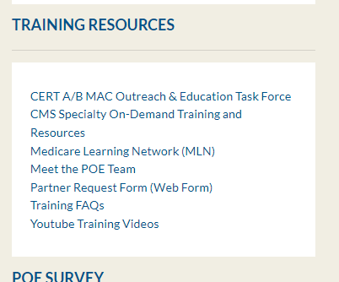
Resources
Less prevalent, but still available
Provider Outreach and Education Advisory Group (POE AG)
Team information
YouTube training videos

Slide 16
Tools

Slide 17
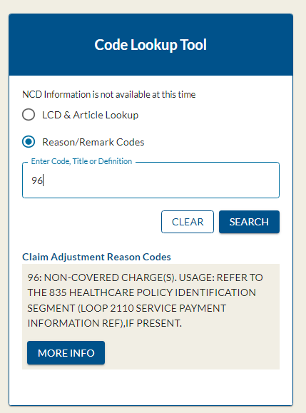
Reason and Remarks Codes
Look-up tool explaining the reason and remarks codes
Provides actions
Additional information

Slide 18
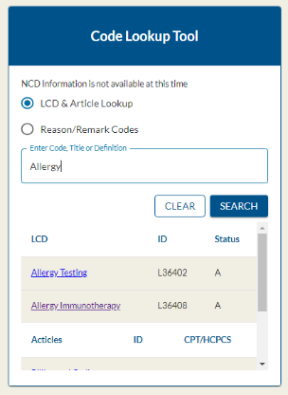
Local Coverage Determination (LCD)
Look-up for LCD and articles
Name
Procedure code

Slide 19
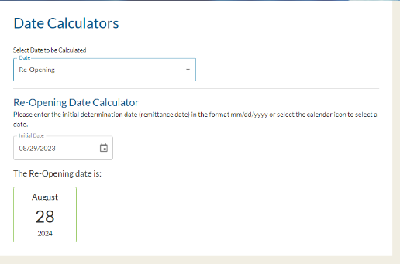
Date Calculators
Displays the date you must act by
Redeterminations
90-day global period
End-stage renal disease coordination period
Medical review
Re-opening
Additional documentation request

Slide 20
Other Tools
Acronyms List
CERT Claim Lookup
Direct Data Entry (DDE)
Electronic Access Request
Submitter ID Request
Enrollment Application Status Inquiry (EASI)
Find a Doctor
All Forms
Medicare Secondary Payer (MSP) Calculator
Universal Data Calculator
NPI Admin Search

Slide 21
Questions

Slide 22
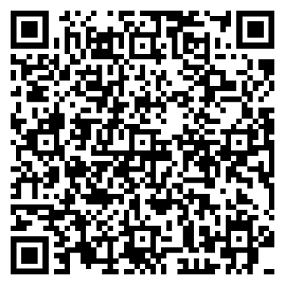
Encore Survey
Let us know what you think!
Take time to complete the survey now.

Slide 23
Encore Closing
Follow-up Questions
Email wps.gha.education@wpsic.com
Topic: Encore: Website Webinar
Send claim specific questions to Customer Service

