Slide 1
New CMS 855I Application

Slide 2
Disclaimer
We prepared this education as a tool to assist the provider community. Medicare rules change often and are part of relevant laws, regulations and rulings found on the Centers for Medicare & Medicaid Services (CMS) website. We will provide responses to questions based on the facts given, but the Medicare rules will determine final coverage.
CMS prohibits recording of the presentation for profit-making purposes.

Slide 3
Agenda

Slide 4
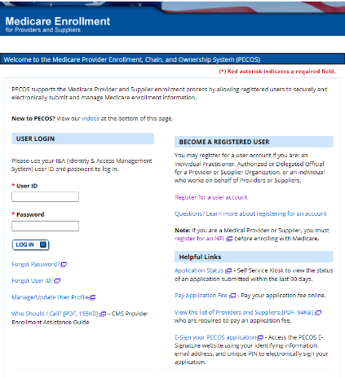
Electronic Application
Always the most current
No visible changes now
Updates in PECOS 2.0

Slide 5
Paper Application

Slide 6
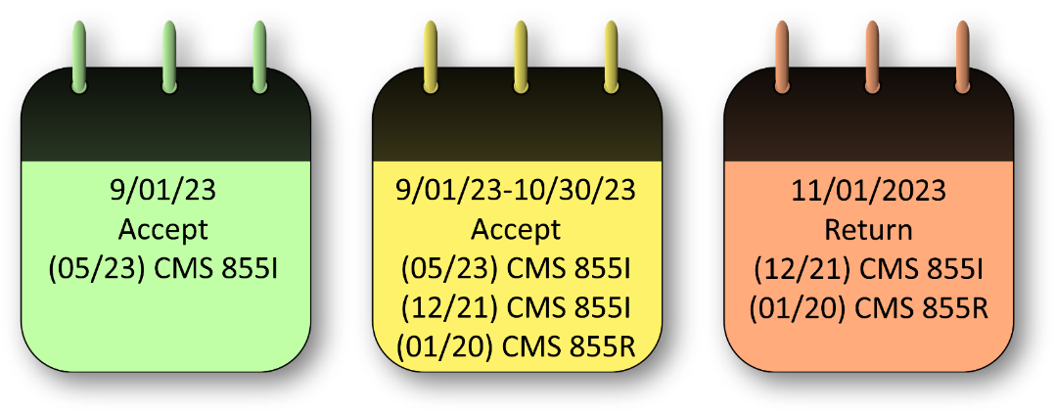
Timeline

Slide 7
Changes
Notes:
Begin Demo and walk through of changes by section.

Slide 8
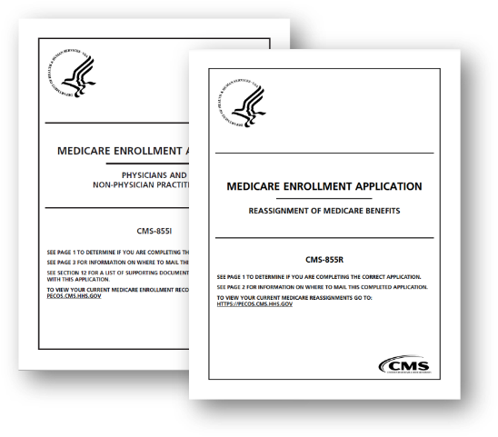
855I and 855R Consolidated
Consolidated CMS 855I and 855R
CMS 855R discontinued
Section 4F contains reassignment
Signatures in section 15
Notes:
Demo the changes on the CMS website.

Slide 9
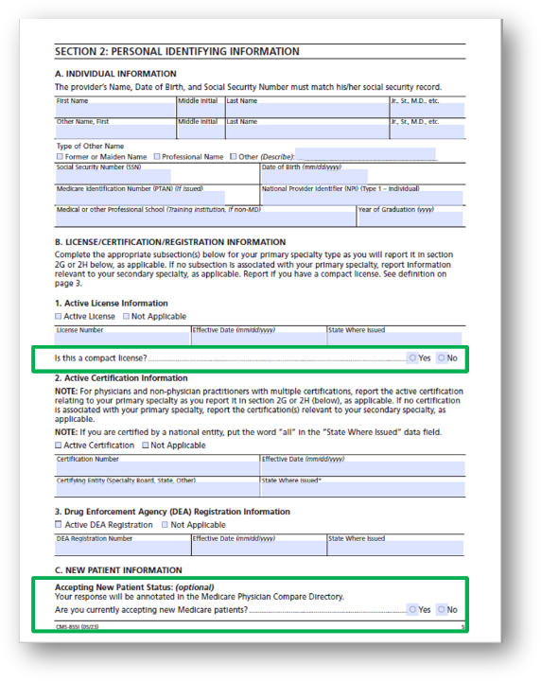
Section 2 Information
Compact license
Accepting new patient purpose

Slide 10
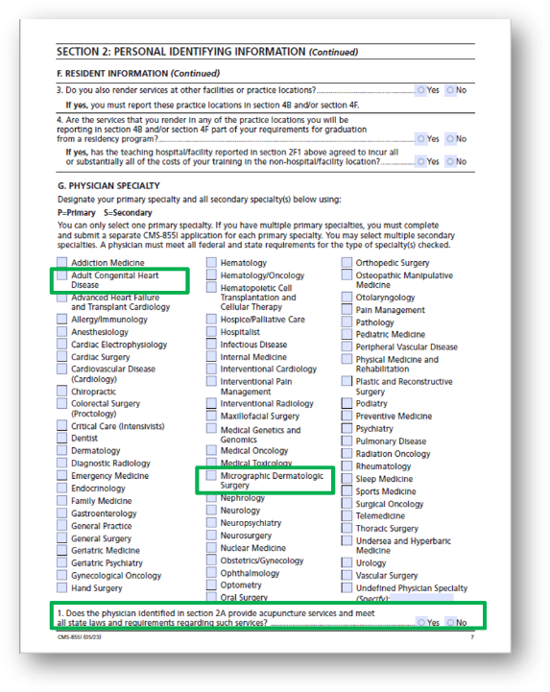
Section 2 Specialty
Two specialties added:
Adult Congenital Heart Disease
Micrographic Dermatology
Acupuncture question

Slide 11
Section 2 Removed
Gender
Physician Assistant Sections
Medicare Program Integrity Manual Chapter 10 § 10.2.3.12
Enroll individually
Receive direct payment
Establish a group
Reassign benefits

Slide 12
Section 4
855R removed
New location types

Slide 13
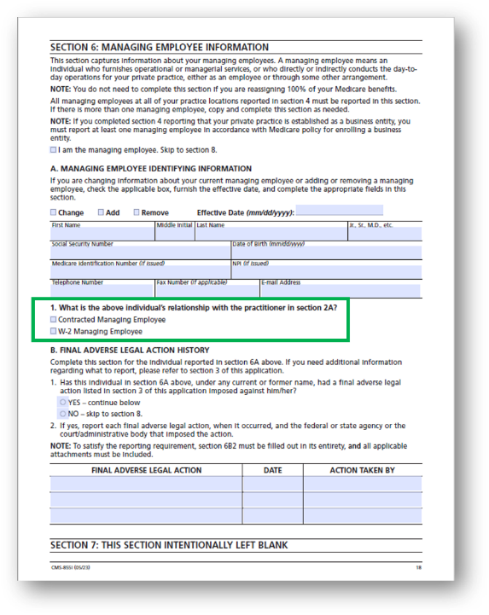
Section 6
Relationship added
W-2
Contracted
Sole owner
Sole proprietor

Slide 14
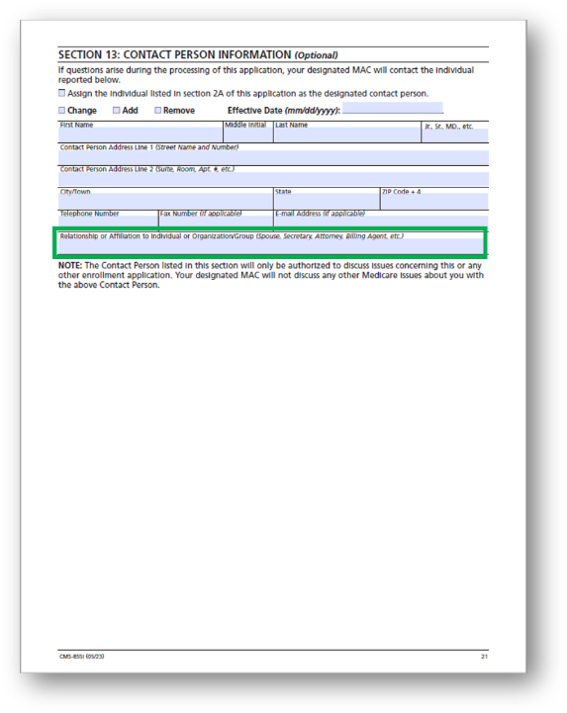
Section 13
Relationship question added

Slide 15
Timeline Reminder

Slide 16
Encore Survey
Let us know what you think!
Take time to complete the survey now
Survey link

Slide 17
Encore Closing
Follow-up Questions
Email wps.gha.education@wpsic.com
Topic: “Encore: New CMS 855I Enrollment Application”
Send claim specific questions to Customer Service

Slide 18
Resources
PECOS: https://pecos.cms.hhs.gov/pecos/login.do#headingLv1
GHA Website: https://www.wpsgha.com/wps/portal/mac/site/enrollment/guides-and-resources/electronic-provider-enrollment
Internet Only Manual 100-08 Chapter 10 §10.2.3.12Physician Assistants: https://www.cms.gov/regulations-and-guidance/guidance/manuals/downloads/pim83c10.pdf

