Slide 1
Ambulance Medical Necessity Denials
October 25, 2023
Thom Ryan, Provider Outreach and Education

Slide 2
Disclaimer
We prepared this education as a tool to assist the provider community. Medicare rules change often. They are in the relevant laws, regulations and rulings on the Centers for Medicare & Medicaid Services (CMS) website.
We will provide responses to questions based on the facts given, but the Medicare rules will determine final coverage.
CMS prohibits recording of the presentation for profit-making purposes.

Slide 3
Agenda
Today we will cover:
Determining medical necessity
Documenting medical necessity
Using the Advance Beneficiary Notice of Noncoverage (ABN)
Goal: Avoid denials for medical necessity during medical review.

Slide 4
Background

Slide 5
Medical Review Denial
Most common ambulance denial is medical necessity
Can cause mileage denial

Slide 6
Medical Review Entities
Who’s Looking?
Office of Inspector General
Ambulance Services - Supplier Compliance with Payment Requirements
Medicare Administrative Contractor
Advanced Life Support (ALS) Ambulance (A0427)
Recovery Audit Contractor
0154-Non-Emergency Ambulance Services- Advanced Life Support and Basic Life Support: Medical Necessity and Documentation Requirements
0183-Specialty Care Transport: Medical Necessity and Documentation Requirements
Comprehensive Error Rate Testing (CERT) Contractor

Slide 7
Determining Medical Necessity

Slide 8
EMT Assessment
Must show the need for the EMT during the transport
Level of care required
Medical skills
Needed for monitoring
Active in the monitoring
Not just a protocol, state, or local requirement

Slide 9
Air Versus Ground
Document the following:
Medical need demonstrated by the EMT assessment
Why is air the safest way to transport?
How long will it take?
If longer than ground transport, why is this the best transport for the patient?

Slide 10
Medical Necessity Errors
Air transport showing ground is medically necessary
Documentation shows another means of transport is safe
Not available due to time of call
Documentation does not support leaving a facility for transport to another facility
Mental health transport
Assessment does not support medical necessity
Dispatch to obvious death
Patient reports no problems, but family wants transport from Skilled Nursing Facility to Hospital

Slide 11
Medical Necessity Questions

Slide 12
Documenting Medical Necessity

Slide 13
EMT Assessment
Include as much information as possible:
Patient’s on-scene complaint
Saw
Shapes and sizes
Hear
Breathing
Smelled
Alcohol or other drugs
Feel
Alignment
Why the EMT is medically needed?

Slide 14
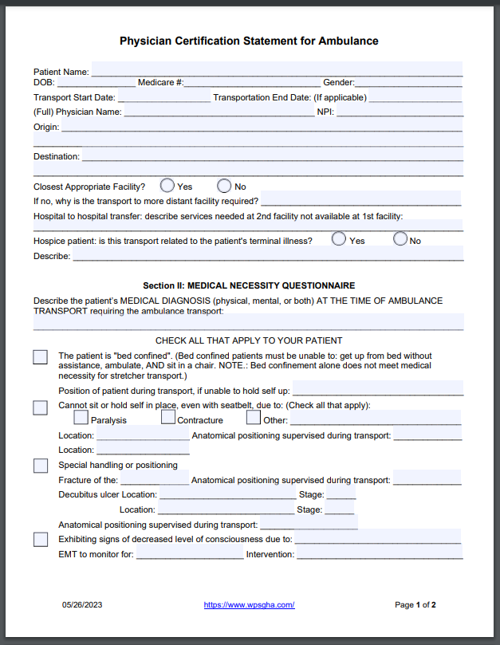
Physician Certification Statement (PCS)
Order for ambulance service
Add support to the reason and areas assessed
Does not prove medical necessity
Sample Physician Certification Statement (PCS) for Ambulance

Slide 15
Documentation Errors
What is wrong with the documentation?
Paramedic signature was not on trip report
Beneficiary or representative signature not obtained prior to billing
No documented attempts
Documentation shows 2 one-way trips versus a round trip
Applies to inpatient
Miles in documentation do not support miles billed
Documented 21 miles
Billed 34 miles

Slide 16
Documentation Questions

Slide 17
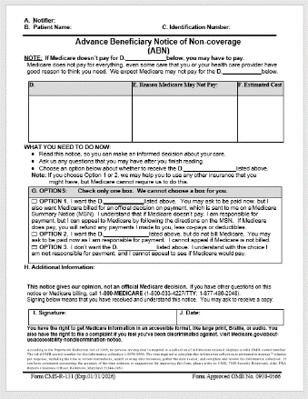
Advance Beneficiary Notice of Noncoverage (ABN)

Slide 18
Used to Change Patient Liability
Medical necessity downgrade
Informs the patient they may be financially responsible
Medicare Claims Processing Manual, Chapter 30, Section 50.2, number 1
§1862(a)(1) of the Social Security Act (SSA)
Not reasonable and necessary

Slide 19
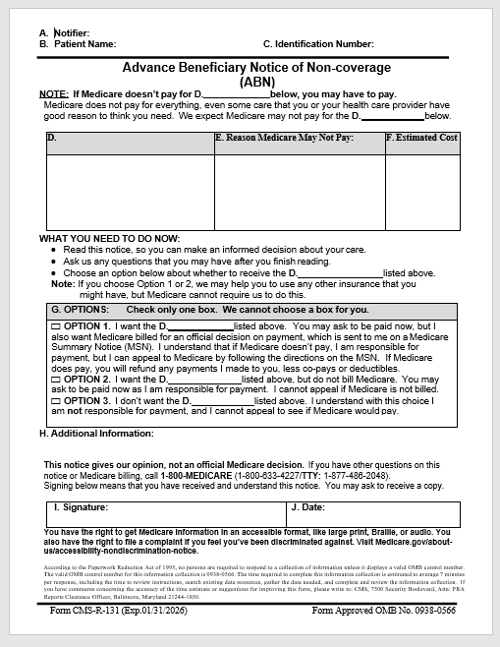
Mandatory Use
Complete the entire form
A through F – ambulance supplier
G – patient’s choice
H – optional
I & J – patient signs and dates

Slide 20
Optional Use
Not medically necessary
Medicare Claims Processing Manual, Chapter 30, Section 50.2.1
“Care that fails to meet the definition of a Medicare benefit as defined in §1861 of the Social Security Act”
1861(s)(7) Ambulance service where the use of other methods of transportation is contraindicated by the individual’s condition, but only to the extent provided in regulations

Slide 21
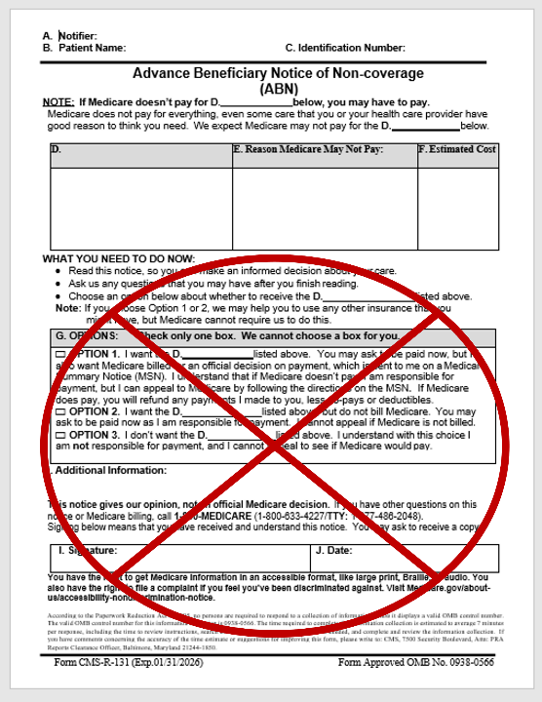
Complete the top
Complete A through F
Stop after the chart for services containing the estimated cost

Slide 22
Scenarios
Should the Emergency Medical Technician (EMT) give an ABN? What does the EMT find during their assessment?
Patient is at a nursing home, and they call for transport due to blood in urine at 3 am
Patient needs a surgery at a local hospital. EMT arrives to find the patient walking and stating they are ready
Doctor orders fixed wing Air Ambulance
EMT arrive to transport to the plane

Slide 23
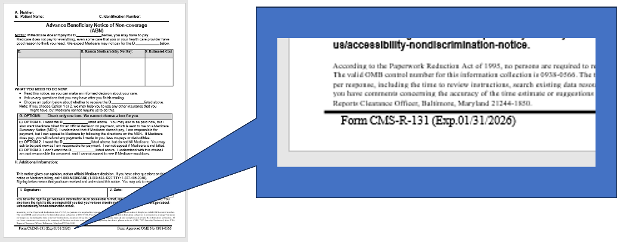
Footer Date
Current version dated 1/31/2026

Slide 24
Wrap-up Questions

Slide 25
CMS Resources
Ambulance Fee Schedule & ZIP Code Files
Ambulance Services Center
Ambulance Open Door Forum
Medicare Benefit Policy Manual, Chapter 10 - Ambulance Services
Medicare Claims Processing Manual, Chapter 15 - Ambulance
Prior Authorization and Pre-Claim Review Initiatives
Revision of SNF CB Edits for Ambulance Services Rendered to Beneficiaries in a Part A Skilled Nursing Facility Stay

Slide 26
WPS Resources
Ambulance Documentation Requirements
Ambulance Statutory and Billing Requirements
Billing Medicare for Transports Decision Tree
Medicare Ground Ambulance Data Collection System (GADCS)
Professionals Ordering Ambulance Services Checklist
Under Arrangement Agreements - Skilled Nursing Facility (SNF) Consolidated Billing
Prior Authorization for Repetitive, Scheduled Non-Emergent Ambulance Transport (RSNAT)

Slide 27
Your Goal is Our Success

