Slide 1
Correct Billing for Physicians and Critical Access Hospitals
September 2023

Slide 2
Disclaimer
We prepared this education as a tool to assist the provider community. Medicare rules change often. They are in the relevant laws, regulations and rulings on the Centers for Medicare & Medicaid Services (CMS) website.
We will provide responses to questions based on the facts given, but the Medicare rules will determine final coverage.
CMS prohibits recording of the presentation for profit-making purposes.

Slide 3
Acronyms
CAH – Critical Access Hospital
MAC – Medicare Administrative Contractor
MLN – Medicare Learning Network
MPFS – Medicare Physician Fee Schedule
NPP – Non-Physician Practitioner
OIG – Office of Inspector General
PECOS – Provider Enrollment, Chain and Ownership System

Slide 4
Agenda and Objectives
Define Method II reimbursement
Understand when separate payment is appropriate
Summarize OIG audit and report
Identify and refund improper payments
Develop process improvements to prevent errors
Explore resources

Slide 5
Payment for Outpatient CAH Services
Standard (Method I)
Optional (Method II)
Election remains until terminated by CAH
Medicare Claims Processing Manual, Chapter 4, Part B Hospital
Section 250, Special Rules for Critical Access Hospital Outpatient Billing

Slide 6
Standard (Method I)
Hospital
Physician/NPP
Facility services
101% of reasonable cost
UB-04 or 837I
Professional services
Fee schedule
CMS-1500 or 837P

Slide 7
Optional (Method II)
Hospital
Physician/NPP
Facility services
101% of reasonable cost
UB-04 or 837I
Professional services
115% of MPFS facility rate
If billing rights reassigned
Professional services
Fee schedule
CMS-1500 or 837P
Unless billing rights reassigned

Slide 8
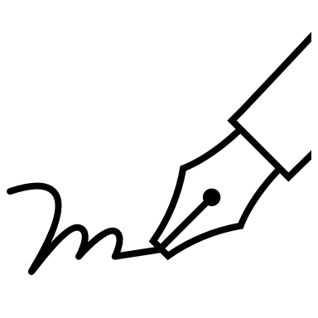
Reassigning Billing Rights
Practitioner chooses to reassign or bill independently
Regardless of CAH Method II election
Complete 855R to reassign billing rights to CAH
Practitioner will not bill for services provided in CAH
Signed attestation on file at MAC and CAH

Slide 9
OIG Audits CAH and Practitioner Claims
Discovered during survey work on Part B claims
CAHs paid for professional services
Practitioners paid for same services
OIG decision to perform audit
Determine if payments complied with Federal guidelines

Slide 10
Details of Audit Period
March 1, 2018 – February 28, 2021
40,026 claims
20,013 from CAHs
20,013 from physicians/NPPs
CAHs received $1,000,000
Practitioners were paid $872,858

Slide 11
What OIG Found
Report A-06-21-05003
Not all services complied with Federal requirements
Only one claim was correct for each date of service
MACs paid providers $907,438
Beneficiaries were responsible for $281,321

Slide 12
CAH Findings
CAHs billed and were paid for professional fees when billing rights were not reassigned
12,156 claims
$331,448 paid inappropriately

Slide 13
Physician/NPP Findings
Professionals who had reassigned their benefits billed and were paid by Medicare
7,857 claims
$575,900 paid inappropriately

Slide 14
Reasons and Reminders
Lack of edits to prevent and detect duplicate claims for:
Same date of service
Same beneficiary
Same procedure
CAH may bill professional services if:
Method II elected
Physician/NPP reassigns billing rights
Physician/NPP cannot bill for outpatient services in CAH
If billing rights are reassigned

Slide 15
Resources
Medicare Learning Network
Information for Critical Access Hospitals, MLN006400
Rural Providers and Suppliers Billing, MLN006762
CMS website
Critical Access Hospitals Center

Slide 16
Working Together
Physician or NPP reassignment of benefits to CAH
Deliberate choice by the provider
855R Reassignment of Medicare Benefits
Provider Enrollment, Chain and Ownership System
Attestation on non-billing

Slide 17
Separate Practices
Professionals may have separate practices
Submission of CAH patient claims comes through the CAH only
Separately submit non-CAH patients

Slide 18
Self-Audit
Examine your processes
Have you reassigned benefits to the CAH?
Have you billed for services for patient registered with the CAH?
Did the professional reassign benefits?
Have you billed for those professional services?
Have you collected deductible and coinsurance from the patient following incorrect billing?
Make changes to internal workflows to prevent future incorrect billing

Slide 19
Refunds
Your self-audits should go back at least four years
Determine correct billing
If incorrect
Determine who should refund
CAH
Professional
Refund
Medicare
Patient

Slide 20
Overpayment Return Instructions
Unsolicited Voluntary Refunds
Paper
Use correct forms
Identify specific claims
Make check to “WPS” or “Medicare”
Electronic
Submit for each specific claim
Medicare refunds > eRefund Entry in portal
YouTube Overpayment Playlist

Slide 21
False Claims Act
Laws Against Healthcare Fraud
Knowingly and willingly
Actual knowledge
Deliberate ignorance or reckless disregard
Signing the 855R or using an electronic signature in PECOS attests to your understanding
Failure to return overpayment
Within 60 days of overpayment identification

Slide 22
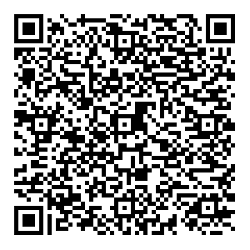
Survey
Let us know what you think!
Take time to complete the survey now.
Survey link

Slide 23
Closing
Follow-up Questions
Email wps.gha.education@wpsic.com
Topic: “Encore: Correct Billing for Physicians and Critical Access Hospitals”
Send claim specific questions to Customer Service
Notes:
.

