Slide 1
Office Services Documentation
November 2023

Slide 2
Disclaimer
We prepared this education as a tool to assist the provider community. Medicare rules change often. They are in the relevant laws, regulations and rulings on the Centers for Medicare & Medicaid Services (CMS) website.
We will provide responses to questions based on the facts given, but the Medicare rules will determine final coverage.
CMS prohibits recording of the presentation for profit-making purposes.

Slide 3
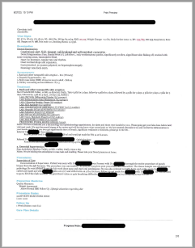
Documentation Example 1

Slide 4
Example 1 History

Slide 5
Example 1 Medications

Slide 6
Example 1 Past, Family, Social History

Slide 7
Example 1 Exam

Slide 8
Example 1 Assessment and Treatment

Slide 9
Example 1 Procedure

Slide 10
Example 1 Findings
Problem Level – High
Data – Moderate
Risk – Moderate
Procedure Code 99214 with Modifier 25

Slide 11
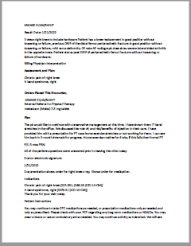
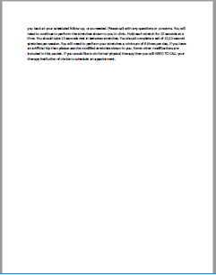
Example 2

Slide 12
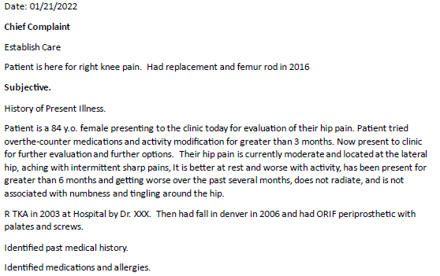
Example 2 History

Slide 13
Example 2 Exam

Slide 14
Example 2 Data

Slide 15
Example 2 Assessment

Slide 16
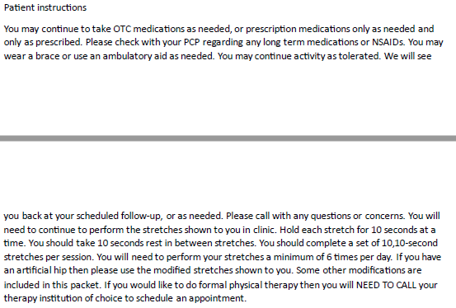
Example 2 Plan

Slide 17
Example 2 Findings
Problem level – Low
Data level – Moderate
Risk level – Moderate
99204
Provider reported time as 30 – 44 minutes
99203

Slide 18
Questions

Slide 19
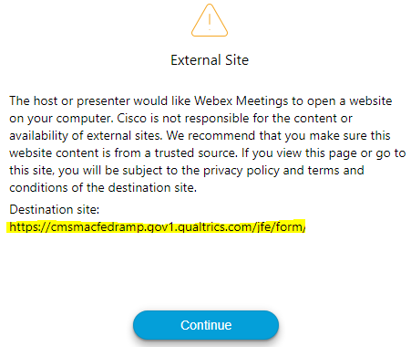
Survey
Let us know what you think!
Take time to complete the survey now.
QR code
Survey link in chat
Redirect after closing webinar

Slide 20
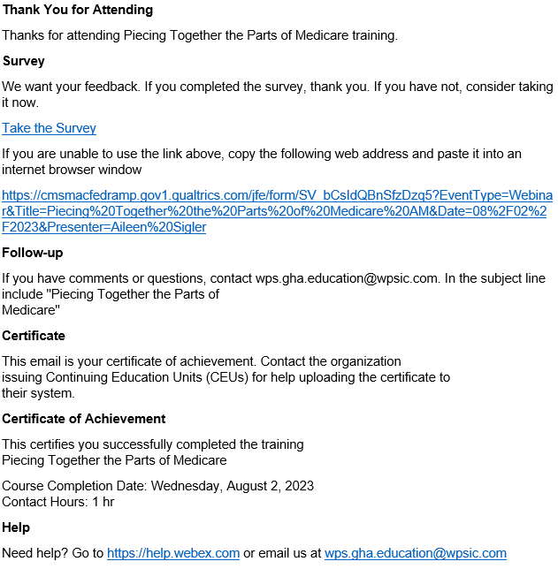
Proof of Attendance
Complete survey
Email contains contact hours
From messenger@webex.com
Check Junk or Spam folders
Add to safe sender list

Slide 21
Closing
Follow-up Questions
Email wps.gha.education@wpsic.com
Topic: 2023 11 02 E/M: Office Documentation Review
Submit by 11/12/203 at 12:00 P.M. CT
Send claim specific questions to Customer Service

Slide 22
You Rock!

