Slide 1
Required Documentation for Annual Wellness Visits

Slide 2
Disclaimer
We prepared this education as a tool to assist the provider community. Medicare rules change often. They are in the relevant laws, regulations and rulings on the Centers for Medicare & Medicaid Services (CMS) website.
We will provide responses to questions based on the facts given, but the Medicare rules will determine final coverage.
CMS prohibits recording of the presentation for profit-making purposes.

Slide 3
Acronyms
ADL Activities of Daily Living
CNS Clinical Nurse Specialist
DDD Degenerative Disc Disease
DO Doctor of Osteopathy
HTN Hypertension
HRA Health Risk Assessment
IADL Instrumental Activities of Daily Living
OSA Obstructive Sleep Apnea
MD Doctor of Medicine
NP Nurse Practitioner
PA Physician Assistant
PND Paroxysmal Nocturnal Dyspnea
ROM Range of Motion
SOB Shortness of Breath
YO Year Old
YR Year

Slide 4
Agenda

Slide 5
Annual Wellness Visit (AWV)
Procedure code: G0439
A visit to develop/update a Personalized Prevention Plan (PPP) and perform a Health Risk Assessment (HRA)
The visit is performed once ever 12 months
There is a minimum about of information that needs to be collected

Slide 6
Documentation Requirements
Documentation Requirements

Slide 7
Documentation
Past medical and surgical history
Current medications and supplements
Review of family history
Weight OR waist circumference
Blood pressure
Routine measurements

Slide 8
Health Risk Assessment
Demographic data
Health status-self assessment
Psychosocial risks
Behavioral risks
ADLs
IADLs

Slide 9
Other Forms of Documentations
Providers/suppliers
Cognitive screening
Preventative screening schedule
Risk factors
Health advice

Slide 10
Additional Documentation Requirements
Visit must be preformed and signed by one of the following qualified professionals
MD or DO
PA, NP, CNS
Allowable medical professional

Slide 11
Documentation Review

Slide 12
Chart 1 Health Risk Assessment Example
Demographic Data: 79 yo Caucasian female (no ethnicity listed)
Health Status Self-Assessment: Presents for AWV, follow up to 1 yr ago eye bleed, hearing loss and right sided headaches from HTN.
At this time: No blurred vision, chest pain, headaches, malaise/fatigue, neck pain, orthopnea, palpitations, PND, SOB or sweats.
Active problems: Hypothyroidism, dyslipidemia, osteoarthrosis, impaired fasting glucose, HTN, lumbar stenosis, DDD of lumbar, anxiety, neural foraminal stenosis of cervical spine, obese, OSA
Psychosocial Risks: Anxiety, stressful job (getting ready to retire), married, no listed social determinants of health, no acute distress, positive for agitation and decreased concentration
Behavior Risks: No tobacco/vaping, minimal alcohol, no drugs, no sexual activity due to drug use, caffeine use, 100% seat belt user, ambulatory, no listed social determinants of health, negative behavior problems including confusion, dysphoric mood, hallucinations, self-injury, sleep disturbances and suicidal ideation
ADLs: Normal ROM. Patient reports no reported issues with toileting, dressing, feeding independently
IADLs: Patient reports no issues with meal prep, transportation, taking medications, handling finances

Slide 13
Chart 2 – Health Professional Example
History of present illness written on physician letterhead
Physician listed as Doctor of Osteopathy (Doctor 1)
No signature
Next to HPI there is a different name from physician, no credentials (Person 1)
Next to the history there is another name, different than physician, no credentials (Person 2)
Review of systems and physical have the name (Person 1) next to them
Only signature listed is by (Person 1)

Slide 14
Chart 3 – Multiple Items Missing
90-year-old client who had hysterectomy in past and is not currently pregnant
Frail elderly female listed in physical exam
No other demographic info of race/ethnicity
No documentation of other providers or suppliers listed
No documentation to support that the patient is not associated with other providers or suppliers

Slide 15
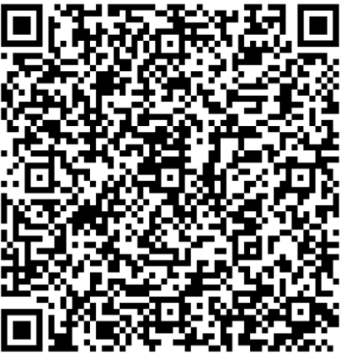
Encore Survey
Let us know what you think!
Take time to complete the survey now.

Slide 16
Encore Closing
Follow-up Questions
Email wps.gha.education@wpsic.com
Topic: “Encore: Required Documentation for Annual Wellness Visits”
Send claim specific questions to Customer Service

