Slide 1
Common Mistakes with the Skilled Nursing Facility (SNF) Patient Driven Payment Model (PDPM)

Slide 2
Disclaimer
We prepared this education as a tool to assist the provider community. Medicare rules change often. They are in the relevant laws, regulations and rulings on the Centers for Medicare & Medicaid Services (CMS) website.
We will provide responses to questions based on the facts given, but the Medicare rules will determine final coverage.
CMS prohibits recording of the presentation for profit-making purposes.

Slide 3
Acronyms
ADL – Activities of Daily Living
BIMS – Brief Interview for Menta
CMG – Case-Mix Group
HIPPS – Health Insurance Prospective Payment System
IPA – Interim Payment Assessment
MDS – Minimum Data Set
NTA – Non-Therapy Ancillary
OT – Occupational Therapy
PDPM – Patient Driven Payment Model
PHQ – Patient Health Questionnaire
PPS – Prospective Payment System
PT – Physical Therapy
RUG-IV – Resource Utilization Group, Version IV
SLP – Speech Language Pathology
SNF – Skilled Nursing Facility

Slide 4
Patient Driven Payment Model (PDPM)
What is it and how did it start?

Slide 5
PDPM
Case-Mix Group (CMG) classification system for SNF Part A patients
Replaced the Resource Utilization Group (RUG) Version IV
PDPM eliminated incentives to furnish unnecessary therapy services
Improves accuracy and appropriateness of SNF payments
Classifies patients into payment groups based on specific data-driven patient characteristics
Reducing administrative burden on SNF providers

Slide 6
How Rates are Calculated

Slide 7
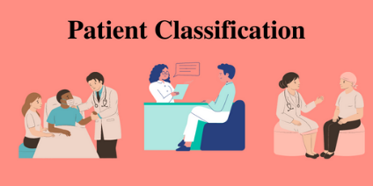
Patient Classification
Each patient classified into a group for each of the five case-mix adjusted components:
PT
OT
SLP
Nursing
NTA

Slide 8
Classification into Payment Group
Six payment components to derive payment
Five are case-mix adjusted
One non-case-mix adjusted component
Different characteristics are used to determine classification into CMG
This Photo by Unknown Author is licensed under CC BY-SA

Slide 9
PDPM Clinical Categories
Major joint replacement/spinal surgery
Orthopedic surgery
Non-orthopedic surgery and acute neurologic
Other orthopedic
Medical management
Acute infections
Cardiovascular and coagulations
Cancer
Pulmonary
Acute neurologic

Slide 10
Functional Score
Coded in section GG of the MDS
Assessment of ADLs in first 3-days
Eating
Oral hygiene
Toileting hygiene
Sit to lying
Lying to sitting on bedside
Sit to stand
Chair/bed-to-chair transfer

Slide 11
The PDPM Components

Slide 12
Patient Classification Components
Each component utilizes different criteria as the basis for patient classification
PT: Clinical Category, Functional Score
OT: Clinical Category, Functional Score
SLP: Presence of Acute Neurologic Condition, SLP-related Comorbidity or Cognitive Impairment, Mechanically-altered Diet, Swallowing Disorder
Nursing: Same characteristics as under RUG-IV
NTA: NTA Comorbidity Score

Slide 13
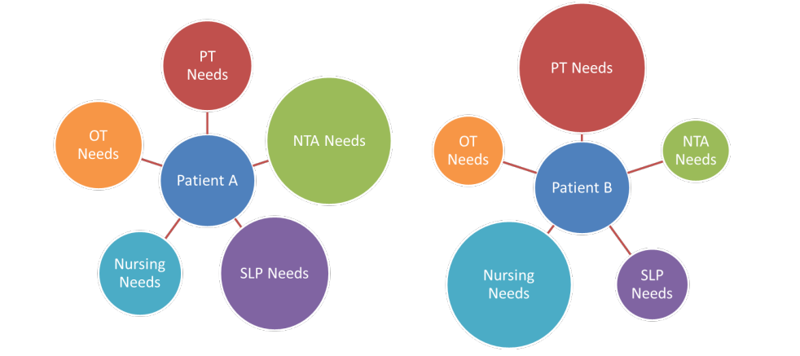
Effect of PDPM
Improves payment accuracy
Encourages more patient-driven care model

Slide 14
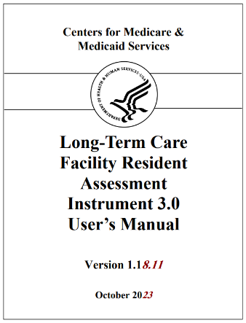
How the PDPM Category is Established
Completion of MDS
Establishes a PDPM category for Medicare Part A payment
Must be submitted to state repository

Slide 15
SNF PPS Assessments
Three assessments under PDPM
5-Day*
Interim Payment Assessment (IPA)**
PPS Discharge Assessment*
Denotes required *
Denotes optional **

Slide 16
Determinants of Payment on MDS Assessment
Physical and Occupational Therapy
Primary reason for SNF care or PDPM diagnosis (I00200B)
Functional status coded on section GG
Variable per diem adjustment rate
Speech Therapy
Primary reason for SNF care or PDPM diagnosis (I00200B)
Cognitive Status (BIMS score section C)
Presence of swallowing disorder or mechanically altered diet (section K)
Other SLP-related comorbidities (section I)

Slide 17
Continued Determinants of Payment
Nursing
Clinical information from SNF stay
Functional status (section GG)
Extensive services received – (section O) i.e., tracheostomy, ventilator and isolation
Presence of depression (section D, PHQ)
Restorative nursing (section O)

Slide 18
Non-Therapy Ancillary Determinants of Payment
NTA
Comorbidities present (section I)
Extensive services (section O) Extensive services received – (section O) i.e., tracheostomy, ventilator and isolation
Variable per diem adjustment rate

Slide 19
Calculations
For NTA component
Each diagnosis has a corresponding score which is multiplied to the federal NTA case mix index
The higher the score the higher the NTA rate
All PDPM components are assigned a score to multiply to the federally assigned case mix index group
After PDPM is determined, the sum of the PDPM component rates is added to the fixed non-case mix rate which determines rate for the entire skilled nursing stay

Slide 20
Revising the Calculation
If there is a change in the patient’s condition which requires additional skilled services
IV medications
MDS nurse will complete the IPA
Capture the changes
Increases daily rate

Slide 21
PDPM Considerations for MDS Nurse
Gather hospital information before admission
Formulate primary or principal diagnosis
Complete section GG by rehab and nursing
Gather interdisciplinary team documentation

Slide 22
Common PDPM Mistakes

Slide 23
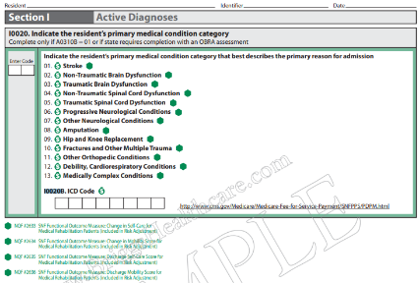
Diagnosis Doesn’t Support SNF Stay
I0020 has 13 different medical condition categories
Which one that best represents the patient category?
I0020B
Enter primary ICD-10 code, including the decimal of the primary diagnosis of the SNF patient
SNF PPS Payment Model Research

Slide 24
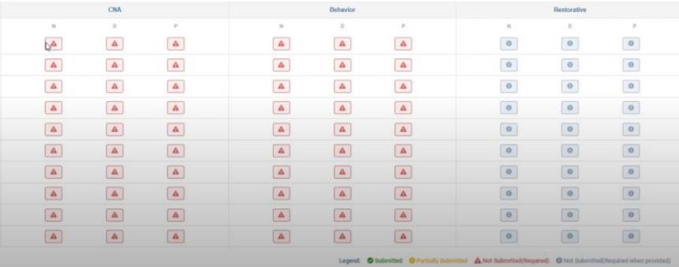
Failure to Collect Relevant ADL Data
Make sure you are capturing across all shifts

Slide 25
Not Understanding the Non-Therapy Ancillary (NTA)
Related to physician diagnosis
Look at SNF patients on a global level
SNF physicians should be looking at overall management of the patient’s health
Query the physician for diagnosis clarification
Especially with unspecified codes

Slide 26
Not Querying the Physician Diagnosis
Was the diagnosis documented by the physician in last 60 days?
During the 7-day lookback, active diagnoses must have direct relationship to residents:
Current functional status
Cognitive status
Mood or behavior status
Medical treatment
Nursing monitoring or
Risk of death

Slide 27
Insufficient Charting
Perform an initial chart review when assessing new admissions to become familiar with any NTA comorbidities
Failure to gain and document such information could impact care and reimbursement
Caregivers are less aware of problems
Accurate reimbursement comes from accurate documentation

Slide 28
Not Reviewing Documentation
Missing documentation or lack of documentation will negatively impact PDPM reimbursement
MDS coordinator must ensure documentation is accurate and complete

Slide 29
Not Accurately Scoring NTA Component
NTA score ranges
0 – NF
1-2 – NE
3-5 – ND
6-8 – NC
9-11 – NB
12+ - NA
There are 50 conditions that contribute to points

Slide 30
That’s a Wrap
We provided you with essential information and reminders to improve your understanding of PDPM by:
Reviewing introduction of PDPM
Highlighting the importance of accurate documentation
Learning how to identify pitfalls or mistakes

Slide 31
Thank You

