Slide 1
Ambulance Mileage
Understanding the rules

Slide 2
Disclaimer
We prepared this education as a tool to assist the provider community. Medicare rules change often. They are in the relevant laws, regulations and rulings on the Centers for Medicare & Medicaid Services (CMS) website.
We will provide responses to questions based on the facts given, but the Medicare rules will determine final coverage.
CMS prohibits recording of the presentation for profit-making purposes.

Slide 3
Webinar Information
Here’s what you need about today's live event!
Questions and comments
Use the Chat feature
We will answer as time permits
We will create a follow-up document with unanswered questions
10-days to complete the course (7/28/23)
Survey
Follow-up questions

Slide 4
Agenda

Slide 5
Payable Mileage
Medicare considers:
Appropriate Facility
Bed
Staff
Equipment
Locality
5 miles difference from the point of pick-up
Change: data driven, no set miles

Slide 6
Procedure Codes
Medicare considers these procedure codes:
A0425: Ground mileage
A0435: Fixed wing air mileage
A0436:Rotary wing air mileage
Non-covered mileage
A0888: Beyond a Medicare covered destination

Slide 7
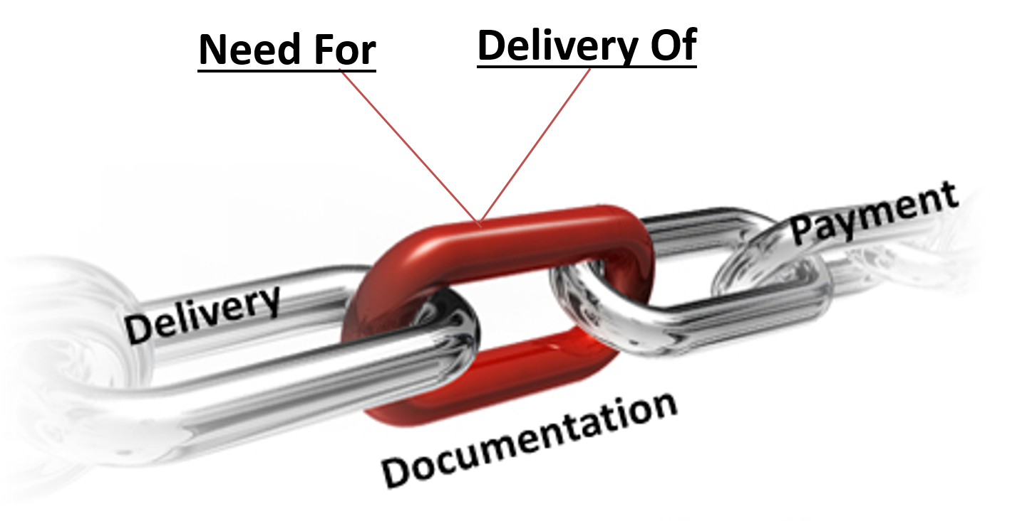
Transport Need
Support the use of the transport at the level provided

Slide 8
Documentation
Document the mileage
Odometer mileage
Electronic method
Document the reason for passing a facility
Patient or provider preference
Missing a required element
Weather, traffic, or longer transport time

Slide 9
Physician Certification Statement
Ambulance order
Document the physician’s destination preference
Mileage maybe be fully or partially payable

Slide 10
Submitting Modifiers
Origin and destination modifiers
Not on A0888

Slide 11
Error Example 1
Mileage for the wrong level
CERT review found the ground transport is medically necessary
Mileage downgrade
Air to ground
Number of ground miles

Slide 12
Error Example 2
Mileage not billed correctly
Total transport documented 26 miles
NAF 12 miles
Provider request to further facility
Billed
A0425 – 26 miles
A0888 – 14 miles

Slide 13
Error Example 3
Patient deceased
Dispatch to possible heart attack
EMT evaluation show the patient died days ago
Billed
A0425 with QL

Slide 14
Error Example 4
Transport to the nursing facility where the patient is a resident
Medically necessary transport for skilled care
Doctor’s physician certification statement (PCS) for transport to facility where the patient lives
Error
A closer Skilled Nursing Facility can provide the care
All miles billed with A0425

Slide 15
Action
Review mileage
American Hospital Directory (AHD)
Review reason for transport
Review patient or provider choice
File an appeal when allowed
MA01: Alert – If you do not agree with what we approved for the service, you may appeal our decision.

Slide 16
Questions
Follow-up questions email: wps.gha.education@wpsic.com
Email subject line “Encore: Ambulance Mileage”

Slide 17
Survey
Let us know what you think!
Take time to complete the survey now.
Survey

Slide 18
Resources
Important websites
WPS website
WPS Claims web page
WPS Ambulance Documentation Requirements
WPS Ambulance Statutory and Billing Requirements
CMS Internet Only Manual
Medicare Benefit Policy Manual, Chapter 10
Medicare Claims Processing Manual, Chapter 15
CMS Ambulances Services Center

