Slide 1
Appeals Tips and Reminders
Avoiding Common Errors

Slide 2
Disclaimer
We prepared this education as a tool to assist the provider community. Medicare rules change often. They are in the relevant laws, regulations and rulings on the Centers for Medicare & Medicaid Services (CMS) website.
We will provide responses to questions based on the facts given, but the Medicare rules will determine final coverage.
CMS prohibits recording of the presentation for profit-making purposes.

Slide 3
Webinar Information
Here’s what you need about today's live event!
Questions and comments
Use the Chat feature
We will answer as time permits
We will create a follow-up document with unanswered questions
10-days to complete the course (9/22/23)
Survey
Follow-up questions

Slide 4
Agenda

Slide 5
Definitions

Slide 6
Redetermination
Level one Medicare fee-for-service appeal
Completed by the Medicare Administrative Contractor (MAC)

Slide 7
Dismissal
No level one decision
MAC sends a notification letter

Slide 8
Uphold
The MAC agrees with the original decision
Notification sent by letter

Slide 9
Overturn
The MAC disagrees with the original decision
Notification sent by Remittance Advice

Slide 10
Reminders

Slide 11
Appealable Issue
Remittance notice
MA01 - Alert - If you do not agree with what we approved for these services, you may appeal our decision.
Medicare Benefit Policy Manual, Chapter 16 - General Exclusions From Coverage

Slide 12
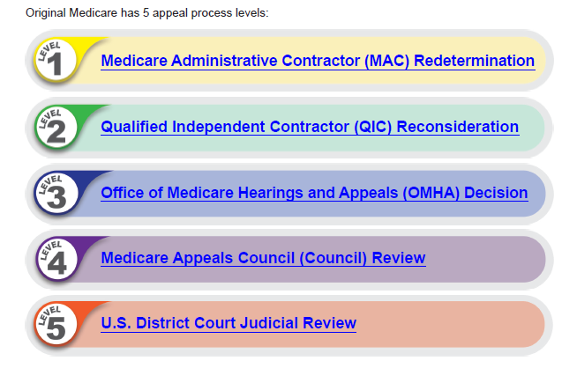
Proper Order
Move through the five levels

Slide 13
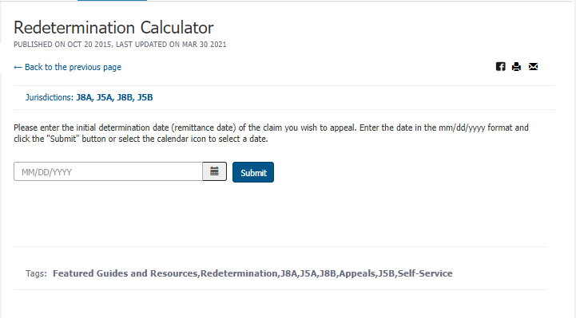
Timeliness
120 days: level one
Remittance notice
Overpayment letter
Redetermination Calculator

Slide 14
Identification
We must identify the following:
The claim or overpayment
Claim number
Remittance notice
Overpayment letter
The patient by name and date of birth
Includes documentation submitted

Slide 15
Duplicates
Avoid filing duplicate
Adjustment and redeterminations
Electronic and paper
60 calendar days to decide
No “status” request at 30 days

Slide 16
Prior Authorization
Submit the current Unique Tracking Number (UTN)
Wrong UTN causing the claim denial
Adjust the denied claim
Non affirmed decision and UTN
No appeal rights
Affirmed decision and UTN
Claim denies during claims processing
Appeal rights

Slide 17
Tips

Slide 18
Electronic Request
Secure Portal
All information
Upload supporting documentation
https://www.wpsgha.com/wps/portal/mac/site/login/

Slide 19
Have a Specific Reason
Appeal the reason for denial
Read the letter or remittance
Lack of documentation
Medical necessity
Example
Denial for lack of physician order
Appeal for medical necessity

Slide 20
Medical Review
Respond timely – 45 days
Appeals for lack of documentation required to be sent back
Review entities:
MAC
Recovery Audit Contractor (RAC)
Comprehensive Error Rate Testing (CERT) Contractor

Slide 21
Medically Unlikely Edits (MUEs)
Learn the MUEs and bill two lines
Line on up to the MUE without a modifier
Line two anything above the MUE with a modifier
Modifier 59
Modifier 91
CMS MUE web page

Slide 22
Consider a Modifier
Provides more information
Commonly eliminates the need to file an appeal
Examples
Ambulance origin and destination
Modifier GY
Anatomical modifiers
WPS Modifier Fact Sheets

Slide 23
Overpayment
Include the overpayment request
Explain why you disagree with the request reason
Don’t request on the claim determination
How to Appeal an Overpayment Decision

Slide 24
Resources

Slide 25
YouTube Series
Six videos
Medicare Fee-For-Service Appeals: Just the Basics
Medicare Fee-For-Service Appeals: Level One
Medicare Fee-For-Service Appeals: Level Two
Medicare Fee-For-Service Appeals: Level Three
Medicare Fee-For-Service Appeals: Level Four
Medicare Fee-For-Service Appeals: Level Five

Slide 26
Important Websites
CMS
Internet Only Manual, Medicare Claims Processing Manual, Chapter 29 - Appeals of Claims Decisions
Original Medicare (Fee-for-service) Appeals
WPS
Appeals web page
How to Appeal a Claim Determination
Appeals YouTube Playlist

Slide 27
Survey
Let’s us know what you think!
Complete the Survey

Slide 28
Questions
Follow-up questions email: wps.gha.education@wpsic.com
Subject line: “Encore – Appeals Webinar”
Send claim specific questions to Customer Service

Slide 29
Thanks for attending!
Thanks for attending!

