Slide 1
Facet Joint – Completing the Prior Authorization Request Form

Slide 2
Disclaimer
We prepared this education as a tool to assist the provider community. Medicare rules change often. They are in the relevant laws, regulations and rulings on the Centers for Medicare & Medicaid Services (CMS) website.
We will provide responses to questions based on the facts given, but the Medicare rules will determine final coverage.
CMS prohibits recording of the presentation for profit-making purposes.

Slide 3
Acronyms
IA – Intra-articular
MBB – Medial Branch Block
PA – Prior Authorization
RFA – Radiofrequency Ablation
SI - Sacroiliac
TOB – Type of Bill
UTN – Unique Tracking Number

Slide 4

Objective and Agenda
Importance of submitting necessary and accurate information on the prior authorization request form
  Who is responsible
  Guidance on completing the form
  What supplementary information to include

Slide 5

Goal
Reduce the number of non-affirmed prior authorization requests
Equipping participants with knowledge and tools needed

Slide 6

The Issues
Reviewing requests that do not need to be submitted
Making 100’s of non-affirmed calls
Cannot affirm decisions if we don’t have the necessary information for

Slide 7

Who Prior Authorization Applies To
Facet interventions performed in the outpatient department of a hospital
  Billed on 13X TOB
Does not include
  Critical Access Hospital (CAH)
  Physician office
  Ambulatory Surgical Center (ASC)

Slide 8

Physician’s Office Can Submit for Hospital
Must include all hospital information on the request form
Cannot submit via the provider portal
Affirmation and UTN is for the facility billing
  Not necessary for physician billing

Slide 9
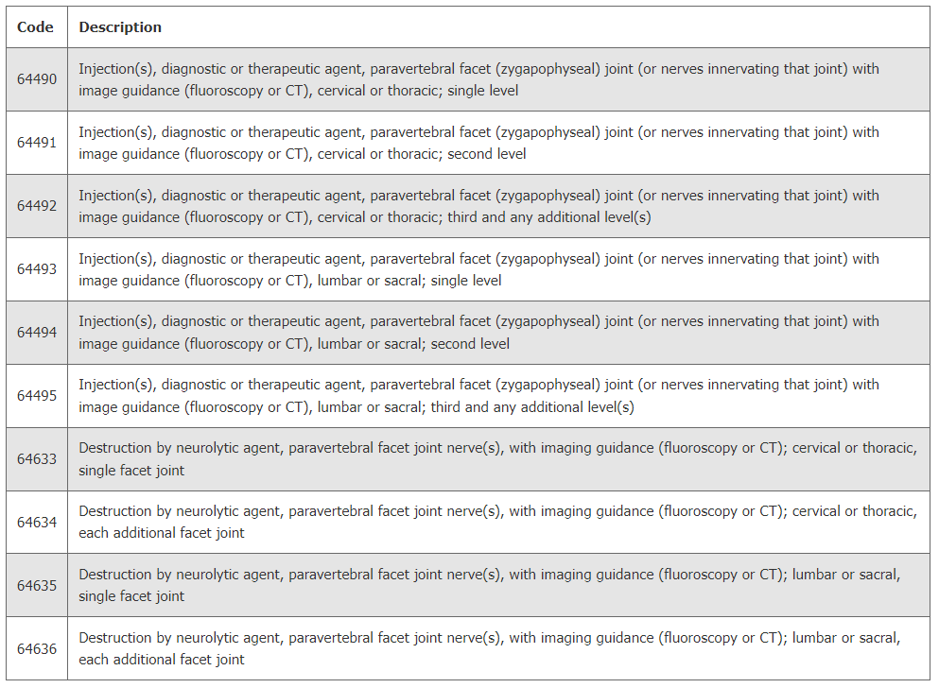

Facet Codes

Slide 10
Synovial Cyst Rupture or Aspiration
CPT code 64999
Not part of the review codes
Does not need PA

Slide 11
Facet Joint vs Sacro-iliac (SI) Joint Injections
Facet (MBB)
SI
Joints occur in pairs along the spine
Cervical and lumbar are most often problematic
Injection directly into the joint or to the path of small nerve which supply sensation
Joint were spine joins hip
Usually radiates distally
Pain usually below L5
Injection into joint itself or area around the joint and ligament

Slide 12
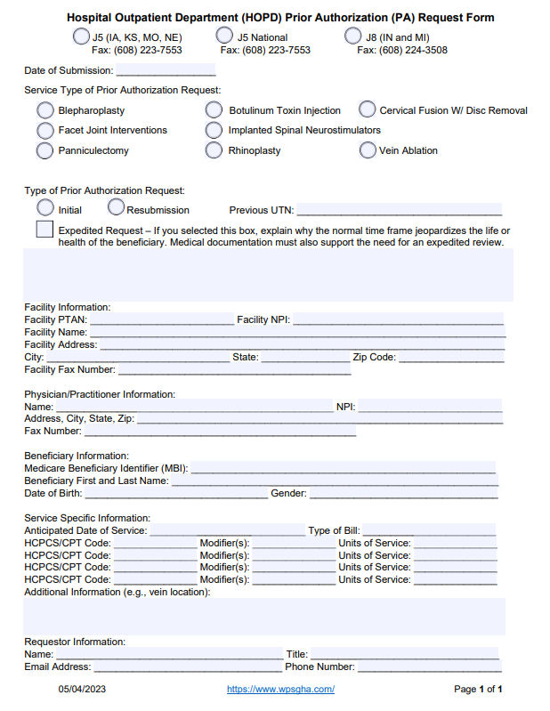
The Request Form

Slide 13

Key Words
Facet technique (MBB, IA, RFA)
Diagnostic vs therapeutic
Treatment number (1st/2nd)
Side (RT/LT)
Level
Axial

Slide 14
Supporting Documentation
Clear indication of what is being requested
History and physical (H/P)
Physician orders and progress notes
Diagnostic test results
Prior procedure records
Pain history to include location, severity and duration
Evidence of failed conservative management
Disability scale rating or a H/P that clearly describes functional disability for each new episode of pain
Medical history records
Signature attestation form, if applicable

Slide 15
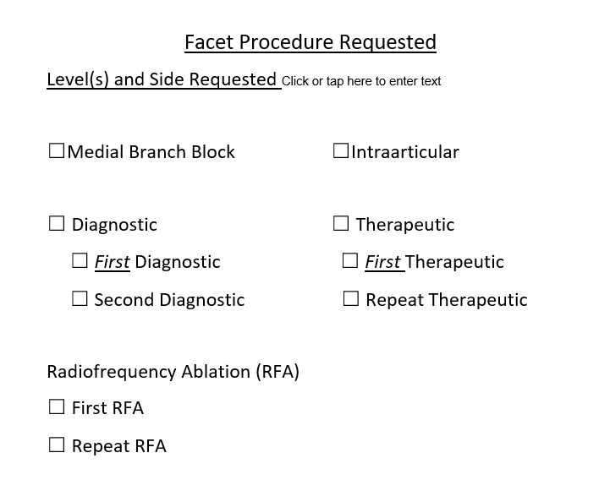
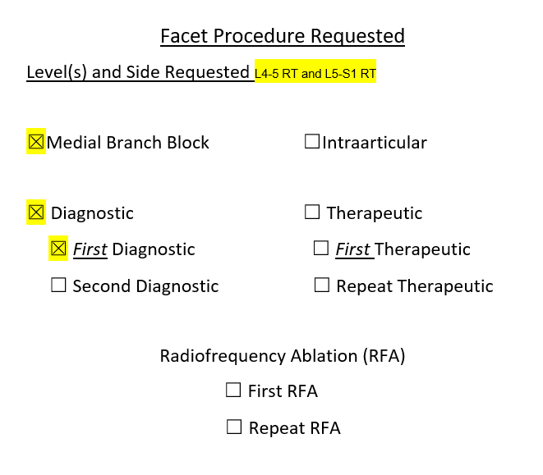
Documentation Examples

Slide 16
Resources
WPS GHA - Medical Review Guides and Resources
Prior Authorization for Facet Joint Interventions
Hospital Outpatient Department (HOPD) Prior Authorization (PA) Request Form
Centers for Medicare & Medicaid Services
Prior Authorization (PA) Program for Certain Hospital Outpatient Department (OPD) Services Operational Guide
Prior Authorization Process for Certain Hospital Outpatient Department (OPD) Services Frequently Asked Questions
Local Coverage Determination
Facet Joint Interventions for Pain Management

Slide 17
Encore Survey
Let us know what you think!
Take time to complete the survey now.
Survey link

Slide 18
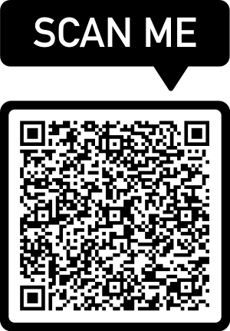
Encore Closing
Follow-up Questions
  Email wps.gha.education@wpsic.com
  Topic: “Encore: Facet Joint – Completing the Prior Authorization Request”
Send claim specific questions to Customer Service

