Slide 1
Common Review Errors: Prior Authorization of Facet Interventions in the Hospital Outpatient Department

Slide 2
Disclaimer
We prepared this education as a tool to assist the provider community. Medicare rules change often and are part of relevant laws, regulations and rulings found on the Centers for Medicare & Medicaid Services (CMS) website. We will provide responses to questions based on the facts given, but the Medicare rules will determine final coverage. CMS prohibits recording of the presentation for profit-making purposes.

Slide 3
Acronyms
CMS Centers for Medicare & Medicaid
HOPD Hospital Outpatient Department
LCD Local Coverage Determination
MAC Medicare Administrative Contractor
PA Prior Authorization
POE Provider Outreach and Education
POS Place of Service
UTN Unique Tracking Number

Slide 4
Objective
This webinar will cover:
A brief review of the prior authorization process
Documentation necessary to submit for prior authorization of facet joint interventions
Common documentation errors for prior authorization of facet joint interventions

Slide 5
Prior Authorization: The Basics
2023 Outpatient Prospective Payment System/Ambulatory Surgical Center Final Rule (CMS-1772-FC)
Effective June 15, 2023, for dates of service July 1, 2023, CMS added facet joint to the process

Slide 6
Who It Applies To
Hospital Outpatient Departments (HOPD)
Type of Bill 13X
POS 19 – off-campus outpatient hospital
POS 22 – on-campus outpatient hospital
Not the physician office

Slide 7
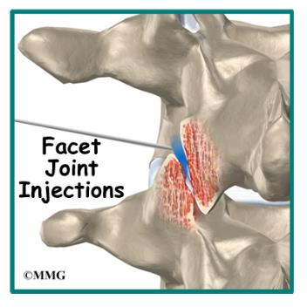
Facet Joint Interventions
Types of procedures
Intraarticular (IA) Facet Joint Injection
Medical Branch Blocks (MBB)
Radiofrequency Ablations (RFA)
Facet Cyst Rupture/Aspiration
Must meet all medically necessary indications in the LCD – L38841

Slide 8
The Codes
64490 : diagnostic or therapeutic, cervical or thoracic; single level
64491: diagnostic or therapeutic, cervical or thoracic; second level
64492: diagnostic or therapeutic, cervical or thoracic; third or any additional levels
64493: diagnostic or therapeutic, lumbar or sacral; single level
64494: diagnostic or therapeutic, lumbar or sacral; second level
64495: diagnostic or therapeutic, lumbar or sacral; third or additional levels
64633: destruction by neurolytic agent, cervical or thoracic, single facet joint
64634: destruction by neurolytic agent, cervical or thoracic, each additional facet joint
64635: destruction by neurolytic agent, lumbar or sacral, single facet joint
64636: destruction by neurolytic agent, lumbar or sacral, each additional facet joint

Slide 9
Facet Documentation Requirements
Include the following documentation with PA requests
History and physical
Diagnostic test results
Pain history to include location, severity and duration
Disability scale rating for each new episode of pain
Medical history records
Physician orders and progress notes
Procedure records
Evidence of failed conservative management
Patient response to prior facet joint interventions, if applicable
Signature attestation form, if applicable

Slide 10
Review Timelines
Initial Submission – 10 business days
Resubmission – 10 business days
Expedited – 2 business days

Slide 11
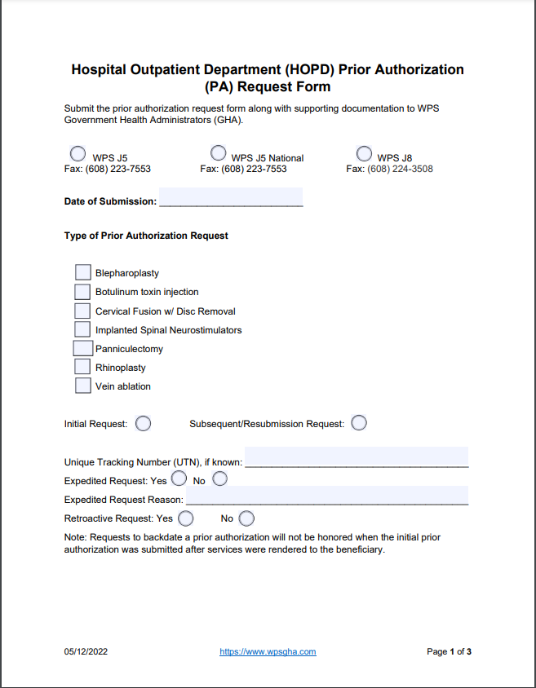
The Request
Used to request PA of service
Complete all components
Can be submitted by hospital or physician

Slide 12
Top Reasons for Non-Affirmed PAR
Support documentation does not include
Axial pain
Disability scale
Description of injection
Include level, diagnostic or therapeutic, number of injection

Slide 13
Axial Pain
Example 1
Example 2
Reports 80% relief of pain in low back and bilateral legs
Able to walk longer distance for 2 weeks but pain returning
Has ongoing axial low back pain
Plan to address axial low back pain with bilateral lumbar medical branch nerve blocks at follow up visit
Patient complains of worsening axial low back pain. That has not been helped with 2 previous epidural injections.

Slide 14
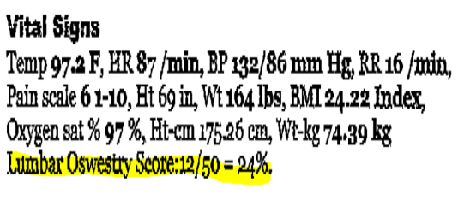
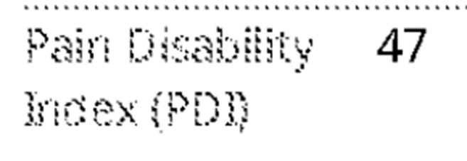
Disability Scale
Example 1
Example 2
Lumbar Oswetry Scale: 12/50= 24%
Pain Disability Index (PDI) 47

Slide 15
Description of Injection: Missing Information

Slide 16
Description of Injection: Example 1

Slide 17
Description of Injection: Example 2

Slide 18
Description of Injection: Example 3

Slide 19
Reasons for Rejection of Prior Authorization Requests
Missing Part A facility PTAN
Part B info entered under Part A facility info
PTAN does not match NPI
Medicare ID number invalid
Submission of CPT code not part of PA program

Slide 20
Resources
Portal Manual for Prior Authorization
Prior Authorization Fax Submission Form
Prior Authorization Operational Guide- CMS
Using Our Website to Locate or Submit a Subsequent Prior Authorization video
Billing and Coding Facet Joint Interventions for Pain Management article
Answers to Questions on Facet Joint Interventions video

Slide 21
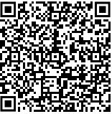
Survey
Let us know what you think!
Take time to complete the survey now.
Scan the QR code or select the Survey link to provide your feedback.

