Slide 1
Excluded Services Modifiers: GY and GX
Presented by Thom Ryan, Provider Outreach and Education

Slide 2
Disclaimer
We prepared this education as a tool to assist the provider community. Medicare rules change often. They are in the relevant laws, regulations and rulings on the Centers for Medicare & Medicaid Services (CMS) website.
We will provide responses to questions based on the facts given, but the Medicare rules will determine final coverage.
CMS prohibits recording of the presentation for profit-making purposes.

Slide 3
Agenda
We will:
Locate the form
Provide instructions on completing the form
Tips and tricks to help you

Slide 4
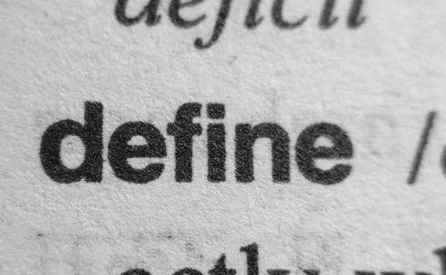
Define

Slide 5
Excluded Services
Not included in Medicare coverage
Law excludes coverage
Never covered
Not based on medical necessity

Slide 6
Patient Information
Medicare & You Handbook
Benefits list
Excluded services
Sent yearly to all households
Website
https://www.medicare.gov

Slide 7
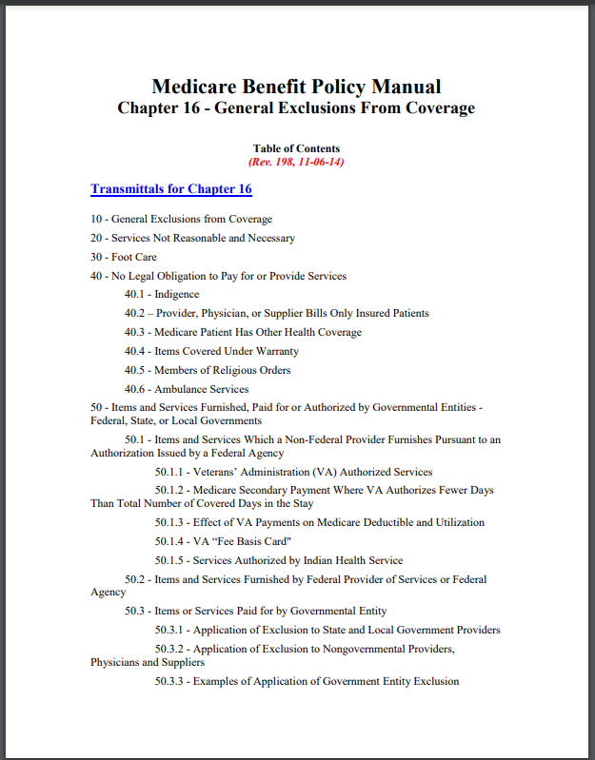
Provider Information
CMS Internet-Only Manuals (IOMs) Publication 100-02 Medicare Benefit Policy Manual, Chapter 16 - General Exclusions From Coverage

Slide 8
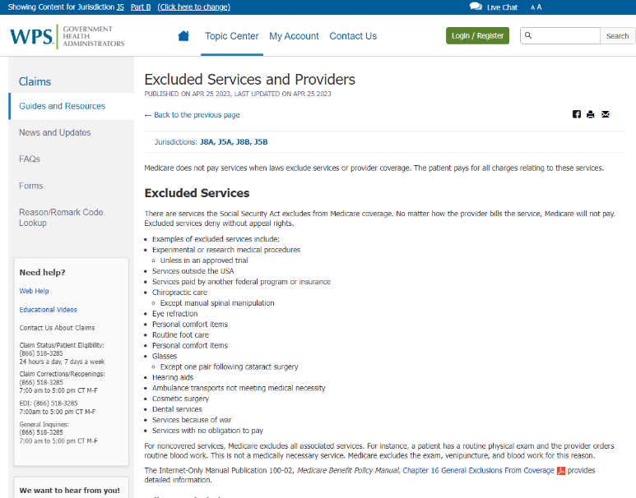
WPS Article
Excluded Services and Providers

Slide 9
Billing

Slide 10
Modifier GY
Append to noncovered service line-item
No Advance Beneficiary Notice of Noncoverage
Can be on multiple lines

Slide 11
Modifier GX
Append to noncovered service line-item
Advance Beneficiary Notice of Noncoverage
Can be on multiple lines

Slide 12
Condition Code 21
Provider deems all services on a claim as non-covered or excluded
The provider needs a denial to bill a Medicare supplemental insurer
Patient request
No line-item modifier

Slide 13
Condition Code 20
Provider deems the Skilled Nursing Facility (SNF) inpatient stay is not medically necessary
Patient requests billing of a non-covered inpatient SNF stay
Medicare reviews the documentation and determines if the stay meets medical necessity
No line-item modifier

Slide 14
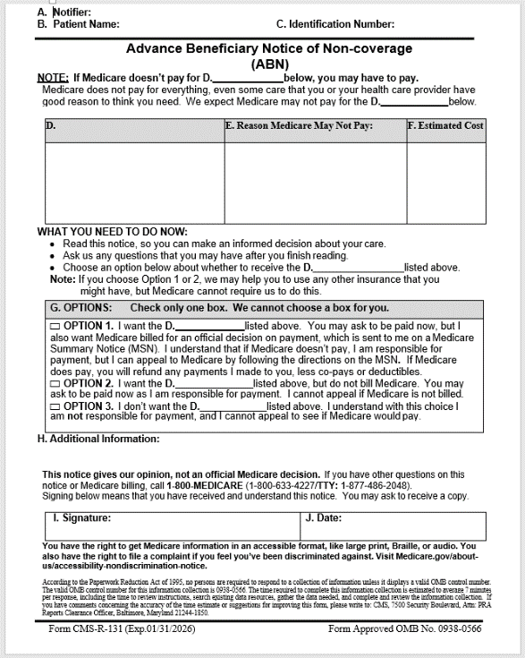
Advance Beneficiary Notice of Noncoverage (ABN)

Slide 15
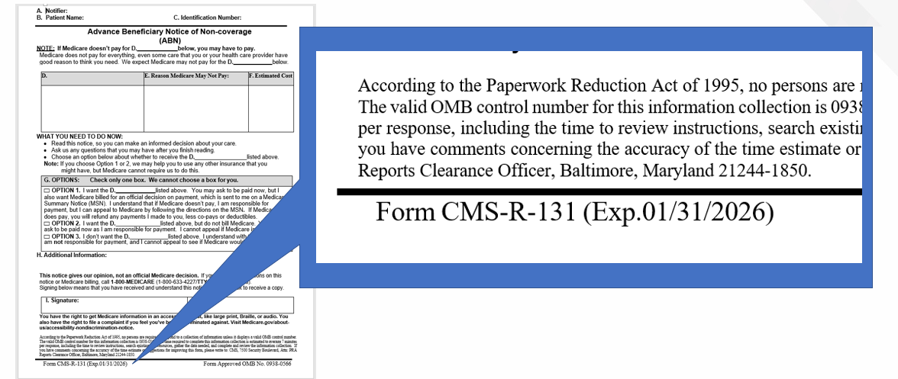
Form Date

Slide 16
Items A through C

Slide 17
Item D

Slide 18
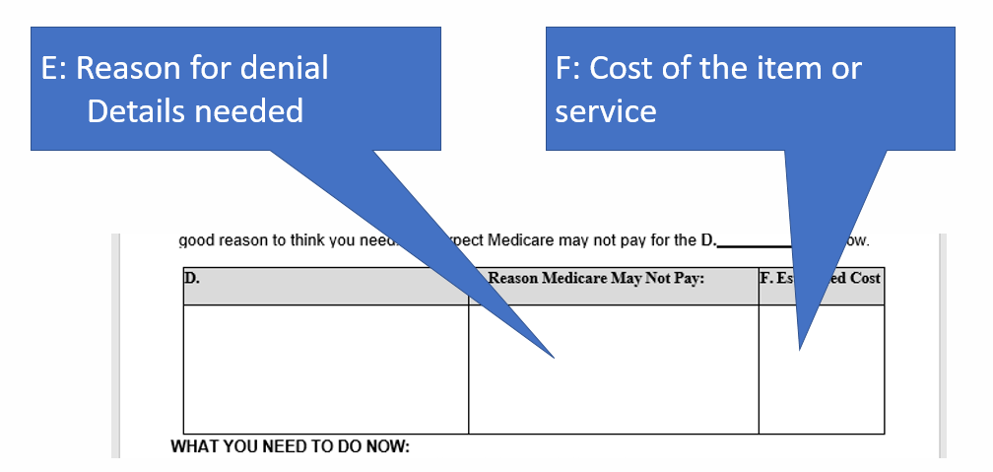
Items E and F

Slide 19
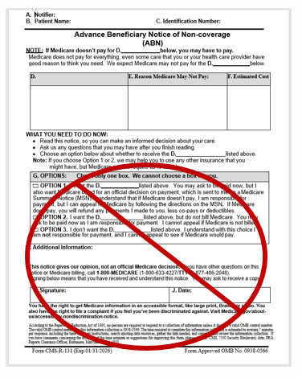
That’s It
No need to complete the rest of the form
Can add information in item H

Slide 20
Follow-up
Follow-up Questions
Email wps.gha.education@wpsic.com
Subject line: “Encore Excluded Services Modifiers”
Send claim specific questions to Customer Service

Slide 21
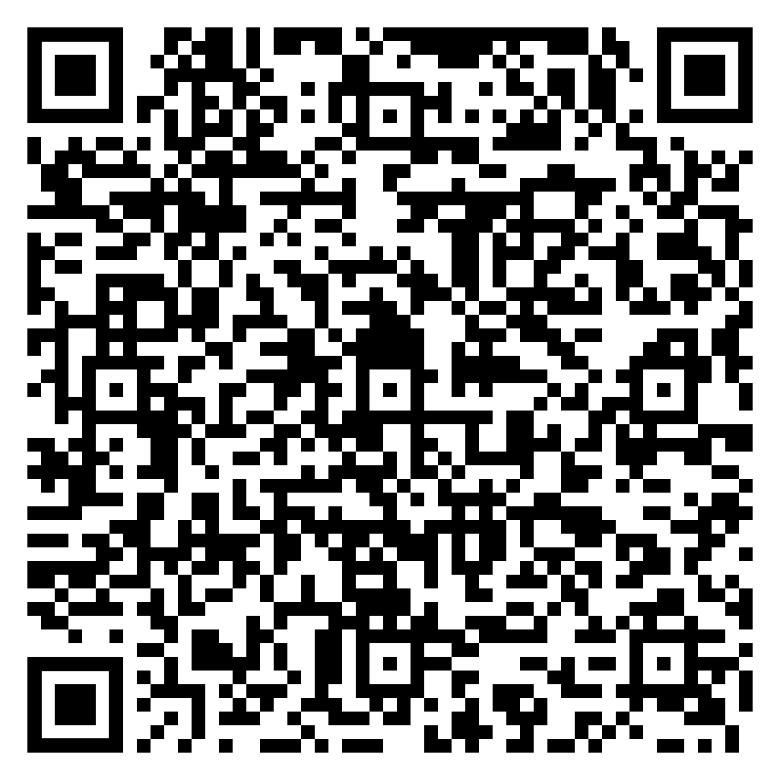
Survey
Let us know what you think!
Take time to complete the survey now.

