Slide 1
Piecing Together the Parts of Medicare

Slide 2
Disclaimer
This education is a tool to help the provider community. Medicare rules change often. They are in the relevant laws, regulations, and rulings on CMS’ website.
We provide responses to questions based on the facts given, but Medicare rules determine final coverage.
CMS prohibits recording of the presentation for profit-making purposes.

Slide 3
Agenda and Objective
At the conclusion of this session, you’ll be able to:
Understand the definition of Original Medicare
Recognize the different parts of Medicare
Identify items and services covered by Medicare

Slide 4
Original Medicare

Slide 5
Background
Federal health insurance program enacted in 1965
Americans aged 65 and older
Title XVIII of the Social Security Act
Administered by the Centers for Medicare & Medicaid Services (CMS)
Division of the Department of Health & Human Services (HHS)

Slide 6
Expanded Coverage
1972 – coverage added to include those <65 with certain medical conditions:
Permanent disability
End-stage renal disease (ESRD)
Stage 5 kidney failure requiring dialysis or transplant
2001 – amyotrophic lateral sclerosis (ALS) added as an eligible diagnosis

Slide 7
Definition
Original Medicare is a “fee-for-service” plan
Medicare pays a share of an approved amount
Up to certain limits
Beneficiary pays the remaining amount (fee) for the service they receive
Original Medicare also known as Traditional Medicare
Consists of Part A and Part B

Slide 8
Parts of Medicare

Slide 9
Part A
Coverage for:
Inpatient care in a hospital or skilled nursing facility (SNF)
Home Health
Hospice
Primarily funded by payroll taxes
Premium free if paid taxes for at least 40 quarters
Beneficiary pays deductible and coinsurance

Slide 10
Part B
Coverage for:
Outpatient hospital care
Non-hospital medical expenses (not an all-inclusive list):
Doctor’s office visits
Lab and diagnostic tests
Preventive and screening services
Outpatient rehabilitation therapy
Funded primarily by monthly premiums
Beneficiary pays deductible and coinsurance

Slide 11
Part C
Also called Medicare Advantage (MA)
Private companies contracted with CMS
Common types:
Health Maintenance Organization (HMO)
Preferred Provider Organization (PPO)
Private Fee-for-Service (PFFS)
Special Needs Plan (SNP)
Beneficiary enrollment replaces Original Medicare

Slide 12
More About Part C
MA plans combine Part A and Part B coverage
May include Part D
Some offer additional benefits
Premiums, deductibles and co-pays vary by plan
Coverage limited to providers in plan’s network
Unique identification card and policy number

Slide 13
Part D
Prescription drug coverage
Administered by private insurance companies
May be bundled with Part C or MA plan
Premiums, deductibles and co-pays vary by plan
Unique identification card and policy number

Slide 14
Medigap
Medicare supplemental insurance
Pays after Original Medicare pays its share
Sold by private insurance companies
Must follow Federal and State laws
Standardized policy types
Identified by letters A-D, F, G, K-N
Premiums vary
Unique identification card and policy number

Slide 15
Medicare Eligibility

Slide 16
Who is Eligible
Medicare is a Federal entitlement program
Guarantee certain level of benefits
To those who meet requirements established by law
Earn the right to enroll by working and paying taxes
Minimum required period
40 quarters = 10 years

Slide 17
When is a Person Eligible
Attain age 65
U.S. citizen or permanent legal resident for at least five years
Younger than 65 if certain medical conditions
Permanent disability
After 24 months of entitlement to Social Security
End-stage renal disease (ESRD)
After three months of dialysis at a facility
Sooner if doing home dialysis
ALS (Lou Gehrig’s disease)

Slide 18
Medicare Enrollment
Facilitated by the Social Security Administration (SSA) or Railroad Retirement Board (RRB)
Some are automatically enrolled
Other ways to enroll:
Online at socialsecurity.gov
Visit or call a local Social Security office
Visit or call local RRB office

Slide 19
Covered Services

Slide 20
What Services are Covered
Considered when medical necessary
Appropriate for the care of an:
Illness
Injury
Malformed body member
For the early detection of disease or illness

Slide 21
Title XVIII of the Social Security Act
Section 1861
Definition of covered services
Restrictions on coverage
Section 1862
Definition of medical necessity
Excluded services
Not considered under any provision of the law

Slide 22
Resources
CMS
Medicare Program – General Information: https://www.cms.gov/medicare/medicare-general-information/medicaregeninfo
Medicare Learning Network (MLN)
MLN906765 Items & Services Not Covered by Medicare: https://www.cms.gov/Outreach-and-Education/Medicare-Learning-Network-MLN/MLNProducts/Downloads/Items-and-Services-Not-Covered-Under-Medicare-Booklet-ICN906765.pdf

Slide 23
More Resources
WPS
New to Medicare: https://www.wpsgha.com/wps/portal/mac/site/training/guides-and-resources/new-to-medicare-training
Medicare.gov
Get Started with Medicare: https://www.medicare.gov/basics/get-started-with-medicare

Slide 24
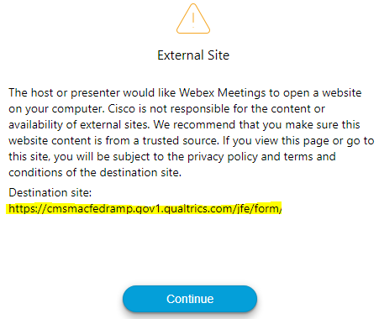
Survey
Let us know what you think!
Take time to complete the survey now.
QR code
Survey link in chat
Redirect after closing webinar
Notes:
AM session

Slide 25
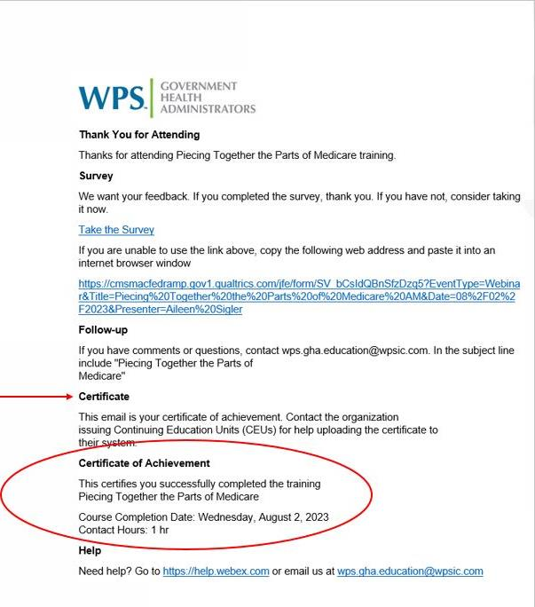
Proof of Attendance
Complete survey
Email contains contact hours
From messenger@webex.com
Check Junk or Spam folders
Add to safe sender list
Notes:
AM session

Slide 26
Closing
Follow-up Questions
Email wps.gha.education@wpsic.com
Topic: 8/2/23 Parts of Medicare
Submit by 8/12/2023 at 12:00 P.M. CT
Send claim specific questions to Customer Service
Notes:
AM session

