Slide 1
Ins and Outs of the Advance Beneficiary Notice of Noncoverage (ABN)

Slide 2
Disclaimer
We prepared this education as a tool to assist the provider community. Medicare rules change often. They are in the relevant laws, regulations and rulings on the Centers for Medicare & Medicaid Services (CMS) website.
We will provide responses to questions based on the facts given, but the Medicare rules will determine final coverage.
CMS prohibits recording of the presentation for profit-making purposes.

Slide 3
Agenda
We will:
Locate the form
Provide instructions on completing the form
Tips and tricks to help you

Slide 4
Background

Slide 5
Purpose
Form CMS-R-131
Transfer financial liability to patients
Conveys Medicare is not likely to provide coverage in a specific case

Slide 6
Medical Necessity
Policy
NCD
LCD
Manuals
Patient’s condition
Provider’s medical training

Slide 7
ABN Use
Yes
Traditional Medicare
Outpatient service
All facility and provider types
No
Medicare advantage

Slide 8
Locating the form

Slide 9
Standards
Key items to know:
Reproducing
One form
Font to paper contrast
Changes
Retain for five years from discharge or delivery of care
Unless specified in state law

Slide 10
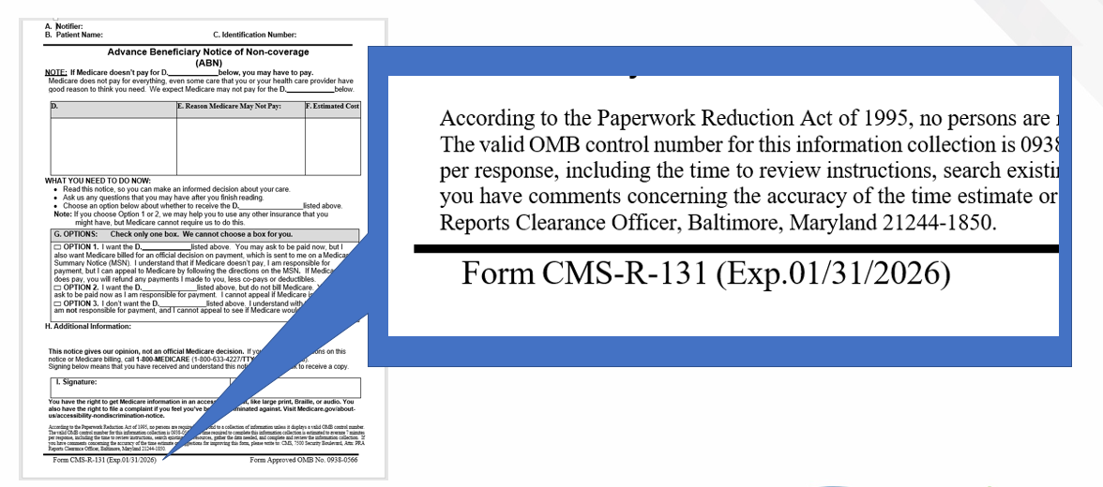
Form Date

Slide 11
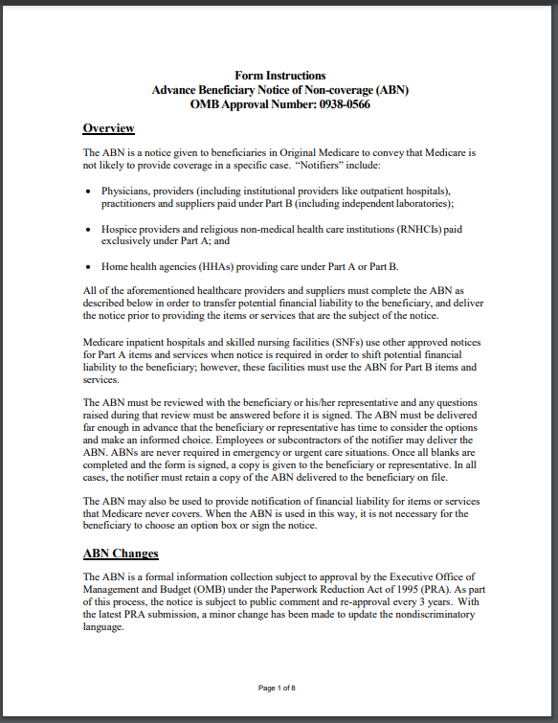
Completing the Form

Slide 12
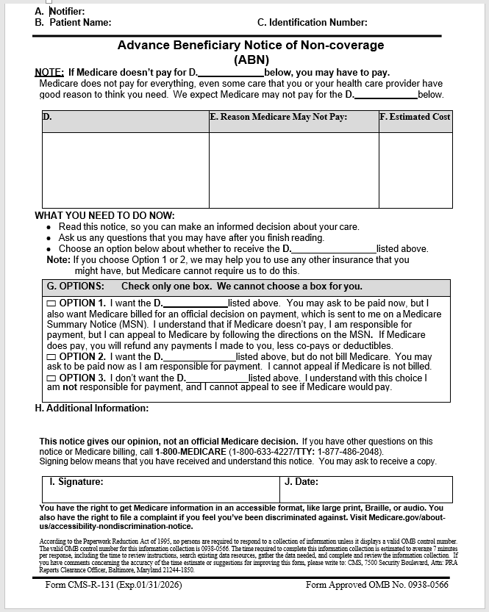
Form Sections
Providers complete
A – F
H (if needed)
Patients complete
G
I and J

Slide 13
Items A through C

Slide 14
Item D

Slide 15
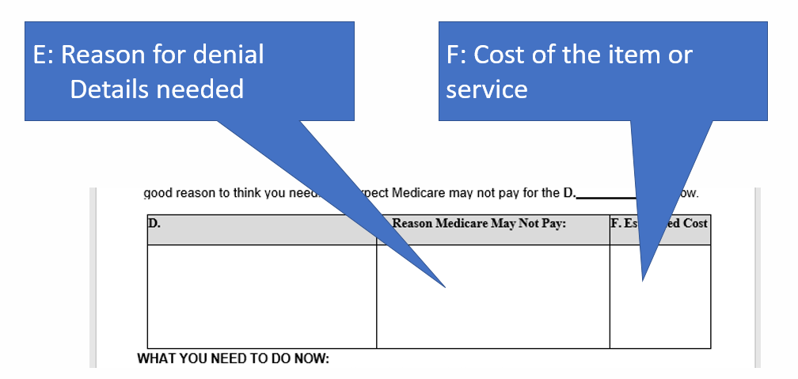
Items E and F

Slide 16
Items G and H

Slide 17
Items I and J
Patient
Representative
Witness form presentation
No financial liability
Include
Date of the signature

Slide 18
Refusal to Sign
Medicare recommendation
No service
Document on the form:
Patient or representative
Date of refusal
Witness to refusal (Optional)

Slide 19
Deliver Options
In-person
Recommended
Another provider
Phone
Fax
Email
Mail
Always document your attempts

Slide 20
Presenting
Provider or representative
Complete
Present
Answer questions
Two copies

Slide 21
Tips and Tricks

Slide 22
Option Change
Patient changes their mind for option G
Add document of the change
Never alter the original choice
Sign and date
Send the patient a copy to sign and date
Document all attempts to contact the patients

Slide 23
Dual Eligible
Notes:
What’s wrong with Alt text?

Slide 24
What’s Important to Know
Estimate based on what the patient will pay
Stop a service and complete the ABN
Service not medically necessary
Always provide a copy
Explain the options with out advice
Allow the patient to contact 1-800-Medicare for unanswered questions
1-800-633-4227

Slide 25
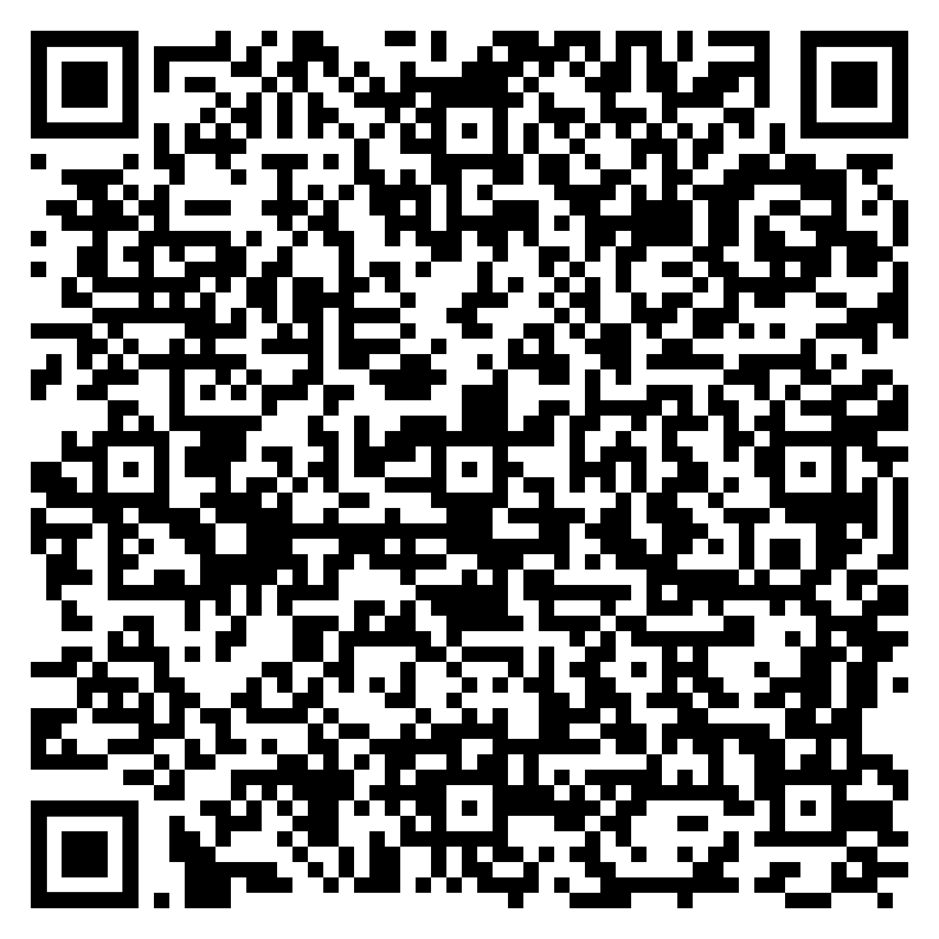
Survey
Let us know what you think!
Take time to complete the survey now.
Survey

Slide 26
Questions
Follow-up questions email: wps.gha.education@wpsic.com
Email subject line “Encore: ABN Ins and Outs”

Slide 27
Resources
CMS Beneficiary Notices Initiative (BNI) web page
CMS Internet-Only Manual Publication 100-04, Chapter 30, Section 50 – Advance Beneficiary Notice of Non-coverage (ABN)
WPS

