Slide 1
Modifier Monday Modifiers JW and JZ
August 7, 2023

Slide 2
Disclaimer
We prepared this education as a tool to assist the provider community. Medicare rules change often. They are in the relevant laws, regulations, and rulings on the Centers for Medicare & Medicaid Services (CMS) website.
We will provide responses to questions based on the facts given, but the Medicare rules will determine final coverage.
CMS prohibits recording of the presentation for profit-making purposes.

Slide 3
Objective

Slide 4
Agenda

Slide 5
Resources
CMS MM 13056 – New JZ Claims Modifier for Certain Medicare Part B Drugs
Medicare Program Discarded Drugs and Biologicals JW Modifier and JZ Modifier Policy Frequently Asked Questions
CMS Internet-Only Manual (IOM) Publication 100-04, Medicare Claims Processing Manual, Chapter 17, Drugs and Biologicals, Section 40
Modifier JW Fact Sheet
Modifier JZ Fact Sheet

Slide 6
Questions

Slide 7
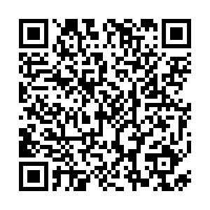
Survey
Please use the following link to complete the survey for the encore presentation

Slide 8
Thanks

