Slide 1
Chronic Kidney Disease
And Preventive Services

Slide 2
Disclaimer
This education is a tool to help the provider community. Medicare rules change often. They are in the relevant laws, regulations, and rulings on CMS’ website.
We provide responses to questions based on the facts given, but Medicare rules determine final coverage.
CMS prohibits recording of the presentation for profit-making purposes.

Slide 3
Acronyms and Abbreviations
CKD – Chronic kidney disease
OTC – Over the counter
IPPE – Initial preventive physical exam
AWV – Annual wellness visit
IBT – Intensive Behavioral Therapy
MNT – Medical Nutrition Therapy
DSMT – Diabetes Self-Management Training
ESRD – End Stage Renal Disease
NCD – National Coverage Determination
BMI – Body Mass Index
CVD – Cardiovascular disease
SGOT – Serum glutamic-oxaloacetic transaminase
CRD – Chronic renal disease

Slide 4
Agenda and Objective
This webinar will help you
Identify the risk factors associated with kidney disease
Learn the stages of chronic kidney disease and how it can be diagnosed
Discover what preventive services are available to help prevent or slow the progression of chronic kidney disease

Slide 5
Why Talk Kidney Health?
15% of adults in the US are estimated to have CKD
90% are undiagnosed
Diabetes causes 47% of new cases
96 million Americans have prediabetes
High blood pressure causes 29% of new cases
Nearly 810,000 Americans living with kidney failure
Close to 570,000 on dialysis
Approximately 240,000 living with a kidney transplant
Social factors associated with worsening CKD

Slide 6
Who’s at Risk?
People 65 years and older
Diagnosed with one of the following
Diabetes
High blood pressure
Heart disease
Family member with chronic kidney disease
Race
Some races have higher rates of diabetes and chronic kidney disease
Obesity

Slide 7
What is Chronic Kidney Disease?
Defined as having a kidney abnormality and decreased kidney function for 3 months or longer
Kidneys gradually lose their ability to continue to filter waste which causes fluid build up in the body
Irreversible

Slide 8
Five Stages of Chronic Kidney Disease
Stage 1
Early Stage CKD: Slight kidney damage with normal kidney function
Stage 2
Early Stage CKD: Kidney damage with mild decrease/loss in kidney function
Stage 3a
Early Stage CKD: Kidney damage with mild to moderate decrease/loss of kidney function
Stage 3b
Early Stage CKD: Kidney damage with moderate to severe loss of kidney function

Slide 9
Five Stages of Chronic Kidney Disease cont.
Stage 4
Late Stage CKD: Severe decrease/loss of kidney function
Stage 5
End Stage Renal Disease: Kidney failure and need for dialysis or transplant

Slide 10
Causes
Diabetes – leading cause
High blood pressure – second leading cause
Disease
Glomerulonephritis – inflammation and damage to kidney’s filtering units
Autoimmune – Lupus
Inherited or congenital
Polycystic kidney disease - most common inherited
Drugs
OTC such as aspirin, naproxen and ibuprofen
Cocaine, heroin and amphetamines
Alcohol

Slide 11
Diagnosis
Blood test
Serum creatinine
Estimated glomerular filtration rate
Blood urea nitrogen (BUN)
Urine test
Urine protein
Albumin to creatinine ratio
Creatinine clearance
Imaging test
Ultrasound
CT scan
Kidney biopsy

Slide 12
Estimated Glomerular Filtration Rate (eGFR)
Definition:
Measures how well kidneys are working
Is an estimated number based on
Age
Gender
Body type
Race
CKD is generally diagnosed when there is evidence, for more than three months, of decreased kidney function (eGFR less than 60)

Slide 13
eGFR Measures Kidney Functions
Each stage of kidney disease is based on the eGFR blood test numbers:
Stage 1 – Early Stage CKD: eGFR of 90 or higher
Stage 2 – Early Stage CKD: eGFR of 89-60
Stage 3a – Early Stage CKD: eGFR of 59-45
Stage 3b – Early Stage CKD: eGFR of 44-30
Stage 4 – Late Stage CKD: eGFR of 29-15
Stage 5 – End Stage Renal Disease: eGFR less than 15

Slide 14
Laboratory Tests – CRD Patients (NCD 190.10)
Purpose : Laboratory tests are essential to monitor the progress of CRD patients.
Limitations of Coverage: The following tests and frequencies incorporate the level and types of routine laboratory test that are covered. Routine test at greater frequencies must include medical justification.
Per Dialysis
All hematocrit or hemoglobin and clotting time tests furnished incident to dialysis treatment
Per Week
Prothrombin time for patients on anticoagulant therapy
Serum CREATININE
Per Week or Thirteen Per Quarter
Blood Urea Nitrogen (BUN)

Slide 15
Laboratory Tests – CRD Patients cont.
Monthly
Complete Blood Count (CBC)
Serum Calcium
Serum Potassium
Serum Chloride
Serum Bicarbonate
Serum Phosphorous
Total Protein
Serum Albumin
Alkaline Phosphate
Aspartate Aminotransferase (AST) (SGOT)
Lactic Acid Dehydrogenase (LDH)

Slide 16
Laboratory Tests – CRD Patients coverage cont.
Guidelines for tests other than those routinely performed include:
Serum Aluminum – one every 3 months
Serum Ferritin – one every 3 months
Tests for hepatitis B are covered when patients first enter a dialysis facility
Coverage of future testing depends on the patient’s serologic status and successfully immunization
See NCD 190.10 for more information

Slide 17
Medicare Coverage for Preventive Services
Diabetes
Medical nutrition therapy
High blood pressure
Cardiovascular Disease
Obesity
Alcohol
Tobacco use

Slide 18
Diabetes

Slide 19
Diabetes Screening Coverage
Covered under Medicare Part B if:
High blood pressure
History of abnormal cholesterol & triglyceride levels
Obesity
History of high blood sugar
Have two or more of the following conditions
65 or older
Overweight
Family history of diabetes (parents or siblings)
History of gestational diabetes or delivery of a baby weighing over 9 lbs
Covers blood glucose lab test screening*
Up to two screenings per year
No cost to patient if provider accepts assignment*

Slide 20
Diabetes Screening Billing
HCPCS and CPT
82947
82950
82951
ICD-10
Z13.1
Additional codes may apply
Frequency
Once every 6 months
Patients diagnosed with pre-diabetes
Once every 12 months
Patient has not been diagnosed with pre-diabetes or has never been tested
Additional coding
Modifier TS should be added if patient meets the pre-diabetes definition

Slide 21
Diabetes Self-Management Training Coverage (NCD 40.1)
Covered under Medicare Part B
Written order
10 hours initial training
1 hour individual, 9 hours group
2 hours follow-up training each calendar year
After Part B deductible is met, patient pays 20% of Medicare-approved amount

Slide 22
Diabetes Self-Management Training Billing
HCPCS & CPT
G0108
G0109
ICD- 10
Patient must be diagnosed with diabetes
Additional codes may apply
Frequency
Initial year – up to 10 hours initial training
Subsequent years – up to 2 hours follow-up training
Additional coding
DSMT and MNT can’t be billed on same day or incident to professional services

Slide 23
Medicare Diabetes Prevention Program Coverage
Covered once in a lifetime under Part B if all conditions apply within 12 months of first session
A1c test results between 5.7 and 6.4%
Fasting glucose of 110-125mg/dL
2-hour glucose of 140-199mg/dL
Body mass index of 25 or more
No history of type 1 or type 2 diabetes
Never diagnosed with ESRD
Never participated in the Medicare diabetes prevention program
No cost to eligible beneficiaries

Slide 24
Medicare Diabetes Prevention Program Billing
HCPCS & CPT
Additional maintenance if applicable
G9880
G9881
G9882
G9883
G9884
G9885
Additional codes
G9890
G9891
Core Session
G9873
G9874
G9875
Core Maintenance
G9876
G9877
G9878
G9879

Slide 25
Billing cont.
ICD-10
Additional codes may apply
Frequency
Each G code is paid once per lifetime
Exception
G9890 – bridge payment paid only once per patient per supplier
G9891 – session reporting
Up to 24 sessions within two years

Slide 26
Medical Nutrition Therapy

Slide 27
Medical Nutrition Therapy Coverage (NCD 180.1)
Covered under Medicare Part B for patients with the following
Diagnosed with diabetes
Diagnosed with kidney disease
Kidney transplant within last 36 months and Dr. referral
Services provided by registered dietitian or nutrition professional
No cost if patient qualifies

Slide 28
Medical Nutrition Therapy Billing
HCPCS & CPT
97802
97803
97804
G0270
G0271
ICD-10
Additional codes may apply
Frequency
First year – 3 hours one on one counseling
Subsequent years – 2 hours

Slide 29
Hypertension

Slide 30
Initial Preventive Physical Exam Coverage
Once per lifetime
No later than first 12 months after Part B eligibility date
Review medical and social history
Depression screening
Review functional ability and safety level
Exam - vitals including blood pressure
End-of-life planning

Slide 31
Initial Preventive Physical Exam Billing
HCPCS & CPT
G0402
G0403
G0404
G0405
G0468
ICD-10
No specific code
Frequency
Once per lifetime
No later than 12 months after the Part B effective date

Slide 32
Initial Preventive Physical Exam Cost
G0402
No cost to beneficiary
G0403, G0404, and G0405
Copayment or coinsurance, and deductible apply
G0468
No cost to beneficiary
To use this code, providers must offer a standard bundle of services to all patients
See CMS Internet-Only Manual Publication 100-04, Chapter 9, Section 60.2

Slide 33
Annual Wellness Visit Coverage
Covered once every 12 months
Can’t take place within 12 months from Part B enrollment date or IPPE
Vitals including blood pressure
Review medical & family history
Review current prescriptions
Advanced care planning
Health risk assessment
Depression screening

Slide 34
Annual Wellness Visit Billing
HCPCS & CPT
G0438
G0439
G0468
99497
99498
ICD-10
No specific code required
Frequency
G0438 – once per lifetime
G0439 or G0468 – annually
99497 or 99498 – optional annually

Slide 35
Annual Wellness Visit Cost
G0438 & G0469 – No copayment, coinsurance, or deductible
G0468 – No copayment, coinsurance or deductible
You must provide AWV or IPPE with a standard bundle of services
99497 & 99498 – No copayment, coinsurance, or deductible
Bill using modifier 33 (preventive service) on the same AWV claim
Must be delivered on the same day by the same AWV provider

Slide 36
Cardiovascular Disease

Slide 37
Cardiovascular Disease Screening Coverage (NCD 190.23)
Blood test for cholesterol, lipid, and triglyceride levels
Covered under Part B for patients without apparent cardiovascular disease signs or symptoms
Patient pays no copayment, coinsurance or deductible

Slide 38
Cardiovascular Disease Screening Billing
HCPCS & CPT
80061 Lipid Panel
Must include cholesterol, serum, total (82465) Lipoprotein, direct measurement, high density cholesterol (83718), and Triglycerides (84478)
ICD-10
Z13.6
Additional codes may apply
Frequency
Once every 5 years

Slide 39
Cardiovascular Behavior Therapy Coverage (NCD 210.11)
Behavior therapy to help lower risk for cardiovascular disease
Risk factors for CVD include being overweight, obesity, physical inactivity, diabetes, cigarette smoking, high blood pressure, high cholesterol, family history of myocardial infarction and older age
May check blood pressure, discuss aspirin use, give tips on eating well
Patients with Medicare Part B who are:
Competent and alert at the time counseling is provided
Furnished counseling by a qualified primary care physician or other primary care practitioner and in a primary care setting
No copayment, coinsurance, or deductible

Slide 40
Cardiovascular Behavior Therapy Billing
HCPCS & CPT
G0446 – Annual, fact-to-face intensive behavioral therapy for cardiovascular disease, individual, 15 minutes
ICD-10
No specific code required
Frequency
Annually

Slide 41
Obesity

Slide 42
Obesity Intensive Behavior Therapy Coverage (NCD 210.12)
Patients with Medicare Part B who:
Have a body mass index (BMI) > 30 kilograms per meter squared
Are competent & alert during counseling
Counseling provided by qualified primary care physician other primary care practitioner in a primary care setting
Additional information
Obesity reassessment & weight loss determination is required at 6-month visit
If the patient loses at least 3 kg during first 6 months, they’re eligible for additional face-to-face visits occurring once a month for months 7-12
For patient who don’t lose at least 3 kg in first 6 months, reassess their readiness to change and BMI after an additional
No copayment, coinsurance, or deductible

Slide 43
Obesity Intensive Behavior Therapy Billing
HCPCS & CPT
G0447 – Face-to-face behavioral counseling for obesity, 15 min
G0473 – Face-to-face behavioral counseling for obesity, group (2-10), 30 min
ICD-10
Z68.30, Z68.31, Z68.32, Z68.33, Z68.34, Z68.35, Z68.36, Z68.37, Z68.38, Z68.39, Z68.41, Z68.42, Z68.43, Z68.44, Z68.45
Additional codes may apply
Frequency
Medicare pays up to 22 visits with codes G0447 & G0473 combined, in a 12-month period
First month – 1 face-to-face visit per week
Months 2-6 – 1 face-to-face visit every other week
Months 7-12 – 1 face-to-face visit every month if patient meets certain requirements

Slide 44
Alcohol

Slide 45
Alcohol Misuse Screening & Counseling Coverage (NCD 210.8)
Patients with Medicare Part B who:
Screen positive for alcohol misuse but levels or alcohol consumption patterns don’t meet dependence criteria
Are competent and alert during counseling
Get counseling from a qualified primary care physician or other primary care practitioner in a primary care setting
No copayment, coinsurance, or deductible

Slide 46
Alcohol Misuse Screening & Counseling Billing
HCPCS & CPT
G0442 – Annual alcohol misuse screening, 5-15 minutes
G0443 – Brief face-to-face behavioral counseling for alcohol misuse, 15 minutes
ICD-10
No specific code requirement
Frequency
G0442 – Annually
G0443 – 4 times a year if patient screens positive for misuse

Slide 47
Alcohol Misuse vs Alcohol Dependence
Misuse – risky/hazardous and harmful drinking which place individuals at risk for future problems
Risky or hazardous
Women - >7 drinks per week or >3 drinks per occasion
Men - >14 drinks per week or >4 drinks per occasion
Harmful
Persons currently experiencing physical, social or psychological harm from alcohol use, but don’t meet criteria for dependency
Dependence – exhibits at least three of the following behaviors: tolerance; withdrawal symptoms; impaired control; preoccupation with purchase and/or use; persistent desire or unsuccessful efforts to quit; sustains social, occupational, or recreational disability; use continues despite adverse consequences

Slide 48
Tobacco Use

Slide 49
Counseling to Prevent Tobacco Use Coverage (NCD 210.4.1)
Smoking can worsen kidney disease
Interfere with medication to lower blood pressure
Covered under Medicare Part B for those who meet the criteria
Use tobacco, regardless of whether they have signs or symptoms of tobacco related disease
Are competent and alert during counseling
Counseling is provided by a qualified physician or other Medicare-recognized practitioner
Up to 8 counseling sessions in a 12-month period
Cost – no copayment, coinsurance, or deductible

Slide 50
Counseling to Prevent Tobacco Use Billing
HCPCS & CPT
99406 - Smoking and tobacco use cessation counseling visit; intermediate, greater than 3 minutes up to 10 minutes
99407 - Smoking and tobacco use cessation counseling visit; intensive, greater than 10 minutes
ICD-10
F17.210, F17.211, F17.213, F17.218, F17.219, F17.220, F17.221, F17.223, F17.228, F17.229, F17.290, F17.291, F17.293, F17.298, F17.299, T65.211A, T65.212A, T65.213A, T65.214A, T65.221A, T65.222A, T65.223A, T65.224A, T65.291A, T65.292A, T65.293A, T65.294A, Z87.891
Additional codes may apply
Frequency
2 cessation attempts per year
Each attempt may include a maximum of 4 intermediate or intensive sessions, with the patient getting up to 8 sessions per year

Slide 51
CMS Preventive Services Tool

Slide 52
Telehealth and Preventive Services

Slide 53
Resources
National Kidney Foundation - https://www.kidney.org/
Kidney Health: Help Address Disparities - https://www.cms.gov/outreach-and-educationoutreachffsprovpartprogprovider-partnership-email-archive/2022-03-17-mlnc#_Toc98247779
Chronic Kidney Disease Disparities in Medicare Fee-For-Service Beneficiaries https://www.cms.gov/About-CMS/Agency-Information/OMH/Downloads/Data-Snapshot-Chronic-Kidney-Disease.pdf
Chronic Kidney Disease Initiative - https://www.cdc.gov/kidneydisease/index.html
Preventive & Screening Services Tool - https://www.medicare.gov/coverage/preventive-screening-services
Medicare Coverage Database - https://www.cms.gov/medicare-coverage-database/search.aspx
Medicare Wellness Visits - https://www.cms.gov/Outreach-and-Education/Medicare-Learning-Network-MLN/MLNProducts/preventive-services/medicare-wellness-visits.html
Medicare Diabetes Prevention Program Expanded Model - https://www.cms.gov/Outreach-and-Education/Medicare-Learning-Network-MLN/MLNProducts/Downloads/MDPP-MLN34893002.pdf
Screening and Behavioral Counseling Interventions in Primary Care to Reduce Alcohol Misuse CR 7633 - https://www.cms.gov/Regulations-and-Guidance/Guidance/Transmittals/Downloads/R138NCD.pdf

Slide 54
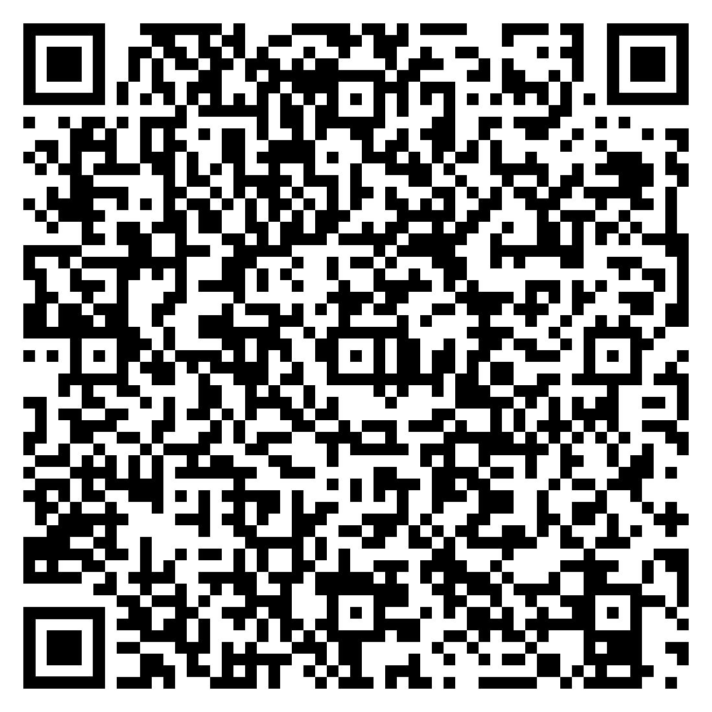
Survey
Let us know what you think!
Take time to complete the survey now.
Survey link
Notes:
QR code will be removed

Slide 55
Closing
Follow-up Questions
Email wps.gha.education@wpsic.com
Topic: Encore: Kidney Health
Send claim specific questions to Customer Service
Notes:
QR code will be removed

