Slide 1
Let’s blog! WPS Medicare Buzz
July 11, 2023

Slide 2
Disclaimer
We prepared this education as a tool to assist the provider community. Medicare rules change often. They are in the relevant laws, regulations and rulings on the Centers for Medicare & Medicaid Services (CMS) website. We will provide responses to questions based on the facts given, but the Medicare rules will determine final coverage. CMS prohibits recording of the presentation for profit-making purposes.

Slide 3
What is a Blog?
A timeline
Then
Now
In 1994, a college student is credited with the creation of the first blog
In 1997 a blogger coined the term “weblog”
Meant to describe his process for logging the web
In 1999, “weblog” was shortened to “blog”
Posted reverse chronologically, a blog is a personal web log or journal used to share information or one’s opinion on a variety of topics
A blog is a regularly updated website or web page used for personal use or to fulfill a business need

Slide 4
Why did WPS start a blog?
To accomplish our CMS Innovation Challenge goals

Slide 5
Two CMS Grants Awarded to WPS
Chronic Care Management
Depression Screening
Goal is to increase use of this benefit
Goal is to increase use of this benefit
Goal is to decrease suicide attempts

Slide 6
What’s the name of WPS GHA’s blog?
WPS Medicare Buzz

Slide 7
Our Primary Blogger
Dr. Joelle Vlahakis,
Contractor Medical Director
WPS Government Health Administrators
She received her medical degree from the University of Miami, completed her residency training in Internal Medicine and Pediatrics at the Michigan College of Human Medicine’s center in Kalamazoo, Michigan. She has practiced in private practice, in rural health, and, since 2006, in hospice and palliative medicine. Dr. Vlahakis was the founding program director of the Hospice and Palliative Medicine Fellowship at Sarasota Memorial Hospital.

Slide 8
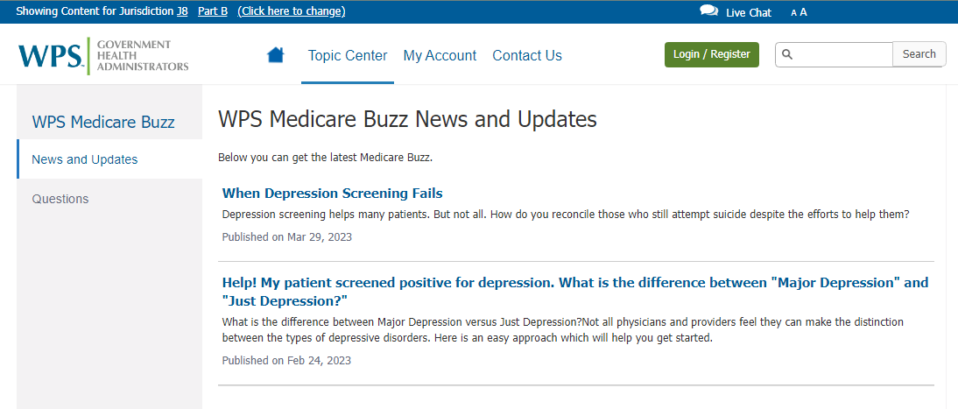
Find WPS Medicare Buzz

Slide 9
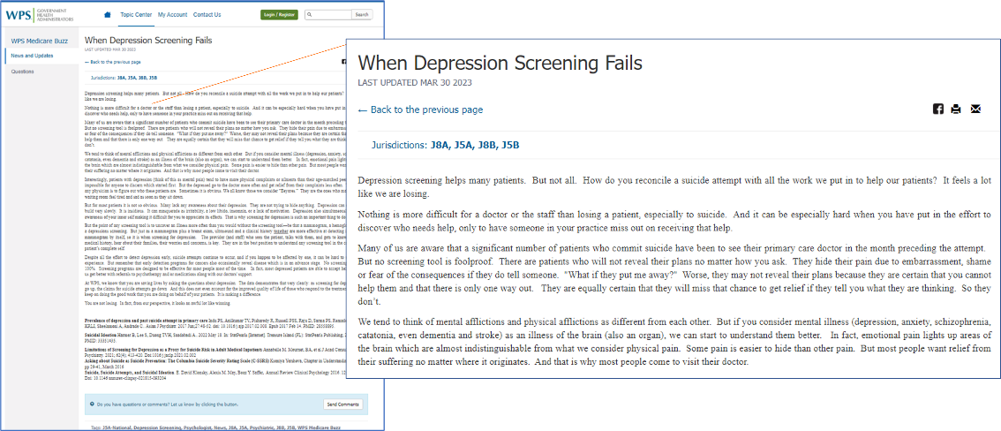
What does a post look like?

Slide 10
Have questions about anything posted on our blog?

Slide 11
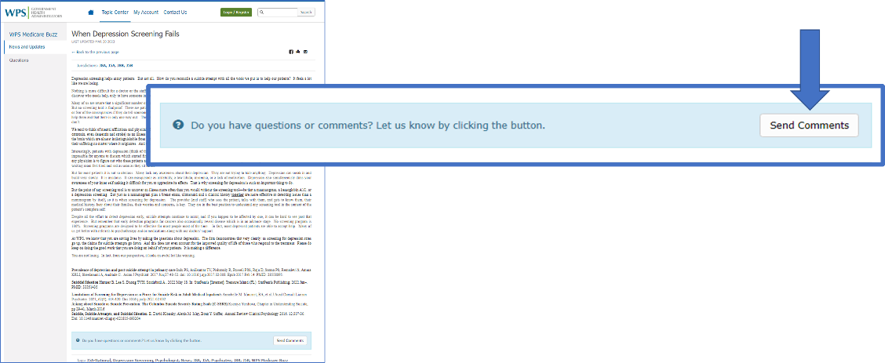
Scroll to the bottom of the post and choose Send Comments

Slide 12
Your question along with the answer may show up here

Slide 13
What does the future hold for WPS Medicare Buzz?
It was in our proposal!

Slide 14
Survey
Scan this QR code or use link to share feedback with WPS

Slide 15
Thank You

