Slide 1
Skilled Nursing Facility (SNF) Consolidated Billing (CB): Getting Started
Part 1 of the SNF CB Series

Slide 2
Disclaimer
We prepared this education as a tool to assist the provider community. Medicare rules change often. They are in the relevant laws, regulations and rulings on the Centers for Medicare & Medicaid Services (CMS) website.
We will provide responses to questions based on the facts given, but the Medicare rules will determine final coverage.
CMS prohibits recording of the presentation for profit-making purposes.

Slide 3
Agenda
Today’s topics:
Define SNF CB
Provide the SNF CB overview
Demonstrate recourse to help you
Provide the building blocks to understand SNF CB.

Slide 4
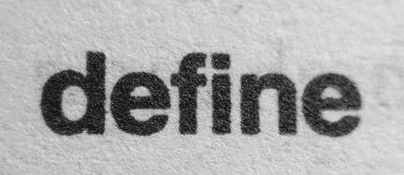
Define

Slide 5
Bundled
SNF’s responsible for most care
One payment for all included services during a Part A covered inpatient stay

Slide 6
Stays
Two types of stays
Part A stay
Medicare is covering the inpatient stay
100 days during a benefit period
Part B stay
Medicare is not covering the inpatient stay
Does not meet the coverage criteria or benefits exhausted

Slide 7
Type of Excluded Services
Two types:
Medicare excluded services
Medicare will not cover
Excluded in the law
SNF CB excluded services
Not part of the bundle
Billed by the provider performing the service

Slide 8
Definition Questions

Slide 9
Overview

Slide 10
Benefits of SNF CB
Why was this enacted?
Enhances overall care
SNFs oversee and coordinate
Less patient out-of-pocket
Eliminates duplicate billing

Slide 11
Affected Providers
All providers have the potential to be affected depending on the service billed.
Most affected:
Hospitals including Critical Access Hospitals (CAHs)
Imaging centers
Ambulance suppliers
Radiology centers
Rehabilitation therapists
Physicians

Slide 12
Not Affected
Not all providers are affected
CAH swing beds
Rural Health Clinics (RHCs)
Federally Qualified Health Center (FQHCs)

Slide 13
Reimbursement
Includes payment for included:
Part A services
Part B services

Slide 14
SNF’s Payment Responsibility
Part A Stay
Medicare covered services
Clinical Social Worker services
Incident to services
Preventive and screening services
Part B Stay
Physical therapy
Occupational Therapy
Speech-language pathology

Slide 15
SNF CB Exclusions
What services are excluded?
Most physician services
Most emergency room services
Services outside the scope of the SNF
Medicare excluded services
Telehealth originating site facility fee

Slide 16
Billing
Everyone must determine who to bill, Medicare or the SNF

Slide 17
SNF Billing
The SNF payment and billing are affected!
The SNF send claims:
Monthly
Discharge
Medicare pays the claims in chronological order
Late charges causing claim adjustments can affect or delay future payments

Slide 18
Overview Questions

Slide 19
Resources

Slide 20
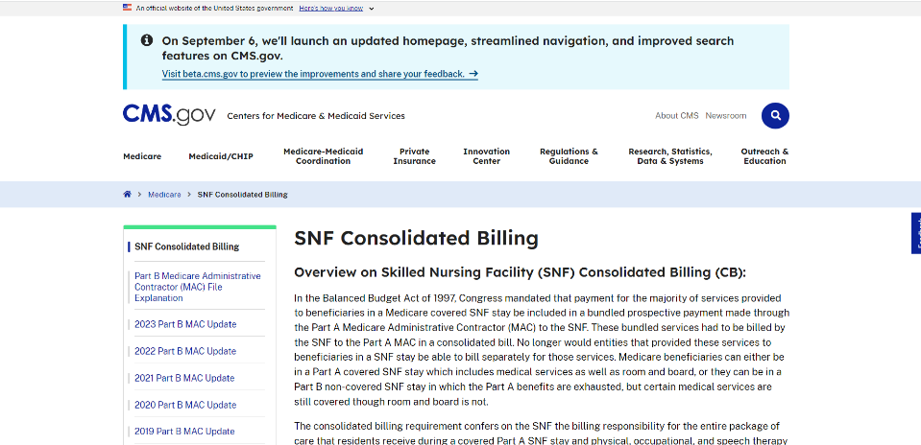
CMS’s SNF CB Web Page

Slide 21
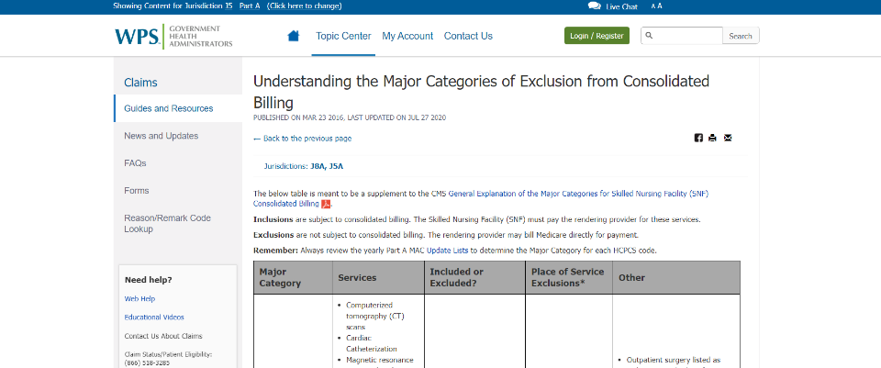
Understanding the Major Categories of Exclusion from Consolidated Billing

Slide 22
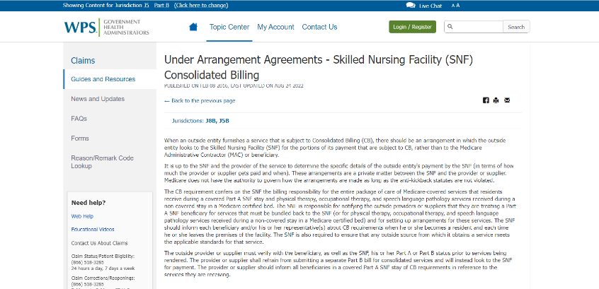
Under Arrangement Agreements - Skilled Nursing Facility (SNF) Consolidated Billing

Slide 23
Final Questions

Slide 24
More Information
CMS web resources
SNF Consolidated Billing
SNF CB Best Practices Guidelines
Skilled Nursing Facility PPS
Historical Questions & Answers on SNF Consolidated Billing
Skilled Nursing Facility Billing Reference
On-demand course SNF Consolidated Billing

