Slide 1
Skilled Nursing Facility (SNF) 5-Claim Sample Review Findings

Slide 2
Disclaimer
We prepared this education as a tool to assist the provider community. Medicare rules change often. They are in the relevant laws, regulations and rulings on the Centers for Medicare & Medicaid Services (CMS) website.
We will provide responses to questions based on the facts given, but the Medicare rules will determine final coverage.
CMS prohibits recording of the presentation for profit-making purposes.

Slide 3
Acronyms
ADL – Activities of Daily Living
ARD – Assessment Reference Date
HIPPS – Health Insurance Prospective Payment System
MAR – Medication Administration Record
MDS – Minimum Data Set
OT – Occupational Therapy
PT – Physical Therapy
SLP – Speech Language Pathology
SNF – Skilled Nursing Facility
IV – Intravenous

Slide 4
Objective and Agenda
To equip attendees with a comprehensive understanding of the common review issues to enhance your compliance efforts
Outline the review process
Identify and examine the most prevalent issues
Review guidance on accurate documentation

Slide 5
The Review Process
SNF providers can expect
Establishment of a point of contact
Notification letter
Sample selection of 5 claims
Results letter with individualized findings
Offers for widespread or 1:1 education

Slide 6
Documentation Guidance
Acute care discharge summary and transfer records
Admission records including diagnoses/conditions requiring skilled care
Provider orders and progress notes
Nursing flow sheets, treatment records and progress notes
Social services/case management records
Nutrition records
Medication administration records (MAR)/IV MAR

Slide 7
Documentation Continued
Activities of daily living (ADL) records
PT, OT, SLP
Evaluations/Plan of care
Progress notes
Treatment records (logs/grids) with actual treatment minutes
Physician certification/re-certifications
Plans of care
Diagnostic records
MDS

Slide 8
Common Findings
Not supporting level of service billed
Conflicting documentation
No hospital lookback information
Use of DR condition code without supporting documentation

Slide 9
Level of Care Issues
Documentation doesn’t support
Daily skilled service
Performed by or under supervision of professional or technical personnel
Services ordered by a physician
Services rendered for condition treated in the hospital or arose in SNF for condition treated in hospital

Slide 10
Level Billed Issues
Documentation doesn’t support HIPPS code(s) billed
Lookback documentation not submitted
Up to 30 days before ARD
Hospital information
Nursing or therapy notes missing or missing components
Claim recoded based on documentation provided

Slide 11
Conflicting Information
Information in progress notes different then MDS
Pressure ulcer information and items to reduce pressure
Self-care assessments
Therapy functional abilities vastly different then nursing

Slide 12
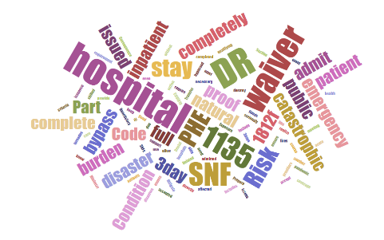
Not Supporting Use of DR Condition Code
It is the SNF’s burden of proof to support why the 3-day qualifying stay was not met due to the emergency
Admission to SNF before completing the full course of hospital treatment
Diversion of hospital and direct admit to a SNF

Slide 13
Questions and Answers

Slide 14
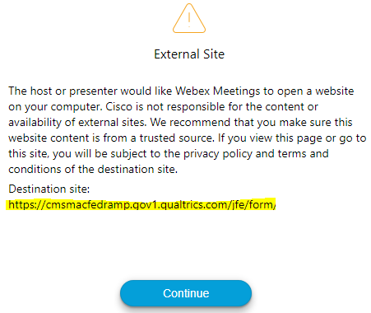
Survey
Let us know what you think!
Take time to complete the survey now.
QR code
Survey link in chat
Redirect after closing webinar

Slide 15
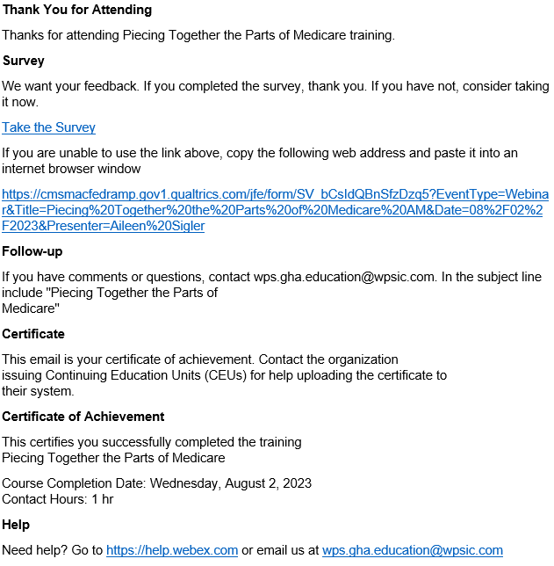
Proof of Attendance
Complete survey
Email contains contact hours
From messenger@webex.com
Check Junk or Spam folders
Add to safe sender list

Slide 16
Closing
Follow-up Questions
Email wps.gha.education@wpsic.com
Topic: SNF 5-Claim Sample Review Findings
Submit by 11/17/2023 at 12:00 P.M. CT
Send claim specific questions to Customer Service

Slide 17
Thank You

