Slide 1
Mental Health Playbook – Psychiatrist Rejections and Denials
April 2026
Notes:
Encore Presentations
Posted to our website within 2 weeks
Available for 60 to 90 days after posting
Presentation available for download
Questions
Send questions and comments in Chat
Trouble shooting technical difficulties
Still hearing music? Close and restart the session
Change your audio setting by Choosing “Audio & Video” and selecting “Switch Audio”
Call in: The phone information is in the chat
Email us with your technical difficulties: wps.gha.education@wpsic.com

Slide 2
Objective & Agenda
Objective: Learn how to fix/avoid common Medicare claim rejections and denials
Agenda
Define rejections and denials
Reveal reasons for common rejections and denials for this specialty based on data
Share ways to fix and avoid both
Provide resources
Review the legal disclaimers at the end of the presentation.

Slide 3

Rejection vs Denial

Slide 4
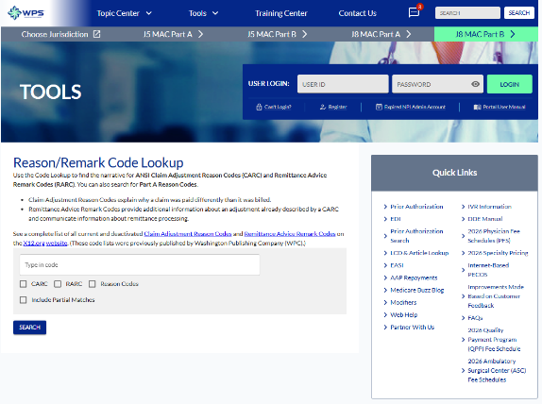
Remittance Advice (RA)
Use RA to check status of claim
Helpful tools
  Reason/Remark Code Lookup
  SNAP
    Portal User Manual
  IVR System
    IVR Operating Guide
Notes:
SNAP – Secure Net Access Portal
IVR – Interactive Voice Response

Slide 5

Rejection
Unprocessable
Returned on the “front end”
Missing or incorrect information
No appeal rights; resubmit the service
Remark code MA130 and group code CO16 appear on remittance advice
Patient not liable

Slide 6

Denial
Adjudicated
Fails to meet payment criteria
  Statutory requirements
  Medical necessity/frequency
  Eligibility
MA01 code provides appeal rights
Patient liability determined

Slide 7

Rejection vs. Denial – Potential Actions to Choose
Rejection (CMS calls these “unprocessable”)
  Fix the error, resubmit the service
Denial
  Fix the error, resubmit the service, if able
  Use CER process
    Registered users can use SNAP
  Request an appeal
Notes:
CER – Clerical Error Reopening
SNAP – Secure Net Access Portal

Slide 8

The Data

Slide 9
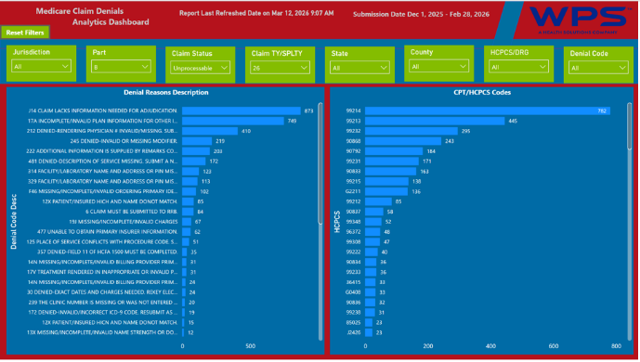
Dashboard – Use of Data Slicers for Data Analysis
MAC Jurisdictions 5 and 8
Part B claims
  Claim submission dates 12/01/25 – 02/28/26
  Data last refreshed 03/12/26
Specialty 26 - Psychiatrist
All codes

Slide 10

Top Five Reasons for Rejections in Descending Order
Incomplete/invalid plan information for other insurance
Rendering physician # invalid/missing
Invalid or missing modifier
Description of service missing
Facility/laboratory name and address or PIN missing

Slide 11

Top Rejected Codes in Descending Order
99214
99213
99232
90868
90792
CPT only copyright 2025 American Medical Association. All rights reserved.
Notes:
RRB – Railroad Retirement Board

Slide 12

Top Rejected Codes and Top Reasons
99214
  Incomplete/invalid plan information for other insurance
  Rendering physician # invalid/missing
  Claim must be submitted to RRB
99213
  Invalid or missing modifier
  Incomplete/invalid plan information for other insurance
  Rendering physician # invalid/missing
CPT only copyright 2025 American Medical Association. All rights reserved.

Slide 13
More – Top Rejected Codes and Top Reasons
99232
  Incomplete/invalid plan information for other insurance
  Patient/insured HICH plan and name do not match
  Facility/laboratory name and address or PIN missing
99213
  Invalid or missing modifier
  Incomplete/invalid plan information for other insurance
  Rendering physician # invalid/missing
CPT only copyright 2025 American Medical Association. All rights reserved.

Slide 14

Another Top Rejected Code and Top Reasons
90792
  Rendering physician # invalid/missing
  Incomplete/invalid plan information for other insurance
  Invalid or missing modifier
CPT only copyright 2025 American Medical Association. All rights reserved.

Slide 15
Top Five Reasons for Denials in Descending Order
Collection of fee-for-service during periods of managed care
Duplicate charge paid DATE on claim ICN
Duplicate charge of claim ICN now being processed
The time limit for filing your claim has expired – no appeal right
The physician is not eligible to receive payment
Notes:
DATE – Multi Carrier System will insert a date
ICN – Internal Control Number

Slide 16

More Top Reasons for Denials
6. Not covered when performed/referred/ordered by this provider
7. Charges incurred during an incarcerated period
8. Claim must be sent to EGHP or LGHP first
Notes:
EGHP – Employer Group Health Plan
LGHP – Large Group Health Plan

Slide 17

Top Denied Codes in Descending Order
99232
99214
99213
90792
99233
CPT only copyright 2025 American Medical Association. All rights reserved.

Slide 18
Most Common Denied Codes and Top Reasons
99232
  Duplicate charge paid DATE on ICN
  Collection of fee-for-service during periods of managed care
  Charges incurred during an incarcerated period
99214
  Collection of fee-for-service during periods of managed care
  The time limit for filing your claim has expired
  Duplicate charge paid DATE on ICN
CPT only copyright 2025 American Medical Association. All rights reserved.
Notes:
ICN – Internal Control Number

Slide 19
More Common Denied Codes and Top Reasons
99213
  Collection of fee-for-service during periods of managed care
  Duplicate charge paid DATE on ICN
  One visit/consult per doctor per day
90792
  Medicare does not pay for this many services in this time period
  Collection of fee-for-service during periods of managed care
  Medicare will not pay for this service for this condition
CPT only copyright 2025 American Medical Association. All rights reserved.

Slide 20

Another Common Denied Code and Top Reasons
99233
  Duplicate charge of claim ICN now being processed
  Duplicate charge paid DATE on ICN
  Expenses incurred after coverage terminated
  One visit per doctor per day
CPT only copyright 2025 American Medical Association. All rights reserved.

Slide 21
Ways to Fix or Avoid

Slide 22
Requirements for Medicare Claims
Medicare Claims Processing Manual
  Chapter 24 – General EDI and EDI Support Requirements, Electronic Claims, Coordination of Benefits Requirements, Mandatory Electronic Filing of Medicare Claims
  Chapter 25 – Completing and Processing the Form CMS-1450 Data Set
  Chapter 26 – Completing and Processing Form CMS-1500 Data Set

Slide 23
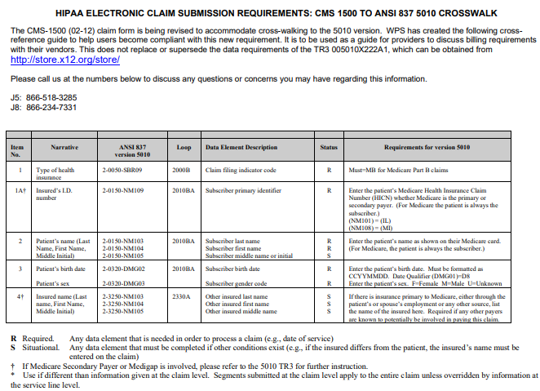
CMS 1500 to ANSI 837 5010 Crosswalk
Crosswalks from paper claim to electronic claim
Notes:
ANSI – American National Standards Institute

Slide 24

Provider Eligibility
Verify
  Provider identifiers reported on claim when required
    Includes rendering, ordering or referring
  Identifiers keyed correctly
  Eligibility dates
    Check provider enrollment records

Slide 25

Patient Eligibility
Verify
  Patient name and MBI exact match
    Ask to see insurance cards
  If patient enrolled in hospice
  Submit to correct payer
    Railroad Retirement Board
    Managed Care Plan if patient has elected Part C (Medicare Advantage)
Notes:
MBI – Medicare Beneficiary Identifier

Slide 26

Modifier Issues
Verify
  Required modifier present
  Modifier matches procedure code
  Modifier valid for date of service

Slide 27
Avoid Duplicate Denials
Verify
  No auto resubmitting prior to establishing status
  Appropriate billing
  Appropriate modifiers
Consider use of
  IVR System
  SNAP
Notes:
IVR – Interactive Voice Response
SNAP – Secure Net Access Portal

Slide 28

Avoid MSP Denials
Medicare Secondary Payer (MSP) Fact Sheet
MSP Questionnaire
CMS Medicare Secondary Payer web page
WPS YouTube Channel
  MSP Playlist
Notes:
MSP – Medicare Secondary Payer

Slide 29

Avoid Coverage or Frequency Denials
LCD L34616 provides coverage and indications
Companion article A57480 provides billing and coding guidelines
    CPT and diagnosis codes
    Service specific guidelines, including frequency for psychiatric diagnostic interview examination
Notes:
LCD – Local Coverage Determination

Slide 30

Avoid Denials for Patients in Custody
Medicare generally does not pay for services while patient is in custody
  MLN Fact Sheet Patients in Custody Under a Penal Authority
  Incarcerated Medicare Beneficiaries webpage
  Medicare Claims Processing Manual, Ch. 1, §10.4 and 60
  Medicare Benefit Policy Manual, Ch. 16, §50.3.3
Notes:
MLN – Medicare Learning Network

Slide 31
Timely Filing of Claims
Must file within one calendar year of the date of service
Claims denied based on timely filing do not have appeal rights
Providers who believe they have “good cause” must submit request to waive timely filing to WPS Claims Manager
Claim not filed timely due to third party error does not qualify for waiver of timely filing

Slide 32

Medicare Managed Care
Refers to Medicare Advantage plans (Part C), mostly offered by private companies that contract with CMS
Patients may be disenrolled for several reasons
Confirm eligibility before submitting claims to Medicare
Original Medicare vs. Medicare Advantage provides differences in coverage

Slide 33
Resources

Slide 34
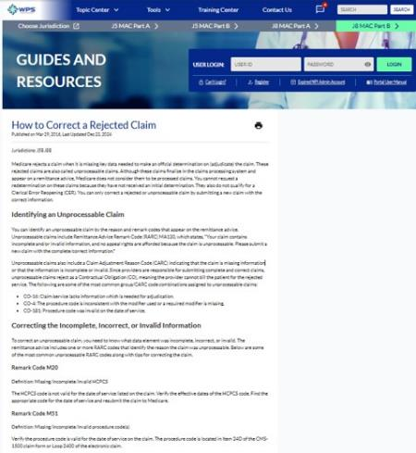
Rejected Claim Resources
How to Correct a Rejected Claim
  See Remark Codes and tips for correcting the claim
Rejections and Denials YouTube Playlist

Slide 35

Patient Eligibility Help
Use SNAP
Checking Medicare Eligibility MLN8816413

Slide 36
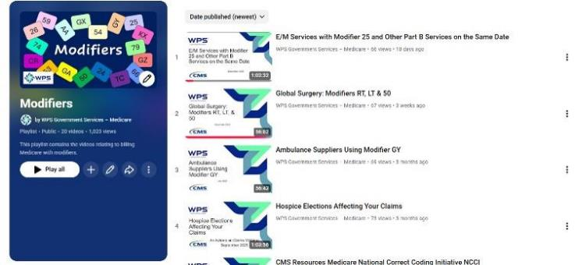
Modifier Help
WPS Modifiers webpage includes links to Modifier Fact Sheets
WPS YouTube channel Modifiers playlist

Slide 37
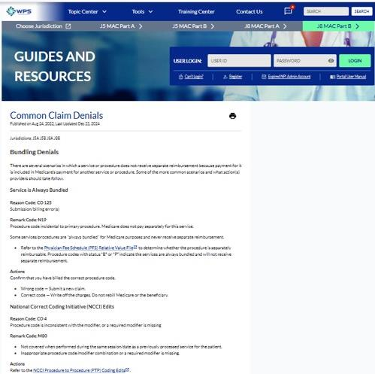
Common Claim Denials
Arranged by denial category
  Bundling
  Duplicate Claim/Service
  Entitlement
  Payer/Contractor

Slide 38
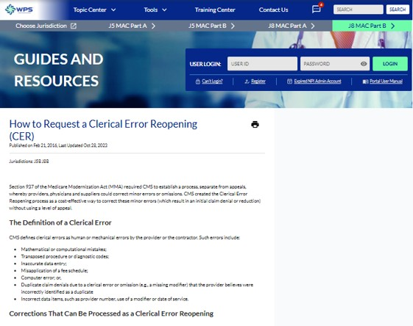
How to Request a Clerical Error Reopening (CER)
Includes
  Definition of CER
  Corrections/situations that can/cannot be processed as a CER
  Time limit for requesting a CER
    One year from initial RA notice
  How to submit
    SNAP
    Other
Notes:
RA – Remittance Advice

Slide 39
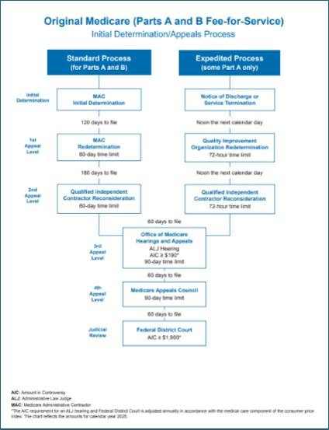
Fee for Service Appeals Process Flowchart
Includes all five appeal levels and the entity that renders each
Days to file the request
Time limit to render and send notice of decision, if any
  Letter and new RA
AIC for levels three and five
Notes:
AIC – Amount in controversy

Slide 40

Overpayments
Return funds or set-up a request
SNAP on our website (preferred)
  Overpayment Claim Adjustments (OCA)
  Refunds
Paper
  Use our Overpayment Notification/Refund Form
  Follow instructions

Slide 41
Questions and Answers

Slide 42
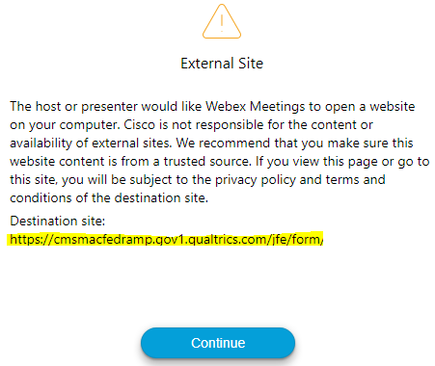

Survey
Let us know what you think!
Take time to complete our survey now.
Survey link in chat
Redirect after closing webinar

Slide 43
Thanks for attending!
Notes:
Continuing Education Units (CEUs)
WPS offers a certificate of achievement via a follow-up email. The email contains contact hours, which governing bodies may accept for CEUs. Contact your CEU governing body for details on submitting our contact hours.
Follow-up Questions
WPS will accept event related questions for seven days following the live event. The questions must be received by noon on the seventh day.
Email wps.gha.education@wpsic.com
Subject Line: Today’s Topic
Send claim specific questions to Customer Service

Slide 44
Disclaimers
This material is a tool to assist the provider community. Medicare rules change often. Access CMS’ website for current coverage, regulations and rulings.
The basis for answers given today rely on facts given in the question. Medicare rules determine final coverage.
Do not record the event as CMS does not allow this for profit making purposes.

Slide 45
CPT Copyright Notice
CPT codes, descriptions, and other data only are copyright 2025 American Medical Association. All Rights Reserved. Applicable FARS/HHSARS apply. Fee schedules, relative value units, conversion factors and/or related components are not assigned by the AMA, are not part of CPT, and the AMA is not recommending their use. The AMA does not directly or indirectly practice medicine or dispense medical services. The AMA assumes no liability for data contained or not contained herein.

