Slide 1
Medical Review Findings in Outpatient Rehabilitative Therapy Services
December 2025
Notes:
Encore Presentations
Posted to our website within 2 weeks
Available for 60 to 90 days after posting
Presentation available for download
Questions
Send questions and comments in Chat
Trouble shooting technical difficulties
Still hearing music? Close and restart the session
Change your audio setting by Choosing “Audio & Video” and selecting “Switch Audio”
Call in: The phone information is in the chat
Email us with your technical difficulties: wps.gha.education@wpsic.com

Slide 2
Objective & Agenda
Objective: Identify key Medicare coverage and documentation requirements for outpatient rehabilitative therapy services.
Agenda
Outpatient therapy coverage criteria
Documentation for outpatient therapy
Common medical review findings
Review the legal disclaimers at the end of the presentation.

Slide 3


Medical Review Overview

Slide 4

What’s Driving TPE
Data analysis of CPT codes 97110, 97112, 97150 and 97530
  CERT findings
  WPS data analysis
CPT only copyright 2024 American Medical Association. All rights reserved.
Notes:
CPT – Current Procedural Terminology
CERT – Comprehensive Error Rate Testing
TPE – Targeted Probe and Educate
WPS – Wisconsin Physicians Service

Slide 5
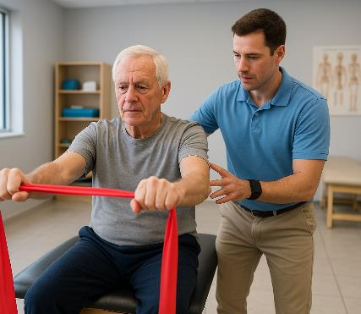
Therapeutic Procedures 97110
Therapeutic procedure, 1 or more areas, each 15 minutes: therapeutic exercises to develop strength and endurance, range of motion and flexibility
  Aerobic conditioning, post-surgical rehabilitation, range of motion, stationary cycling, treadmill walking, chronic pain management
CPT only copyright 2024 American Medical Association. All rights reserved.

Slide 6
Neuromuscular Reeducation 97112
Therapeutic procedure – Neuromuscular reeducation of movement, balance, coordination, kinesthetic sense, posture and/or proprioception for sitting and/or standing activities
Used for correcting dysfunctional movement patterns after an injury or with a neurological condition, helping individuals regain control and improve function
  Musculoskeletal injuries, neurological conditions like stroke or Parkinson’s disease, post-surgical rehabilitation and balance disorders
CPT only copyright 2024 American Medical Association. All rights reserved

Slide 7

Therapeutic Procedure(s), Group 97150
Therapeutic procedure(s), group, (2 or more individuals). Report 97150 for each member of the group
Group therapy procedures involve constant attendance of the physician or other qualified health care professional, but by definition do not require on-on-one patient contact by the same physician or other qualified health care professional.
CPT only copyright 2024 American Medical Association. All rights reserved

Slide 8
Therapeutic Activities 97530
Therapeutic activities, direct (1:1) patient contact (use of dynamic activities to improve functional performance), each 15 minutes
Functional dynamic activities requiring direct involvement
  Functional transfers, lifting, carrying and pushing/pulling, balance and coordination, stair negotiation, reaching and grasping, locomotion, sport-specific training
CPT only copyright 2024 American Medical Association. All rights reserved

Slide 9
Why 97110?
J5A
Originated from CERT error rate of 28.3%
Data analysis identified 119 providers above targeted threshold of 2,959.70 units per facility
Identified issues include:
  Insufficient documentation
CPT only copyright 2024 American Medical Association. All rights reserved

Slide 10
Why 97112?
J8B
Originated from projected CERT error rate of 13.2%
Data analysis identified 553 providers above targeted threshold of 336.25 units per provider
Identified issues include:
  Missing certification/recertifications
CPT only copyright 2024 American Medical Association. All rights reserved

Slide 11
Why 97150?
J5A
Data analysis shows high utilization with a low dollar per claim rate
Units per beneficiary in J5 exceeded national average
No CERT error rate for this problem
Identified causes of this problem include:
  Documentation does not support the need for the ongoing skills of a qualified therapist
  Documentation was missing the number of individuals/participants present in group therapy sessions
CPT only copyright 2024 American Medical Association. All rights reserved

Slide 12
Why 97530?
J8A
Data analysis of 97530 identified a significant potential risk to the Medicare Trust Fund with total dollars at risk above the 99th percentile and average dollars per claim above the 50th percentile
CERT forecast report has an error rate of 12.8%
Identified issues of this problem include:
  No documentation submitted in response to the ADR
  Documentation does not support the continued need for skilled therapy
  Progress reports were completed by a PTA
CPT only copyright 2024 American Medical Association. All rights reserved
Notes:
ADR – Additional Documentation Request
PTA - Physical Therapy Assistant

Slide 13

Understanding Outpatient Therapy Coverage

Slide 14

Coverage Criteria
Medicare Benefit Policy Manual, 100-02, Chapter 15, Sections 220-230
Need-based services
Established POC
Under care of a physician
Physician certification
Notes:
POC – Plan of Care

Slide 15

Documentation Expectations

Slide 16
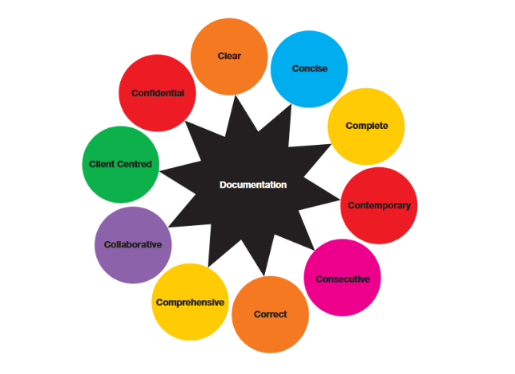
Principles of Documentation

Slide 17

Required Components of Documentation
Evaluation and Reevaluations
POC
Goals
Certification/Recertification
Progress notes/reports
Discharge summary
Treatment notes for each day of treatment
Treatment minutes
Signatures with credentials

Slide 18

Supporting Intensity, Complexity and Skilled Nature of Treatment
Requires skills of a therapist
Objective and measurable
Observations and assessments
Follows POC
Progress toward goals, hinderances and working through plateaus
Minutes of treatment

Slide 19

Linking Goals, Interventions and Outcomes
Patient-centered and functional
SMART framework
Medical necessity
Regular review
Notes:
SMART: Specific
Measurable
Achievable
Relevant
Time-Based

Slide 20
Documentation of Therapeutic Procedure
Functional limitations or impairments that necessitate the therapy
Relevant medical history, diagnostic findings, and clinical assessments
Demonstration of why direct supervision is required
A description of the procedure, including specific techniques and equipment
List or describe the specific exercises, tasks, or activities performed
The amount of time spent on the therapy
The type, amount, duration, and frequency of services

Slide 21

Documentation of Neuromuscular Reeducation
Identify the neuromuscular deficits addressed
Detail specific exercises or interventions used
Demonstrate skilled therapeutic reasoning
Describe how intervention improves movement quality, coordination, balance, posture and kinesthetic sense

Slide 22

Documentation of Therapeutic Activities
Describe dynamic activities to improve functional performance
  Movement patterns used to accomplish tasks
Functional activities
  Bending, lifting, carrying, reaching, catching and overhead activities

Slide 23
Documentation of Group
Detail the number of people in the group
Detail the therapeutic procedure(s) being performed
Therapy goal of group session
Proof of supervising healthcare provider
It is not necessary that all patients perform the same activity simultaneously
Bill only once per session regardless of time

Slide 24

Documentation That Must Be Performed by Therapist
Evaluation and Reevaluations
POC with goals
  Changes to POC
Progress notes/reports
  Discharge summary
  Completed every 10 treatment days

Slide 25

Review Findings

Slide 26

TP001
Documentation does not support the plan of care was established and signed by a qualified clinician/practitioner
  POC can only be established or changed by physician or therapist
Notes:
POC – Plan of Care

Slide 27

TP002
The documentation submitted did not support the approval/certification of the plan of care for the therapy service(s)

Slide 28

TP004
The documentation submitted did not support the reason for delayed/lapsed (re)certification

Slide 29

TP007
Documentation does not support the POC was recertified within the duration of the prior plan of care, or within 90 days, whichever is less

Slide 30
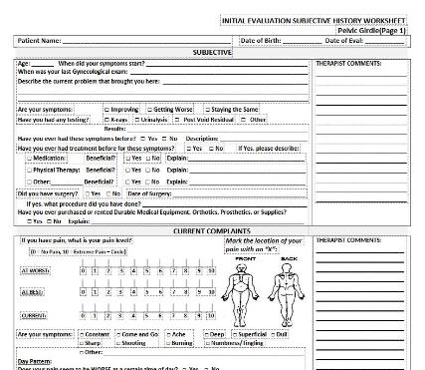
TP100
The documentation submitted did not include an initial evaluation to support the therapy service(s) billed

Slide 31

TP300
The documentation submitted did not include a progress report which was completed

Slide 32

TP301
The documentation submitted did not include a progress report which was either signed or signed by qualified staff

Slide 33

TP303
The documentation submitted did not include a progress report which was completed a minimum of every 10th treatment visit throughout the episode of care or within 7 calendar days from the end date of the reporting period

Slide 34

TP400
The documentation submitted lacked evidence to support the ongoing skills of a qualified therapist were required to complete the treatment

Slide 35
TP501
Documentation did not include a treatment note which contained all the required elements including date of treatment, description of modality/procedure to support accurate billing, total treatment minutes/total timed code treatment minutes and signature of qualified professional

Slide 36

TP903
The documentation supports the CQ and/or CO modifier should have been billed as services were furnished in whole or in part by a therapy assistant

Slide 37
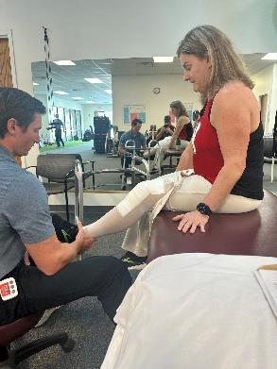
GBB03
The documentation submitted does not support services were rendered as billed

Slide 38

Connecting Findings to Overall Compliance
These codes are review drivers—not the full scope of compliance
Documentation principles apply across all therapy services
Importance of accurate code selection and billing
Improving documentation for these codes strengthens overall compliance

Slide 39

Resources
Medicare Benefit Policy Manual, Chapter 15, Sections 220-230
Therapy Assistants: What They Cannot Do
Outpatient Therapy Services
Modifier CQ Fact Sheet
Modifier CO Fact Sheet

Slide 40

Let’s Recap
Identified key Medicare coverage and documentation requirements for outpatient rehabilitative therapy services.
  Outpatient therapy coverage criteria
  Documentation for outpatient therapy
  Common medical review findings

Slide 41

Questions and Answers

Slide 42

Annual Medicare Participation Announcement
Still trying to decide if you are going to be a participating provider in Medicare for 2026?
Review the CMS Annual Medicare Participation Announcement
Fees will be placed on our website after the CY2026 physician fee schedule regulations are put on display
Notes:
As you plan for next year, CMS reminds you of the advantages of participating in Medicare:
You’re paid the full Medicare Physician Fee Schedule allowed amount. If you’re a non-participating provider, Medicare pays 5% less than the Medicare Physician Fee Schedule allowed amount.
Medicare pays you directly (on an assignment-related basis).
Medicare forwards claim information to Medigap (Medicare supplement coverage) insurance (if any).
By December 31, 2025, all physicians, practitioners, and suppliers – regardless of their Medicare participation status – must decide whether to participate for CY 2026.
You don’t need to do anything if you’re:
Already participating in Medicare, and you want to continue your participation
Not currently participating, and you don’t want to participate
See the Annual Medicare Participation Announcement webpage for more information on how to change your Medicare participation.
Additionally, the fees will be placed on our website after the CY 2026 physician fee schedule regulation is put on display.

Slide 43
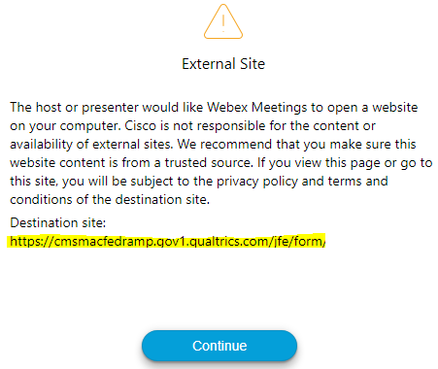

Survey
Let us know what you think!
Take time to complete our survey now.
Survey link in chat
Redirect after closing webinar

Slide 44
Thanks for attending!
Notes:
Continuing Education Units (CEUs)
WPS offers a certificate of achievement via a follow-up email. The email contains contact hours, which governing bodies may accept for CEUs. Contact your CEU governing body for details on submitting our contact hours.
Follow-up Questions
WPS will accept event related questions for seven days following the live event. The questions must be received by noon on the seventh day.
Email wps.gha.education@wpsic.com
Subject Line: Today’s Topic
Send claim specific questions to Customer Service

Slide 45
Disclaimers
This material is a tool to assist the provider community. Medicare rules change often. Access CMS’ website for current coverage, regulations and rulings.
The basis for answers given today rely on facts given in the question. Medicare rules determine final coverage.
Do not record the event as CMS does not allow this for profit making purposes.

Slide 46
CPT Copyright Notice
CPT codes, descriptions, and other data only are copyright 2024 American Medical Association. All Rights Reserved. Applicable FARS/HHSARS apply. Fee schedules, relative value units, conversion factors and/or related components are not assigned by the AMA, are not part of CPT, and the AMA is not recommending their use. The AMA does not directly or indirectly practice medicine or dispense medical services. The AMA assumes no liability for data contained or not contained herein.

