Slide 1
Medical Review of Mohs Micrographic Surgery
November 2025
Notes:
Encore Presentations
Posted to our website with 2 weeks
Available for 60 to 90 days after posting
Presentation available for download
Questions
Send questions and comments in Chat
Trouble shooting technical difficulties
Still hearing music? Close and restart the session
Change your audio setting by Choosing “Audio & Video” and selecting “Switch Audio”
Call in: The phone information is in the chat
Email us with your technical difficulties: wps.gha.education@wpsic.com

Slide 2
Objective & Agenda
Objective: Learn about the reviews for Mohs Micrographic surgery CPT 17311 and why the reviews are happening
Agenda
Defining Mohs Micrographic Surgery
Why We are Reviewing
Coverage
Documentation
Review the legal disclaimers at the end of the presentation. CPT only copyright 2024 American Medical Association. All rights reserved. Review information located in the notes section of this PowerPoint Slide Deck

Slide 3
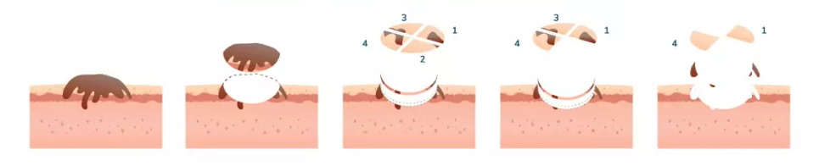

Mohs Micrographic Surgery (MMS)

Slide 4
What is Mohs
Technique for treating two most common types of skin-cancer
  Basal cell carcinomas (BCC)
  Squamous cell carcinoma (SCC)
Staged procedure but one occurrence
  Layers of tissue removed and examined under microscope
  Continues until no more cancer cells found under microscope
Surgeon performs in 2 capacities: surgeon and pathologist
Healthy tissue sparing procedure

Slide 5

Why We Are Reviewing

Slide 6

Data Analysis
J5B providers are exceeding the national average utilization of CPT 17311 in terms of units per provider
  126.49 units per provider in J5
  112.47 units per provider nationally
Reviews of top providers starting Sept, Oct, Nov and Dec
CPT only copyright 2024 American Medical Association. All rights reserved

Slide 7
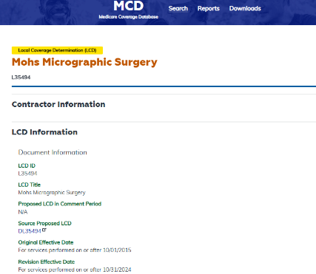
Guidelines Used for Review
LCD – L35494 Mohs Micrographic Surgery
Article – A57477 Billing and Coding: Mohs Micrographic Surgery
Notes:
LCD – Local Coverage Determination

Slide 8

What Reviewers Check For
Proof of medical necessity
  Covered diagnosis
  Coverage indications
  Appropriate surgery
  Lesion characteristics
Documentation requirements
Appropriately billed

Slide 9

Coverage

Slide 10
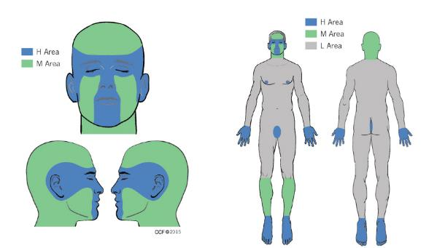
Anatomic Locations for Coverage
Area H: Mask areas of the face, genitalia, hands, feet, nail units, ankles, nipples/areola
Area M: Cheeks, forehead, scalp, neck, jawline, pretibial surface
Area L: Trunk and extremities

Slide 11
Covered Indications
Basal cell carcinoma (BCC)*
Squamous cell carcinoma (SCC)*
Basal or squamous cell carcinoma
Lentigo maligna and melanoma in situ
Other less common skin cancers
* Most common diagnosis for Mohs

Slide 12

Aggressive Features to Help Define Medical Necessity in Basal Cell
Morpheaform, fibrosing, sclerosing
Infiltrating
Perineural
Metatypical/keratotic
Micronodular

Slide 13
Aggressive Features of Squamous Cell Carcinoma
Sclerosing
Basosquamous excluding keratotic BCC
Small cell
Poorly or undifferentiated degree of keratinization
Perineural or perivascular
Spindle cell
Pagetoid
Infiltrating
Keratoacanthoma (KA) type: central facial
Single cell
Clear cell
Lymphoepithelial
Sarcomatoid
Breslow depth below 2mm or greater
Clark level IV or greater

Slide 14

Coverage Limitation
Surgeon who does not personally perform both the excision and histologic evaluation
  Use only standard excision codes
If biopsy is done on same day as Mohs, must use – 59 modifier
Procedures that exceed medical need
Repeat Mohs in last 60-days without prior results and documentation of need

Slide 15

Documentation

Slide 16

Documentation Components
Relevant medical history
Physical examination
Signed operative note
Pathology documentation to support Mohs and Mohs technique
Same physician performing surgery and pathology
Histology representing first stage and subsequent stages

Slide 17
Additional Documentation
Characteristics of the lesion pre-procedure, including location and measurements
Why the lesion was not managed by standard excision or destruction technique and when applicable, why procedures for complex repair, adjacent tissue transfer or rearrangement, flap, or graft are employed
Signature attestation statement, if applicable
ABN, if applicable
Any other documentation supporting requirements of LCD
Notes:
ABN – Advance Beneficiary Notice of Noncoverage

Slide 18
Documentation Tips
If surgical defect created by MMS requires reconstruction, it should support reconstruction was appropriate to preserve functional capabilities and restore physical appearance
Documentation must support billing
  1 unit initial/first stage up to 5 tissue blocks
  Use appropriate add-on codes for additional block/stage after first 5
Incorrect coding may result in downcoding, partial payment or denial
Notes:
MMS – Mohs Micrographic Surgery

Slide 19

Review Findings

Slide 20

GBC01
The documentation submitted does not support medical necessity as listed in coverage requirements in the National Coverage Determination or Local Coverage Determination
  Documentation did not support a covered diagnosis as listed in the LCD

Slide 21

GBB02
The documentation submitted was incomplete and/or insufficient
  Documentation was unclear as to how many blocks were placed for the lesion

Slide 22

Questions and Answers

Slide 23
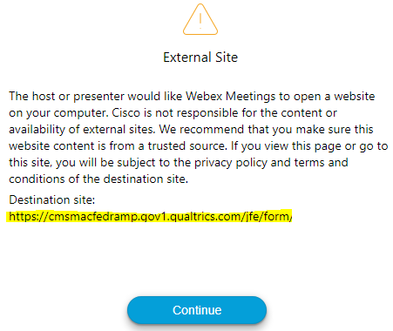

Survey
Let us know what you think!
Take time to complete our survey now.
Survey link in chat
Redirect after closing webinar

Slide 24

Annual Medicare Participation Announcement
Still trying to decide if you are going to be a participating provider in Medicare for 2026?
Review the CMS Annual Medicare Participation Announcement
Fees will be placed on our website after the CY2026 physician fee schedule regulations are put on display
Notes:
As you plan for next year, CMS reminds you of the advantages of participating in Medicare:
You’re paid the full Medicare Physician Fee Schedule allowed amount. If you’re a non-participating provider, Medicare pays 5% less than the Medicare Physician Fee Schedule allowed amount.
Medicare pays you directly (on an assignment-related basis).
Medicare forwards claim information to Medigap (Medicare supplement coverage) insurance (if any).
By December 31, 2025, all physicians, practitioners, and suppliers – regardless of their Medicare participation status – must decide whether to participate for CY 2026.
You don’t need to do anything if you’re:
Already participating in Medicare, and you want to continue your participation
Not currently participating, and you don’t want to participate
See the Annual Medicare Participation Announcement webpage for more information on how to change your Medicare participation.
Additionally, the fees will be placed on our website after the CY 2026 physician fee schedule regulation is put on display.

Slide 25
Thanks for attending!
Notes:
Continuing Education Units (CEUs)
WPS offers a certificate of achievement via a follow-up email. The email contains contact hours, which governing bodies may accept for CEUs. Contact your CUE governing body for details on submitting our contact hours.
Follow-up Questions
WPS will accept event related questions for seven days following the live event. The questions must be received by noon on the seventh day.
Email wps.gha.education@wpsic.com
Subject Line: Today’s Topic
Send claim specific questions to Customer Service

Slide 26
Disclaimers
This material is a tool to assist the provider community. Medicare rules change often. Access CMS’ website for current coverage, regulations and rulings.
The basis for answers given today rely on facts given in the question. Medicare rules determine final coverage.
Do not record the event as CMS does not allow this for profit making purposes.

Slide 27
CPT Copyright Notice
CPT codes, descriptions, and other data only are copyright 2024 American Medical Association. All Rights Reserved. Applicable FARS/HHSARS apply. Fee schedules, relative value units, conversion factors and/or related components are not assigned by the AMA, are not part of CPT, and the AMA is not recommending their use. The AMA does not directly or indirectly practice medicine or dispense medical services. The AMA assumes no liability for data contained or not contained herein.

