Slide 1

Audio Information
The presenter started speaking
  Still hearing music?
    Close and restart the session
  Change your audio setting by
    Choosing “Audio & Video”
    Select “Switch Audio”
  Call in
    The phone information is in the chat
Email for technical difficulties
  wps.gha.education@wpsic.com

Slide 2
Preventive Services for Lung Cancer Screening (Clinical)
November 2025

Slide 3

Housekeeping
Training Center webpage
  Training Material
  Upcoming Events
  Encore Presentations
    60 to 90 days
Send questions and comments in Chat
After this, tell CMS how we did on the survey

Slide 4

Disclaimer
This material is a tool to assist the provider community. Medicare rules change often.
The basis for answers given today rely on facts given in the question. Medicare rules determine final coverage.
Access CMS’ website for current coverage, regulations and rulings.

Slide 5
Acronyms
CT – Computed Tomography
LDCT – Low Dose Computed Tomography
MRI – Magnetic Resonance Imaging
NSCLC – Non-Small Cell Lung Cancer
PET – Positron Emission Tomography
SCLC – Small Cell Lung Cancer
USPSTF – United States Preventive Services Task Force

Slide 6
Objective & Agenda
Objective: Provide an overview of the clinical aspects for the Medicare preventive services of Lung Cancer Screening with Low Dose Computed Tomography
We will cover:
  Background information about lung cancer
  Treatment options for lung cancer
  Strategies for prevention of lung cancer
  Medicare Part B coverage criteria for Lung Cancer Screening with LDCT

Slide 7


Background on Lung Cancer

Slide 8
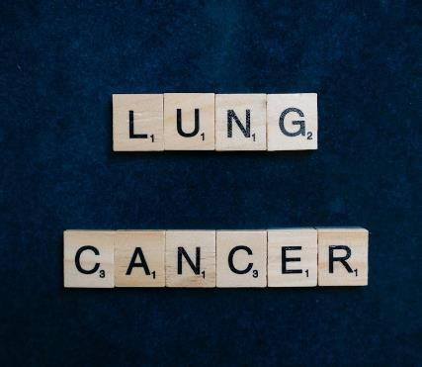
Facts and Statistics
Second most common cancer (excluding skin cancer)
Leading cause of cancer-related deaths in United States
  1 in 5 cancer deaths nationwide
2025
  Approximately 226,650 new cases
  Around 124,730 deaths from the disease

Slide 9

Additional Facts and Statistics
Black men 12% higher likelihood of developing lung cancer
Black women approximately 16% lower rate compared to White women
White men have a higher likelihood to develop SCLC
Primary risk factor for lung cancer is smoking
Responsible for about 80-90% of all lung cancer deaths

Slide 10
Lung Cancer
Occurs when abnormal, malignant cells start growing uncontrollably within the lung tissue
  Multiply and form tumors
  May eventually spread or metastasize
Primary lung cancer refers to cancer that originates specifically within the lung tissue
Secondary lung cancer refers to cancer from another part of the body that metastasizes to the lungs

Slide 11
Types of Lung Cancer
Most Common Types
  Non-small cell lung cancer (NSCLC)
    Adenocarcinoma
    Squamous cell carcinoma
    Large cell carcinoma
  Small cell lung cancer (SCLC)
Less Common Types
  Mesothelioma
  Lung carcinoid tumors
  Chest wall tumors
  Metastasized cancers from other areas of the body

Slide 12

Modifiable Risk Factors
Tobacco smoking
  Leading risk factor
Exposure to secondhand smoke
Diet
Exposure to radon, asbestos, diesel exhaust, and certain industrial chemicals found in the workplace

Slide 13
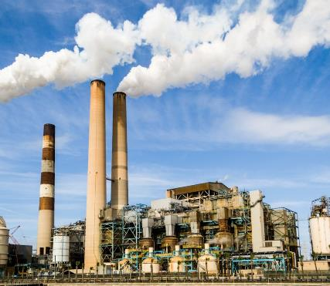
Nonmodifiable Risk Factors
Age
Personal or family history of lung cancer
Previous radiation therapy
Air pollution

Slide 14

Signs and Symptoms
Initial stages – typically asymptomatic
Persistent or worsening cough
Cough with bloody sputum (hemoptysis)
Hoarseness
Chest pain or discomfort
Shortness of breath (dyspnea)

Slide 15

Other Signs and Symptoms
Wheezing
Frequent or recurring episodes of pneumonia and bronchitis
Fatigue
Loss of appetite
Unexplained weight loss
Swollen or enlarged lymph nodes in the mediastinum

Slide 16
Additional Signs and Symptoms
Bone pain
Headache
Difficulty swallowing (dysphagia)
Swelling of the face, neck, or arms
Enlarged lymph nodes in the neck or collarbone area
Weakness or numbness in the arms or legs
Clubbing of fingers
Dizziness
Balance issues
Jaundice
Syndromes
  Horner syndrome due to Pancoast tumors
  Superior vena cava syndrome
  Paraneoplastic syndromes

Slide 17

Screening with LDCT
USPSTF’s recommended method for screening high risk individuals
  Smokers and former smokers
High sensitivity
  Improves accurate detection of lung cancer while helping to exclude other conditions
Detailed images of the lungs analyzed for any abnormalities that could indicate the presence of cancer

Slide 18
Diagnosis/Tests
Completion of a medical history and a physical examination
Questions regarding any current symptoms as well when the symptoms initially appeared
Chest X-ray
Additional tests
  Imaging tests to determine location and size of cancer
  Sputum cytology
  Biopsy
  Imaging tests if provider suspects lung cancer has metastasized

Slide 19

Staging – NSCLC
American Joint Committee on Cancer (AJCC) classification
  0, IA1, IA2 IA3, IB, IIA, IIB, IIC, IIIA, IIIB, IIIC, IVA, and IVB
  The higher the number, the more advanced the cancer is
  T, N, and M to further define the stage grouping
Non-Small Cell Lung Cancer Stages

Slide 20

Staging – SCLC
Two-stage system
  Limited
  Extensive
Small Cell Lung Cancer Stages

Slide 21
Treatment
Surgery (Surgical resection of the lung)
  Sleeve resection
  Wedge resection
  Segmental resection
  Lobectomy
  Pneumonectomy
  Removal of lymph nodes
Chemotherapy
Radiation therapy
  External beam radiation therapy (EBRT)
  Brachytherapy
  Proton therapy
  Often administered in combination with chemotherapy

Slide 22
Additional Treatment
Immunotherapy
Ablative therapies for NSCLC
  Cold therapy such as cryoablation
  Heat therapy such as radiofrequency ablation (or RFA) and microwave ablation
Targeted therapy for NSCLC
Tumor Treating Fields (TTF) therapy for NSCLC
Palliative care (supportive care)

Slide 23
Prevention
Quit smoking or never starting in the first place
  The Great American Smokeout ®
Avoid secondhand smoke whenever possible
Avoid the use of supplements such as beta carotene (if a smoker)
Reduce or limit amount of exposure to radon
Reduce or limit amount of exposure to hazardous chemicals commonly found in the workplace
Test well water for arsenic contamination
Consume a healthy, well-balanced diet
Get screened for lung cancer

Slide 24

Eligibility and Coverage

Slide 25
Eligibility
Covers for Medicare Part B beneficiaries who meet the following criteria
  Are between the ages of 50–77
  Have no signs or symptoms of lung cancer
  Have a history of tobacco smoking equivalent to at least 20 pack-years
    1 pack-year is equal to smoking 1 pack of 20 cigarettes per day for 1 year
  Either currently smokes or quit smoking within the last 15 years
  Received an order from their healthcare provider for lung cancer screening with LDCT

Slide 26
Frequency
Covered annually
Prior to the initial lung cancer screening with LDCT, must receive a counseling and shared decision-making visit (G0296)
  For subsequent annual screenings, the counseling and shared decision-making visit is not required but may still be provided at the provider’s discretion

Slide 27
Counseling and Shared Decision-Making Visit
Required documentation
  Confirmation that the patient meets all eligibility criteria for lung cancer screening
  Evidence of shared decision-making discussion using one or more decision aids
  Documentation of counseling on importance of adhering to annual lung cancer screening with LDCT
  Counseling to discuss the importance of abstaining from cigarette smoking
    If appropriate, provide information about tobacco-cessation resources

Slide 28

Additional Coverage Information
Cost
  No copayment, coinsurance, or deductible
Telehealth
  Counseling and shared decision-making visit (G0296) is telehealth eligible
  Requirement can be met through audio-only interaction

Slide 29
Providers/Setting
Reading radiologist
  Must hold board certification or board eligibility from the American Board of Radiology or an equivalent organization
Lung cancer screening with LDCT
  Must be provided in a radiology imaging facility that uses a standardized system for identifying, classifying, and reporting lung nodules
Reference : Medicare Claims Processing Manual, Chapter 18, § 220

Slide 30

Documentation

Slide 31
Documentation Requirements
Date service was provided
Signed and dated physician or qualified non-physician practitioner order for the procedure performed
Documentation that the counseling and shared decision-making visit occurred prior to the initial lung cancer screening with LDCT being performed
Test results and documentation of any follow-up care or counseling that was given following evaluation of results
Documentation to support medical necessity
Documentation dated and signed with provider’s credentials

Slide 32

Review of Today’s Webinar
During today’s webinar, we
  Discussed background information about lung cancer
  Explained treatment options for lung cancer
  Discussed strategies for prevention of lung cancer
  Reviewed Medicare Part B coverage criteria for the Lung Cancer Screening with LDCT

Slide 33
Resources
MLN006559 – Medicare Preventive Services – Lung Cancer Screening with Low Dose Computed Tomography (LDCT)
National Coverage Determination (NCD) 210.14 Lung Cancer Screening with Low Dose Computed Tomography (LDCT)
American Cancer Society – Lung Cancer
Encore: Preventive Services: Lung Cancer Screening & Smoking Cessation (billing)

Slide 34

Questions and Answers

Slide 35
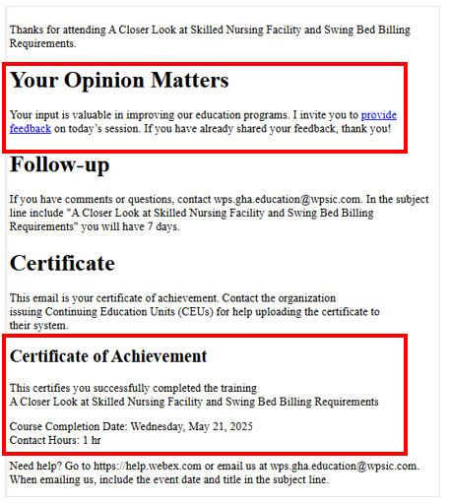

Certificate of Achievement
Complete survey
Email contains contact hours

Slide 36

Follow-up Questions
Send your questions by 12:00 PM CT for seven days following the training
Email wps.gha.education@wpsic.com
Subject Line: Lung Cancer Screening (Clinical)
Send claim specific questions to Customer Service

Slide 37

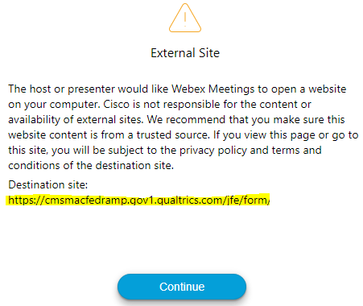
Survey
Let us know what you think!
Take time to complete the survey now.
Survey link in chat
Redirect after closing webinar

Slide 38

We Hear You
We are committed to making changes to improve your education experience.
Based on survey comments
  Chapters to YouTube
  Training indicators

Slide 39
Thanks for attending!

