Slide 1
Common Part B Nurse Practitioner Rejections and Denials
November 2025
Notes:
Encore Presentations
Posted to our website with 2 weeks
Available for 60 to 90 days after posting
Presentation available for download
Questions
Send questions and comments in Chat
Trouble shooting technical difficulties
Still hearing music? Close and restart the session
Change your audio setting by Choosing “Audio & Video” and selecting “Switch Audio”
Call in: The phone information is in the chat
Email us with your technical difficulties: wps.gha.education@wpsic.com

Slide 2
Objective & Agenda
Objective: To help avoid rejected and denied claims.
Agenda
Define rejections and denials
Reveal reasons for rejections and denials for this specialty based on data
Discuss how to fix and avoid both
Provide resources
Review the legal disclaimers at the end of the presentation.

Slide 3

The Claim Process

Slide 4
Claim Submission
Submit electronically
Use 999 report to confirm claim receipts
Use 277 report for more specific information
  Find information in the Medicare 276/277 Companion Guide
    Clarifies, supplements and further defines data content requirements
    Correct or resubmit

Slide 5
Remittance Advice (RA)
Two formats
  Electronic Remittance Advice (ERA)
  Standard Paper Remittance (SPR)
Provides claim adjudication information to provider
Includes information about:
  Adjustments
  Denials
  Missing items
  Refunds
  Offsets

Slide 6
Claim Adjustment Reasons and Remark Codes
Claim Adjustment Reason Codes (CARCs) explain why a claim paid differently than billed
Remittance Advice Remark Codes (RARCs) provide more details about an adjustment described by a CARC

Slide 7

Claim Adjustment Group Codes
Assign financial liability for unpaid portion of claim balance
  CO – Contractual Obligation – provider liable
  PR – Patient Responsibility

Slide 8
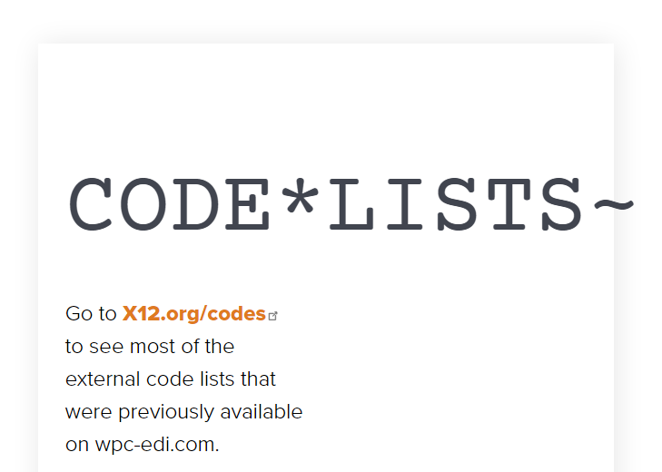
Code Maintenance
Washington Publishing Company (WPC) maintains codes for CMS
Find link to code lists on WPC website

Slide 9
Rejection
Unprocessable
Returned on the “front end”
Missing or incorrect information
No appeal rights; resubmit the service
MA130 and CO16 codes on RA
Patient not liable

Slide 10
Denial
Adjudicated
Fails to meet payment criteria
  Statutory requirements
  Medical necessity/frequency
  Eligibility
MA01 code on RA provides appeal rights
Patient liability determined

Slide 11


Correct or Appeal

Slide 12

Potential Actions to Choose
Rejection
  Fix the error, resubmit the service
Denial
  Fix the error, resubmit the service, if able
  Clerical Error Reopening (CER) process
    Use Secure Net Access Portal (SNAP), if able
  Request an appeal

Slide 13
Appeals
Five levels
  MACs render only level one Redetermination
All levels have time limits to file the request
  Time limits for completion (decision) also apply
Two levels have Amount in Controversy (AIC) thresholds that apply
  Level three (Administrative Law Judge (ALJ) Hearing)
  Level five (Federal Court Review)

Slide 14
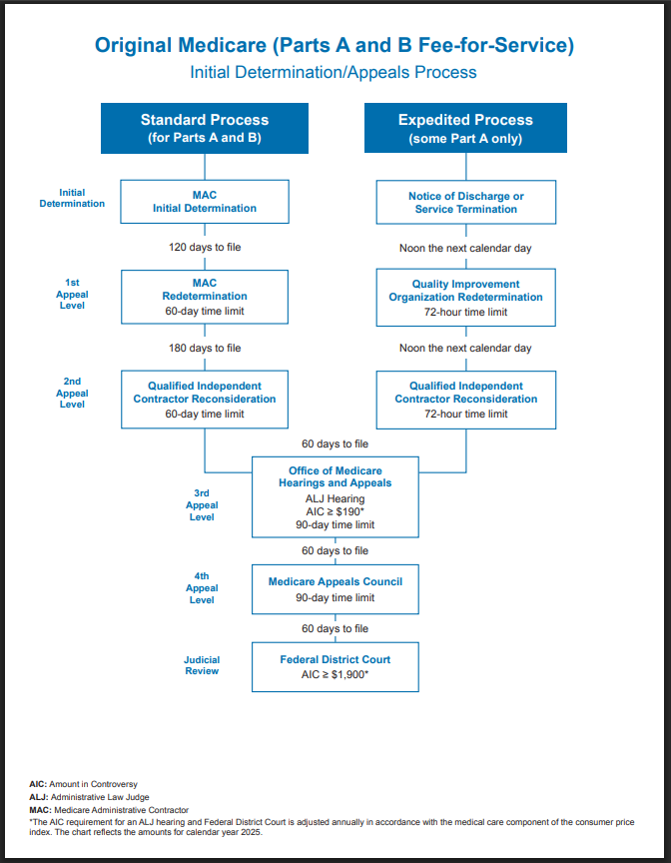
Appeals Resources
How to Appeal a Claim Determination
CMS Fee-for-Service (FFS) Appeals Process Flowchart
  Updated annually

Slide 15

Data Dashboard

Slide 16

Ways to View Data
Rejections or denials
  State(s) and county or counties
    By reason
    By CPT/HCPCS code
    By specialty
Trending

Slide 17

Data Slicers
WPS MAC Jurisdictions 5 and 8
Specialty 50 (nurse practitioner)
Submission dates 07/01/2025 – 09/30/2025
  Data last refreshed on 10/13/2025

Slide 18
Common Rejection Reasons – Specialty 50
PA, NP, or CNS not internally associated with billing provider
Missing/incomplete/invalid ordering primary identifier
Incomplete/invalid plan information for other insurance
Claim must be submitted to RRB
Facility/laboratory name and address or PIN missing
Invalid or missing modifier

Slide 19
More Common Rejection Reasons – Specialty 50
CLIA number is invalid or missing
Missing/incomplete/invalid billing provider primary identifier
This claim has been forwarded to Palmetto (RRB)
The clinic number is missing or was not entered correctly
Patient not enrolled in demo at the time services rendered

Slide 20
Common Rejections by CPT/HCPCS Code – Specialty 50
99309
  Treatment rendered in inappropriate or invalid place of service
  Missing/incomplete/invalid billing provider primary identifier
99214
  Incomplete, invalid plan information for other insurance
  PA, NP, or CNS not internally associated with billing provider
CPT only copyright 2024 American Medical Association. All rights reserved.

Slide 21
More Common Rejections by CPT/HCPCS Code – Specialty 50
99308
  Treatment rendered in inappropriate or invalid place of service
  PA, NP, or CNS not internally associated with billing provider
99213
  Incomplete, invalid plan information for other insurance
  PA, NP, or CNS not internally associated with billing provider
CPT only copyright 2024 American Medical Association. All rights reserved.

Slide 22
Specialty 50 – Common Rejections by CPT/HCPCS
82948
  CLIA number is invalid or missing
  Missing/incomplete/invalid ordering primary identifier
36415
  Missing/incomplete/invalid ordering primary identifier
  PA, NP, or CNS not internally associated with billing provider
CPT only copyright 2024 American Medical Association. All rights reserved.

Slide 23

Trending Example – Specialty 50 – Rejections
Claim must be submitted to RRB
  Current three months – 1,190
  Prior three months – 814
  Difference – 376
  46% increase

Slide 24
Common Denial Reasons – Specialty 50
Collection of fee-for-service during periods of managed care
This is a duplicate charge
Not cov when perf/refer/ordered by this provider
Duplicate charge paid (DATE) on claim (ICN)
Treatment rendered in inappropriate or invalid place of service

Slide 25
More Common Denial Reasons – Specialty 50
These services are denied because the patient is in a hospice
Separate payment not made for this service
Duplicate charge paid (DATE) on claim (ICN)
Can pay only one initial visit per specialty per group
Claim must be sent to EGHP first

Slide 26
Common Denials by CPT/HCPCS Code – Specialty 50
99309
  Treatment rendered in inappropriate or invalid place of service
  Collection of fee-for-service during periods of managed care
99214
  This is a duplicate charge
  Collection of fee-for-service during periods of managed care
99308
  Not cov when perf/refer/ordered by this provider
  Treatment rendered in inappropriate or invalid place of service
CPT only copyright 2024 American Medical Association. All rights reserved.

Slide 27
More Common Denials by CPT/HCPCS Code – Specialty 50
99213
  This is a duplicate charge
  Collection of fee-for-service during periods of managed care
G2211
  Service not payable with other services rendered on the same DOS
  Procedure must be billed with primary services
99204
  Can pay only one initial visit per specialty per group
  Collection of fee-for-service during periods of managed care
CPT only copyright 2024 American Medical Association. All rights reserved.

Slide 28
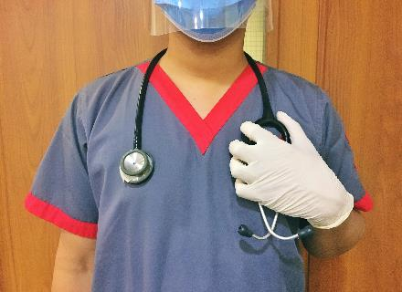
Trending Example – Specialty 50 Denials
Claim must be sent to EGHP first
  Current three months – 6,295
  Prior three months – 4,111
  Difference – 2,184
  53% increase

Slide 29

Modifier Issue Fixes
Verify
  Required modifier present
  Modifier matches procedure code
  Modifier valid for date of service

Slide 30

Patient Eligibility Fixes
Verify
  Patient name and MBI exact match
  Submit services to correct payer
    Railroad Retirement Board (RRB)
    Medicare Advantage Plan (Part C)

Slide 31

Provider Number Fixes
Verify
  Information entered
  No keying errors
  Provider enrollment records valid
  Rendering provider associated with billing provider
  Ordering provider information entered

Slide 32

Avoid Duplicate Denials
Verify
  No auto resubmitting prior to establishing status
  Appropriate billing
  Appropriate modifiers

Slide 33
Claim Form Instructions
Medicare Claims Processing Manual
  Chapter 24 – General EDI and EDI Support Requirements, Electronic Claims, Coordination of Benefits Requirements, Mandatory Electronic Filing of Medicare Claims
  Chapter 25 – Completing and Processing the Form CMS-1450 Data Set
  Chapter 26 – Completing and Processing Form CMS-1500 Data Set

Slide 34

Avoid MSP Denials
Medicare Secondary Payer (MSP) Fact Sheet
MSP Questionnaire
CMS Medicare Secondary Payer webpage
WPS YouTube Channel
  MSP Playlist

Slide 35

Avoid National Correct Coding Initiative (NCCI) Edit Denials
Medicare NCCI Policy Manual
Medicare NCCI Procedure to Procedure Code Edits
Medicare NCCI Medically Unlikely Edits
Medicare NCCI Add-on Code Edits
How to Use the Medicare NCCI Tools

Slide 36

More Resources and Tools

Slide 37
Interactive Voice Response (IVR) System
Find claim status and details
24 hours a day, 7 days a week
  Limited functionality outside normal business hours
Use voice or telephone keypad
Instructions in IVR Operating Guide

Slide 38
WPS Secure Net Access Portal (SNAP)
Log in to check eligibility, claim status, claim details and claim actions
24 hours a day, 7 days a week
  Limited functionality outside normal business hours
Instructions in Portal User Manual

Slide 39
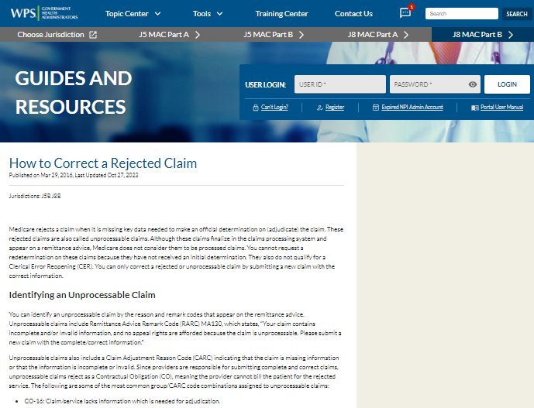
Website Resource - Rejections
How to Correct a Rejected Claim
  Listed by reason and remark codes

Slide 40
Website Resource - Denials
Common Claim Denials suggests actions to take to avoid common reasons for denials
  Listed by reason and remark codes for these categories:
    Bundling
    Duplicate claim/service
    Global surgery rules
    Entitlement denials
    Payer/Contractor denials
    Provider number denials

Slide 41
WPS Resources
WPS website
  Code Lookup Tool on homepage
Provider Enrollment Guides and Resources
Billing Services During a Hospice Election
Review Contractor Directory – Interactive Map
Evaluation and Management Services webpage
  Includes links to CMS resources
    Includes G2211 resources

Slide 42
More WPS Resources
Nonphysician Practitioners (NPPs) in Multi-Specialty Groups
Live Events webpage
Encore Presentations webpage
YouTube Channel
  Includes Medicare Advantage (MA) Plans and more

Slide 43
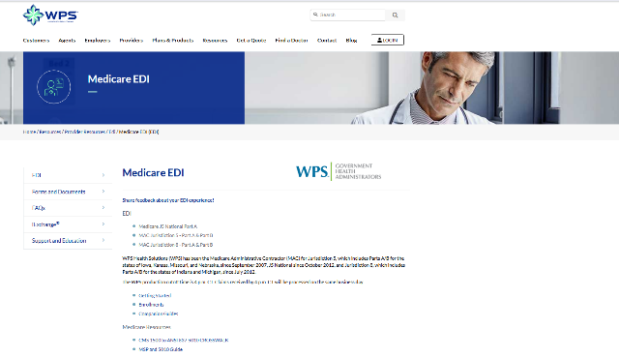
WPS Medicare EDI Webpage
Getting started
Enrollments
Companion guides
Resources
  CMS 1500 to ANSI 837 5010 Crosswalk
More

Slide 44

CMS Resources
Checking Medicare Eligibility Fact Sheet
Order and Referring files
  Includes search
Place of Service Code Set
Clinical Laboratory Improvement Amendments (CLIA) webpage

Slide 45
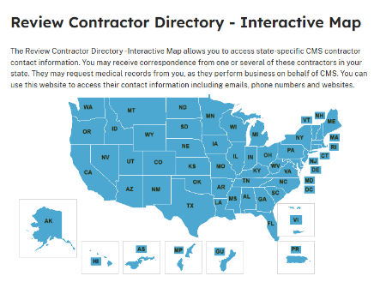
More CMS Resources
Review Contractor Directory – Interactive Map
Physician Fee Service (PFS) Relative Value Files
  “B” in Status column means service is always bundled
Guiding an Improved Dementia Experience (GUIDE) Model webpage

Slide 46
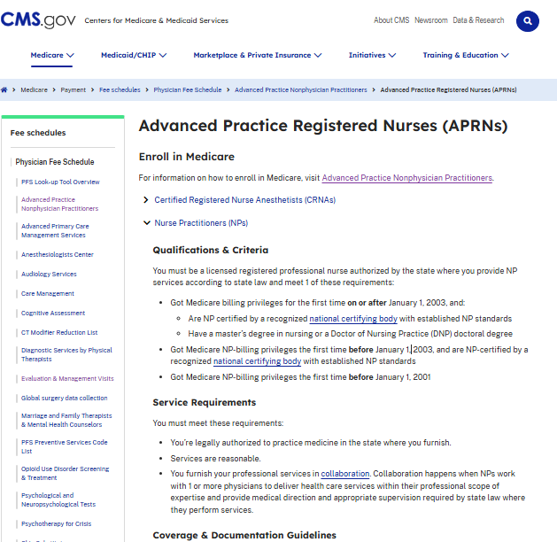
CMS Advanced Practice Registered Nurses (APRNs) webpage
Includes
  Enroll in Medicare
    Qualifications & Criteria
  Service Requirements
  Coverage & Documentation Guidelines
  Billing Guidelines
  Payment Guidelines
  More Information
    NP services

Slide 47

Questions and Answers

Slide 48
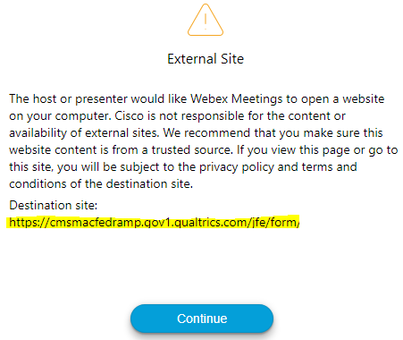

Survey
Let us know what you think!
Take time to complete our survey now.
Survey link in chat
Redirect after closing webinar

Slide 49
Thanks for attending!
Notes:
Continuing Education Units (CEUs)
WPS offers a certificate of achievement via a follow-up email. The email contains contact hours, which governing bodies may accept for CEUs. Contact your CUE governing body for details on submitting our contact hours.
Follow-up Questions
WPS will accept event related questions for seven days following the live event. The questions must be received by noon on the seventh day.
Email wps.gha.education@wpsic.com
Subject Line: Today’s Topic
Send claim specific questions to Customer Service

Slide 50
Disclaimers
This material is a tool to assist the provider community. Medicare rules change often. Access CMS’ website for current coverage, regulations and rulings.
The basis for answers given today rely on facts given in the question. Medicare rules determine final coverage.
Do not record the event as CMS does not allow this for profit making purposes.

Slide 51
CPT Copyright Notice
CPT codes, descriptions, and other data only are copyright 2024 American Medical Association. All Rights Reserved. Applicable FARS/HHSARS apply. Fee schedules, relative value units, conversion factors and/or related components are not assigned by the AMA, are not part of CPT, and the AMA is not recommending their use. The AMA does not directly or indirectly practice medicine or dispense medical services. The AMA assumes no liability for data contained or not contained herein.

