Slide 1

Audio Information
The presenter started speaking
  Still hearing music?
    Close and restart the session
  Change your audio setting by
    Choosing “Audio & Video”
    Select “Switch Audio”
  Call in
    The phone information is in the chat
Email for technical difficulties
  wps.gha.education@wpsic.com

Slide 2
Quarterly Review of Outpatient Hospital Errors
June 2025

Slide 3

Housekeeping
Training Center web page
  Training Material
  Upcoming Events
  Encore Presentations
    60 to 90 days
Send questions and comments in Chat
After this, tell CMS how we did on the survey

Slide 4

Disclaimer
This material is a tool to assist the provider community. Medicare rules change often.
The basis for answers given today rely on facts given in the question. Medicare rules determine final coverage.
Access CMS’ website for current coverage, regulations and rulings.

Slide 5
CPT Copyright Notice
CPT codes, descriptions, and other data only are copyright 2024 American Medical Association. All Rights Reserved. Applicable FARS/HHSARS apply. Fee schedules, relative value units, conversion factors and/or related components are not assigned by the AMA, are not part of CPT, and the AMA is not recommending their use. The AMA does not directly or indirectly practice medicine or dispense medical services. The AMA assumes no liability for data contained or not contained herein.

Slide 6
AHA & NUBC Copyright Notice
Copyright © 2024, the American Hospital Association, Chicago, Illinois. Reproduced with permission. No portion of the AHA copyrighted materials contained within this publication may be copied without the express written consent of the AHA. AHA copyrighted materials including the UB-04 codes and descriptions may not be removed, copied, or utilized within any software, product, service, solution, or derivative work without the written consent of the AHA. If an entity wishes to utilize any AHA materials, please contact the AHA at 312- 893-6816.
Making copies or utilizing the content of the UB-04 Manual, including the codes and/or descriptions, for internal purposes, resale and/or to be used in any product or publication; creating any modified or derivative work of the UB-04 Manual and/or codes and descriptions; and/or making any commercial use of UB-04 Manual or any portion thereof, including the codes and/or descriptions, is only authorized with an express license from the American Hospital Association.
The American Hospital Association (the "AHA") has not reviewed, and is not responsible for, the completeness or accuracy of any information contained in this material, nor was the AHA or any of its affiliates, involved in the preparation of this material, or the analysis of information provided in the material. The views and/or positions presented in the material do not necessarily represent the views of the AHA. CMS and its products and services are not endorsed by the AHA or any of its affiliates.

Slide 7
Agenda
Analyze outpatient claims data
Examine reasons for rejected and returned claims
Review ways to correct and prevent errors
Explore resources for more information

Slide 8
Acronyms
ABN – Advance Beneficiary Notice of Non-coverage
BCRC – Benefits Coordination & Recovery Center
ESRD – End-Stage Renal Disease
HCPCS – Healthcare Common Procedure Coding System
MSP – Medicare Secondary Payer
NCCI – National Correct Coding Initiative
NCD – National Coverage Determination

Slide 9
More Acronyms
PPS – Prospective Payment System
PRV – Patient Reason for Visit
PT – Physical Therapy
PTAN – Provider Transaction Access Number
RTP – Return(ed) to Provider
SLP – Speech Language Pathology
SNF – Skilled Nursing Facility

Slide 10


Data Specifics

Slide 11

Claims Data
Claims submitted February 1 – April 30
J5 and J8 combined
Part A outpatient hospital bill types
  13X
  14X
  85X

Slide 12
Number of Claims in Data Sample
343,914 claims
  Rejected – 225,355
    Technical or billing error
  Return(ed) to provider (RTP) – 107,552
    Sent to provider’s online location (TB9997) for correction
  Denied – 11,007
    Question of medical necessity or coverage criteria
$255,253,888 total dollars noncovered

Slide 13

Comparing Contracts
Jurisdiction 5 – 205,070
Jurisdiction 8 – 138,844
Rejected – 134,771
RTP – 63,646
Denied – 6,653
Rejected – 90,584
RTP – 43,906
Denied – 4,354

Slide 14

Categories of Errors

Slide 15
Error Categories – 13X
Medicare is not the primary payer
Overlaps Part A SNF stay
Screening cardiovascular blood test < 5 years
Outpatient therapy threshold over applied
Overlaps inpatient stay

Slide 16
Error Categories – 14X
Overlaps Part A SNF stay
Medicare is not the primary payer
Screening cardiovascular blood test < 5 years
Lab test not medically necessary
Labs overlap another ESRD claim

Slide 17
Error Categories – 85X
Medicare is not the primary payer
Duplicate claim
Overlaps Part A SNF stay
Screening cardiovascular blood test < 5 years
NCCI procedure to procedure code pair edit

Slide 18

Error Details

Slide 19

Medicare is Not the Primary Payer
Reason Codes 34XXX
Records indicate beneficiary has a __________ plan primary to Medicare
  Working Aged
  Disability
  Workers’ Compensation
  Auto/No fault

Slide 20
Resolution and Prevention – MSP
Gather MSP data
  Check patient’s record
  Ask questions about coverage
Contact the BCRC to update records
Bill primary payer first
  Send secondary claim with payment or denial information
    Ensure appropriate codes are present

Slide 21

Overlaps Part A SNF Stay
Reason Code C7252
Date of service within from and through dates of SNF Part A claim
Services subject to SNF Consolidated Billing

Slide 22
Resolution and Prevention – SNF Overlap
Verify dates of service
Confirm patient was in a Part A stay
  Medicare-certified bed
  Receiving skilled services
  SNF benefit days remaining
Check SNF Consolidated Billing exclusion lists
  Is exclusion based on place of service?

Slide 23

Screening Cardiovascular Blood Test
Reason Code U538S
80061 – Lipid panel
Only allowed every 5 years
  60 months
Beneficiary did not sign ABN
  Provider liable
CPT only copyright 2024 American Medical Association. All rights reserved.

Slide 24
Resolution and Prevention – Cardiovascular Screening Blood Test
Patients without apparent cardiovascular disease signs or symptoms
  Diagnosis Z13.6
Check benefits
Administer ABN if applicable
Do not bill as screening if patient has condition necessitating more frequent testing

Slide 25

Therapy Threshold Over Applied
Reason Code 7V822
Outpatient PT/SLP limit over applied

Slide 26
Resolution and Prevention – PT/SLP
Therapy above threshold is medically necessary
  Submit KX modifier
    Medical record justifies use
Therapy above threshold is not medically necessary
  Submit GA modifier
    Patient given ABN
  Submit Occurrence Code 32
    Date ABN given

Slide 27

Overlaps Inpatient Stay
Reason Code C7080
Outpatient claim has from/thru date that overlaps an inpatient claim
  PTANs are different

Slide 28
Resolution and Prevention – Overlap
Verify date(s) of service
Monthly claim for repetitive services
  Use 74 Occurrence Span Code
Split claim
  If not necessary to bill monthly

Slide 29

Lab Test Not Medically Necessary
Reason Code 54NCD
HCPCS not medically necessary
  Based on diagnosis code(s)
No documentation provided
  For indications outside of the NCD

Slide 30
Resolution and Prevention – Lab NCD
Review NCD for covered indications
Administer ABN if applicable
  Use Occurrence Code 32 and GA modifier
Add covered diagnoses in diagnosis fields
  System may overlook if only in “PRV” field

Slide 31
Lab Overlaps ESRD Consolidated Billing
Reason Code C7565
Outpatient claim for lab services overlaps another ESRD claim
ESRD PPS Consolidated Billing requires some services to be included in the ESRD facility’s payment
  Lab, drugs, equipment, supplies, etc.
ESRD facility furnishes services directly or under arrangement

Slide 32

Resolution and Prevention – Lab and ESRD
Bill dialysis-related services to ESRD provider, not WPS
Use AY modifier for unrelated services
  Allows for separate payment

Slide 33

Duplicate Claim
Reason Code 38092
Multi-channel lab HCPCS present on current claim and history claim for same date of service

Slide 34

Resolution and Prevention – Duplicate
Verify billed services
Was patient seen twice in same day?
Apply modifier if appropriate
Locate duplicate claim in portal

Slide 35

NCCI Code Pair Edit
Reason Codes W7040, W7020
NCCI Procedure to Procedure Code Pair Edits
  Code in column 2 considered component of column 1
    Column 2 code may be allowed if appropriate modifier were present
    Column 2 code not allowed even with modifier

Slide 36

Resolution and Prevention – NCCI Edits
Research code pair on NCCI tables
  Modifier indicator = 0 – modifier not allowed
  Modifier indicator = 1 – modifier allowed if appropriate
Verify claim is coded accurately

Slide 37
Resources
Reason/Remark Code Lookup
Medicare Secondary Payer booklet
SE21002 – Billing for Services when Medicare is a Secondary Payer
MLN901346 – How to Use the Medicare NCCI Tools
Medicare Advance Written Notices of Non-coverage booklet
Medicare NCCI Edits
  Procedure to Procedure Edits

Slide 38
More Resources
CMS SNF Consolidated Billing web page
Medicare Coverage Database
Medicare Claims Processing Manual, Chapter 1- General Billing Requirements, Section 50.2.2
ESRD PPS Consolidated Billing
Medicare Claims Processing Manual, Chapter 5 – Part B Outpatient Rehabilitation and CORF/OPT Services, Section 10.3.3

Slide 39

Questions

Slide 40
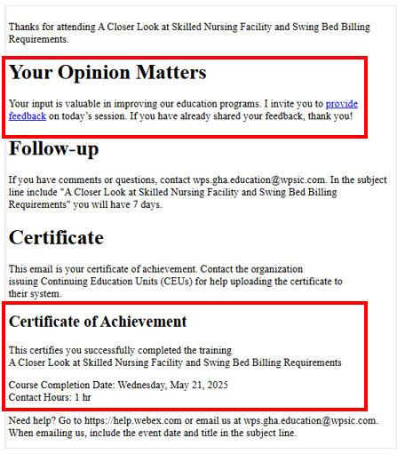

Certificate of Achievement
Complete survey
Email contains contact hours

Slide 41

Follow-up Questions
Send your questions by 12:00 PM CT for seven days following the training
Email wps.gha.education@wpsic.com
Subject Line: Outpatient Errors
Send claim specific questions to Customer Service

Slide 42

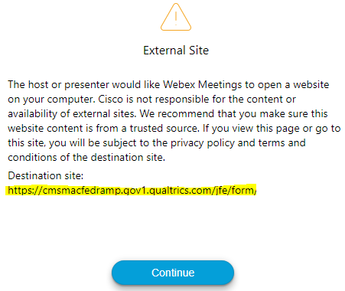
Survey
Let us know what you think!
Take time to complete the survey now.
Survey link in chat
Redirect after closing webinar

Slide 43

We Hear You
We are committed to making changes to improve your education experience.
Based on survey comments
  Chapters to YouTube
  Training indicators

Slide 44
Thanks for attending!

