Slide 1

Audio Information
The presenter started speaking
  Still hearing music?
    Close and restart the session
  Change your audio setting by
    Choosing “Audio & Video”
    Select “Switch Audio”
  Call in
    The phone information is in the chat
Email for technical difficulties
  wps.gha.education@wpsic.com

Slide 2
Documentation and Examples for Annual Wellness Visits
February 2025

Slide 3

Housekeeping
Training Center web page
  Training Material
  Upcoming Events
  Encore Presentations
    60 to 90 days
Send questions and comments in Chat
After this, tell CMS how we did on the survey

Slide 4

Disclaimer
This material is a tool to assist the provider community. Medicare rules change often.
The basis for answers given today rely on facts given in the question. Medicare rules determine final coverage.
Access CMS’ website for current coverage, regulations and rulings.

Slide 5
CPT Copyright Notice
CPT codes, descriptions, and other data only are copyright 2024 American Medical Association. All Rights Reserved. Applicable FARS/HHSARS apply. Fee schedules, relative value units, conversion factors and/or related components are not assigned by the AMA, are not part of CPT, and the AMA is not recommending their use. The AMA does not directly or indirectly practice medicine or dispense medical services. The AMA assumes no liability for data contained or not contained herein.

Slide 6
Acronyms
ACP – Advance Care Planning
ADL – Activities of Daily Living
AWV – Annual Wellness Visit
CFR – Code of Federal Regulations
HRA – Health Risk Assessment
IADL – Instrumental Activities of Daily Living
IPPE – Initial Preventive Physical Exam
SDOH – Social Determinants of Health

Slide 7
Agenda & Objective
Objective: Learn about documentation guidelines for the Annual Wellness Visit
We will cover:
  Medicare coverage criteria and documentation guidelines for the AWV
  Optional Advance Care Planning and Social Determinants of Health Risk Assessment components of the AWV
  Documentation guidelines for the Health Risk Assessment
  Documentation examples of the AWV

Slide 8
Requirements for Coverage of AWV
Needs to be performed by a health professional
  A physician who is a doctor of medicine or osteopathy (as defined in §1861(r)(1) of the Social Security Act (the Act); or,
  A physician assistant, nurse practitioner, or clinical nurse specialist (as defined in §1861(aa)(5) of the Act); or,
  A medical professional (including a health educator, registered dietitian, or nutrition professional or other licensed practitioner) or a team of such medical professionals, working under the direct supervision (as defined in 42CFR 410.32(b)(3)(ii)) of a physician as defined in this section

Slide 9

Medicare Coverage Guidelines
Eligible Medicare Part B beneficiaries
  Do not fall within the 12-month period following the effective date of their initial Medicare Part B coverage period
  Have not received an IPPE or AWV in the preceding 12 months

Slide 10

Frequency and Cost of AWV
Initial AWV covered once per lifetime
Subsequent and AWV in a Federally Qualified Health Center covered once every 12 months
No copayment, coinsurance, or deductible
Telehealth eligible
  Can be met through audio-only interaction

Slide 11
Initial AWV
Review (and administration if needed) of HRA
Beneficiary’s medical and family history
  Past medical and surgical history
  Family history
  Current medications and supplements and other substances beneficiary may be using
List of current providers and suppliers

Slide 12
Additional Documentation for Initial AWV
Physical Examination
  Height and Weight
  Body Mass Index (BMI) or waist circumference, if appropriate
  Blood Pressure
  Other routine measurements as deemed appropriate
Identify potential cognitive impairments in beneficiary
Review of beneficiary’s potential risk factors for depression and mood disorders

Slide 13
Other Documentation for Initial AWV
Review of beneficiary’s functional ability and level of safety
  Cognitive Assessment and Care Plan Services
Written screening schedule for beneficiary
List of risk factors for which interventions are recommend or underway
Personalized health advice and appropriate referrals to health education or preventive counseling services or programs

Slide 14

Other Components for Initial AWV
Review of current opioid prescriptions
  Monthly Chronic Pain Management and Treatment Services
Screening for potential substance use disorders
Optional ACP services
Optional SDOH Risk Assessment

Slide 15
Optional ACP
Voluntary face-to-face conversation
Advance directive – written
  Specifies the beneficiary's preferences
  May appoint a representative
AWV and ACP considered preventive service when provided
  On the same day
  By the same healthcare provider

Slide 16
Documenting ACP Visit
Explanation conversation was voluntary
Description of advance directives
Documentation of the beneficiary’s wishes
Time spent performing the face-to-face ACP visit
List of all participants present
Documentation of any changes in health status

Slide 17
Coverage Guidelines of ACP
Frequency
  99497 and 99498 (when billed with an AWV) covered annually
Cost
  No copayment, coinsurance, or deductible
    Needs to be billed on the same claim as the AWV using modifier 33
  If AWV billed with ACP denied
    Deductible and coinsurance will apply
Telehealth
  ACP (99497 and 99498) telehealth eligible
    Can be meet through audio-only interaction
CPT only copyright 2024 American Medical Association. All rights reserved

Slide 18

Optional SDOH Risk Assessment
42 CFR § 410.15(a)
  A physician who is a doctor of medicine or osteopathy
  A physician assistant, nurse practitioner, or clinical nurse specialist or,
  A medical professional or a team of such medical professionals, working under the direct supervision of a physician

Slide 19

Communication Requirements
When performing the SDOH Risk Assessment, the healthcare provider should ensure that:
  All communication with the patient is tailored to the individual’s educational, developmental, and health literacy level
  Culturally and linguistically appropriate

Slide 20

SDOH Core Needs
Factors that influence a person’s health outcome
Five domains of core needs
  Living situation
  Food
  Transportation
  Utilities
  Safety

Slide 21

SDOH Supplemental Needs
Eight domains of supplemental needs
  Financial strain
  Employment
  Family and community support
  Education
  Physical activity
  Substance use
  Mental health
  Disabilities

Slide 22

Area to Consider for SDOH
US Department of Health and Human Services Healthy People 2030 Social Determinants of Health
  Economic Stability
  Education Access and Quality
  Health Care Access and Quality
  Neighborhood and Built Environment
  Social and Community Context

Slide 23
Issues to Address
Availability of safe housing and transportation
Access to employment opportunities, career counseling, and economic assistance plans
Ability to obtain quality health care
Accessibility of healthy food and clean water to meet nutritional needs
Ability to obtain physical activity

Slide 24
Tools for SDOH Risk Assessment
Accountable Health Communities Health-Related Social Needs Screening Tool
Protocol for Responding to & Assessing Patients’ Assets, Risks & Experiences (PRAPARE) tool

Slide 25
Coverage – SDOH Risk Assessment
Frequency
  Covered once a year (when billed with an AWV)
Cost
  No coinsurance or deductible
    Needs to be billed on the same claim as the AWV using modifier 33
  Deductible and coinsurance apply if
    AWV billed with SDOH denied due to exceeding frequency limit
    Or performed outside covered AWV
  Limited to one assessment every six months

Slide 26
Added Coverage Information
AWV can act as an optional community health integration (CHI) initiating visit when the provider identifies any unmet SDOH needs preventing the patient from adhering the recommended personalized prevention plan

Slide 27

Telehealth
SDOH Risk Assessment (G0136) telehealth eligible

Slide 28
Subsequent AWV
Review (and administration if needed) of HRA
Update of beneficiary’s medical and family history
Updated list of current providers and suppliers
Measurements
  Weight or waist circumference, if appropriate
  Blood Pressure
  Other routine measurements as deemed appropriate

Slide 29
Documentation for Subsequent AWV
Detection of any beneficiary cognitive impairments
Updated written screening schedule for beneficiary
Updated list of risk factors for which interventions are recommended or underway
Personalized health advice and appropriate referrals
Review of current opioid prescriptions
  Monthly Chronic Pain Management and Treatment Services
Screening for potential substance use disorders
Optional ACP services
Optional SDOH Risk Assessment

Slide 30

HRA
Beneficiary self-reported information
  Can be filled out by either healthcare professional or beneficiary before or during AWV
  Can be completed in 20 minutes or less
Customize to address the requirements of
  Individuals from underserved communities
  Those with limited English proficiency
  Individuals facing health literacy challenges
  People with disabilities

Slide 31
Components of HRA
Demographic data
Health status self-assessment
Psychosocial risks
Behavioral risks
ADLs
IADLs
Reference: CFR § 410.15

Slide 32

Claim Examples

Slide 33
Claim 1
70-year-old female
Visit on 6/20/23 for a Medicare preventive visit as well as for hyperlipidemia, skin lesion, and osteopenia
All documentation requirements were addressed
  Annual Wellness Visit
  Health Risk Assessment
  Presence of Advanced Directive

Slide 34
Claim 2
75-year-old male
Annual Wellness Visit on 7/10/23
Documentation on Health Risk Assessment does not contain
  Race
  Ethnicity
Reference: MLN6775421 Medicare Wellness Visits

Slide 35

Review of Today’s Webinar
During today’s webinar, we:
  Reviewed Medicare coverage criteria and documentation guidelines for the Annual Wellness Visits
  Discussed the Optional Advance Care Planning and Social Determinants of Health Risk Assessment components of the Annual Wellness Visit
  Explored the documentation guidelines for the Health Risk Assessment
  Provided documentation examples of the Annual Wellness Visit

Slide 36
Resources
Medicare Benefit Policy Manual, Chapter 15, § 280.5
Medicare Claims Processing Manual, Chapter 12, § 30.6.1.1
MLN006559 Medicare Preventive Services
MLN6775421 Medicare Wellness Visits
MLN909289 Advance Care Planning
Annual Wellness Visit
YouTube Encore presentations

Slide 37

Questions and Answers

Slide 38
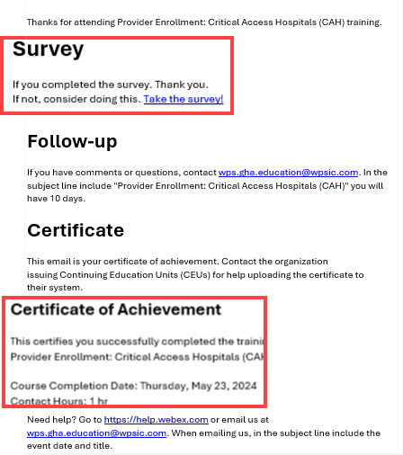

Certificate of Achievement
Complete survey
Email contains contact hours

Slide 39

Follow-up Questions
Send your questions by 12:00 PM CT for seven days following the training
Email wps.gha.education@wpsic.com
Subject Line: Documentation and Examples for Annual Wellness Visits
Send claim specific questions to Customer Service

Slide 40

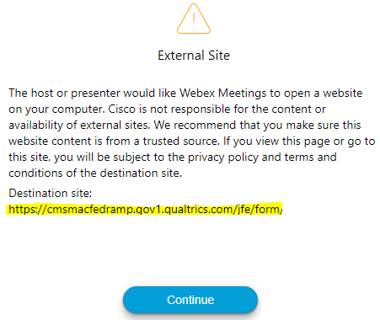
Survey
Let us know what you think!
Take time to complete the survey now.
Survey link in chat
Redirect after closing webinar

Slide 41
Thanks for attending!

